Slide 1
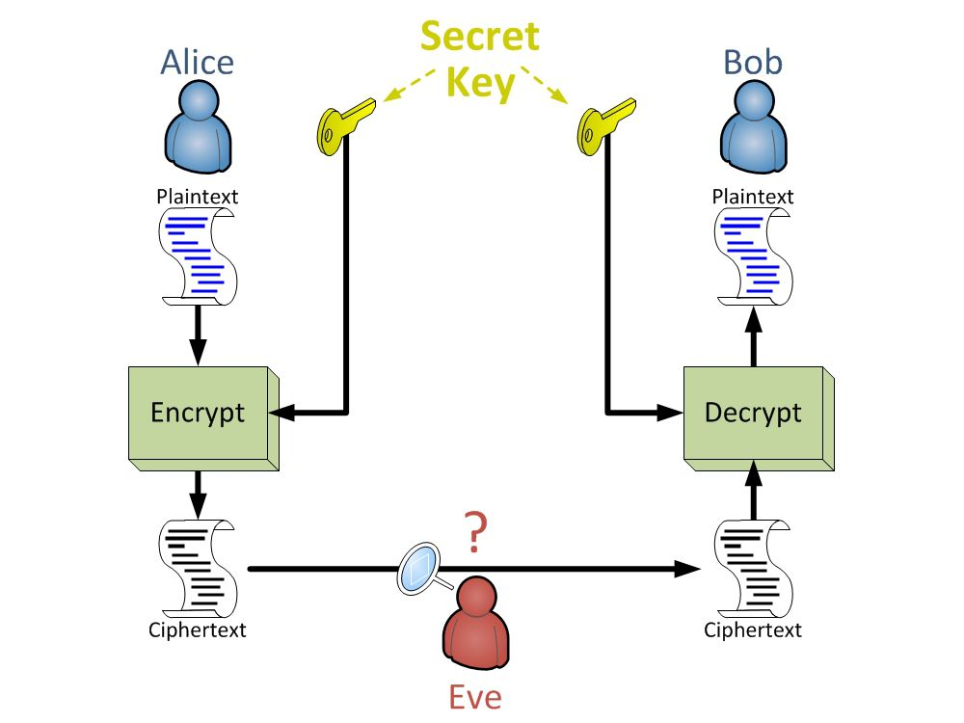
Symmetric Encryption

Slide 2
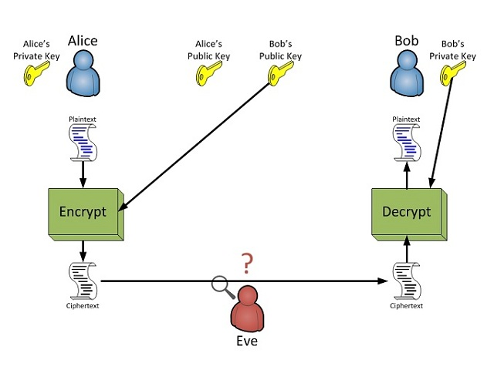
Asymmetric Encryption

Slide 3
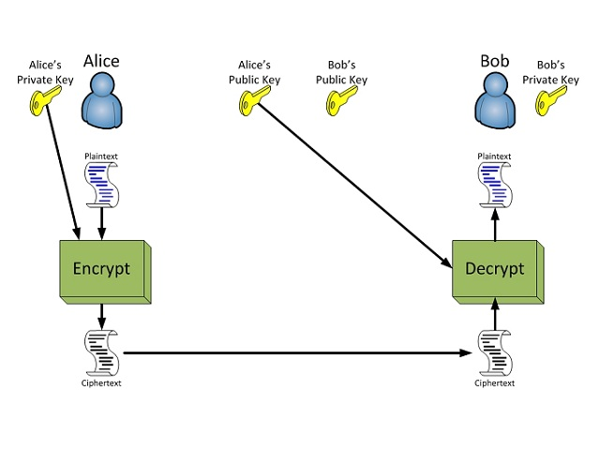
Digital Signatures

Slide 4
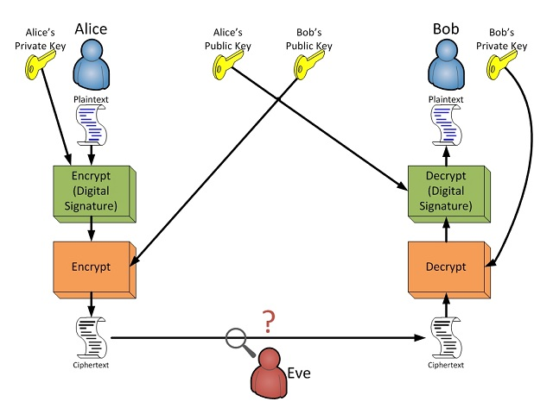
Encryption and Signatures (cont.)

