Slide 1
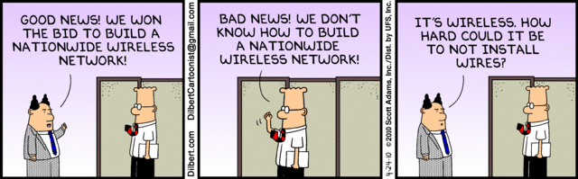
Wireless Networks
USNA SY110
LCDR Brian Kiehl
Leahy 101 | 410.293.0953
kiehl@usna.edu

Slide 2
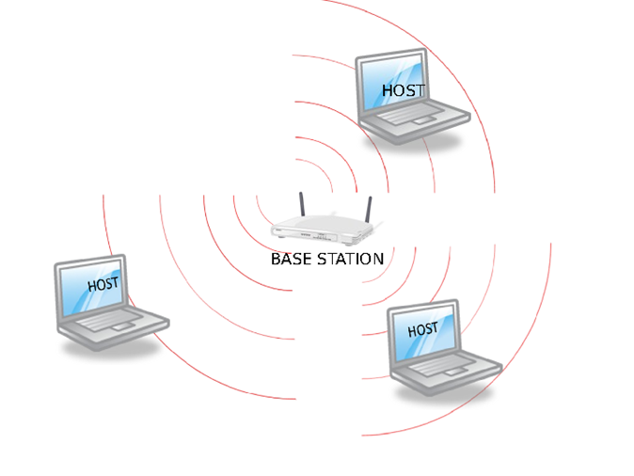
Wireless
A wireless network is pretty much the same as a wired network.
Except it uses radio signals rather than Ethernet cables to form the connections.
Instead of a switch, wireless networks use base stations.

Slide 3
Remember Our TCP/IP Stack?
Application: Deals with programs on different hosts that want to communicate
  Ex: HTTP protocol governs how GET requests are formatted
APPLICATION
TRANSPORT
NETWORK
LINK
PHYSICAL
Transport: Facilitates transfer of bytes from host to host by breaking up data into packets
  Ex: TCP protocol breaking up a GET request into sequential packets
Network: Routes packets via internet from source to destination
  Ensures valid addresses are used
Link: Moves packets from one host to another within a network
Physical: Actual infrastructure that facilitates communication, etc.
  Ex: cables, boxes, wires, radio waves, etc.

Slide 4
Wired vs. Wireless
Network Stack Comparison
Wired Wireless
-----------
-same- Application -same-
-----------
-same- Transport -same-
-----------
-same- Network -same-
-----------
e.g. Ethernet → Link ← e.g. 802.11
-----------
e.g. Cables → Physical ← e.g. Radios
-----------

Slide 5
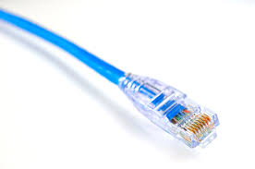
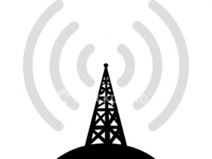
Wireless
You know what Ethernet cables are…
And you know what a radio signal is…
But what the heck is 802.11
It’s a communication standard: i.e. the Mbps and frequency a communication will use.
?
Ethernet Cable
Radio signal
[playing Green Day]

Slide 6
The IEEE 802.11 Family
Several iterations of the 802.11 standard:
  Most differ by frequency and data rate
Standard | Adopted | Data Rate (Mbps) | Frequency
802.11 | 1997 | 1, 2 | 2.4 GHz
802.11a | 1999 | 6, 9, 12, 18, 24, 36, 48, 54 | 5 GHz, 3.7 GHz
802.11b | 1999 | 5.5, 11 | 2.4 GHz
802.11g | 2003 | 6, 9, 12, 18, 24, 36, 48, 54 | 2.4 GHz
802.11n | 2009 | 7.2, 14.4, 15, 21.7, 28.9, 30, 43.3, 45, 57.8, 60, 65, 72.2, 90, 120, 135, 150 | 2.4 GHz, 5 GHz
802.11ac | 2014 | 347, 800, 1.7 Gbps, 3.5 Gbps | 5 GHz

Slide 7
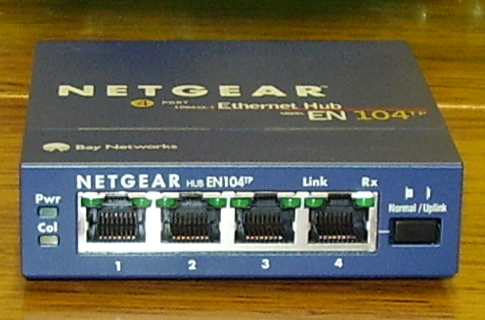
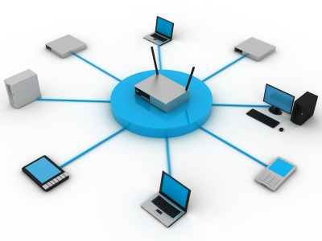
Wireless Networks: Basic Setup
Station: Anything with a radio that can play 802.11
  Note that 802.11 radios have MAC addresses just like ethernet cards
Base station: The base station acts like a hub in a wireless network. The other stations send any network traffic to it, which it then broadcasts out for all stations to receive.
  WAP - Wireless Access Point - is more or less a synonym.
  We will refer to the other stations on the network as host stations.
Basic Service Set (BSS): A base station and the hosts stations that are communicating with/through it.
BSSID: The BSS can be uniquely identified by the MAC address of the base station
A Hub. Do you remember the problem with hubs?
Basic Service Set (BSS)

Slide 8
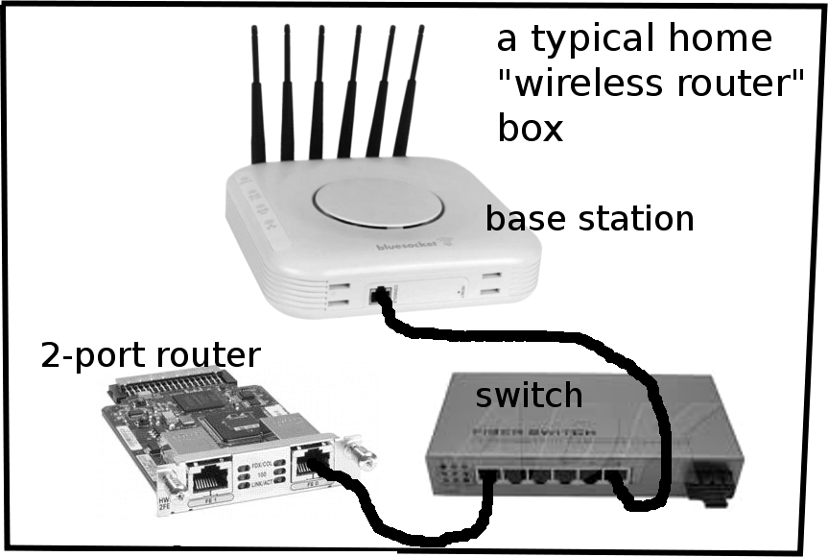
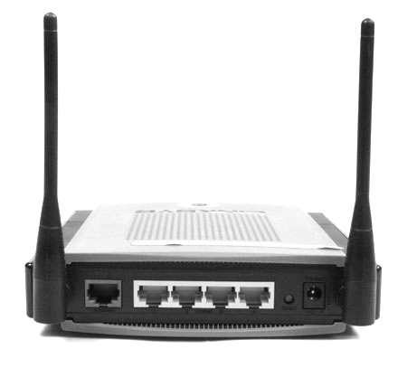
Your Home WiFi Equipment
Home WiFi equipment usually comes with a box that people call a “wireless router” but really it is a base station, switch, and (gateway) router rolled into one device.
=

Slide 9
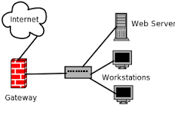

Default Gateway
Router that provides access to networks outside of the local network
Host first determines if the destination IP address is on its local network
  If so, data is transferred directly to that host
    Using the host’s MAC address
Traffic destined outside the local network must be passed to the default gateway
  Default gateway determines the best path to the destination network
    Forwards the data to the next hop on that path

Slide 10

Wireless Networks: Basic Setup
A base station with a collection of host stations is very similar to a single wired network with hosts and a hub/switch.
Hosts must have IP Address and Subnet masks set.
In order to communicate with another host on the network, a host has to label each packet with the MAC address of the recipient host.
Without a Gateway Router there is no communication with other networks.
Since we have radios not wires, this is a hub-like situation: every station hears everything broadcast by the base station.

Slide 11
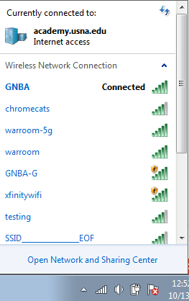
Wireless Problem #1
"The LAN Before Time"
"Pretty Fly for a Wi-Fi"
"FBI Surveillance Van #594"
"Hide Yo Kids, Hide Yo Wi-Fi!"
"Skynet Global Defense Network"
"A Van Down By The River"
"Go Go Gadget Internet"
"Mom, Click Here for Internet"
"Click Here for Viruses"
"Drop it like it’s Hotspot"
"LANdo Calrissian"
"99 problems, but WiFi ain’t one"
"I Pronounce you Man and WiFi"
"Keep it on the Download"
What if there are multiple base stations within range of my radio ... which network am I on?
  There is no analogous problem in a wired network since the hub/switch you're plugged into is unambiguous.
The solution is to give each wireless network a name, called its Service Set Identifier (SSID), so that a host can identify by name which wireless network it wants to join when multiple base stations are within range.
You may have seen a dialogue box pop up to ask you which wireless network you want to join. If so, what you got to choose from was a list of SSIDs.

Slide 12
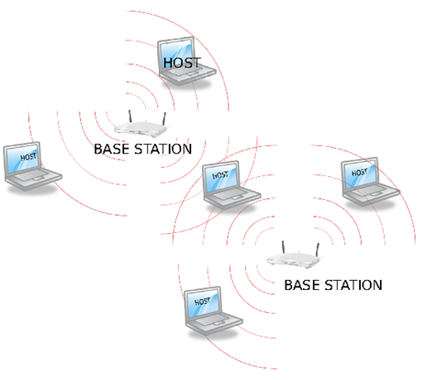
Wireless Problem #2
What if a base station's (or host's) signal strength is insufficient to allow all the host stations I want on the network to communicate with the base station?
  In the wired world I could just grab a longer cable, but the maximum range of a base or host's radio is pretty much set.
To solve this, 802.11 allows multiple base stations to act as a single network.
So although there are different base stations, they share a common Extended SSID (ESSID) and all host stations connected to any one of these base stations is on the same network.
Conceptually, this works as if we had one super base station, even if that isn't literally true, so we will continue as if there is always one base station for a network.
ESSID abcd
ESSID’s allow for multiple base stations to become one network.

Slide 13
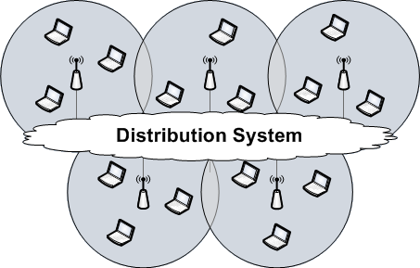
USNA Wireless Infrastructure
There are a number of base stations spread throughout the 2nd deck of Michelson that all belong to ESSID GNBA-M.
GNBA-M

Slide 14
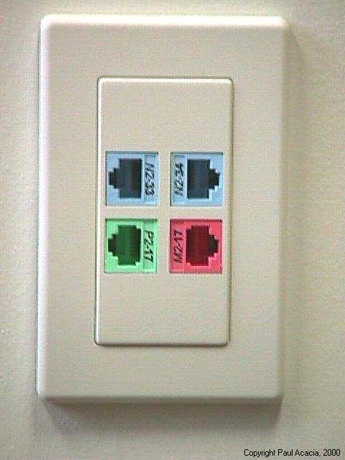
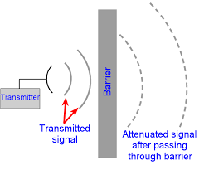
Wireless Problem #3
One can't effectively control who transmits and receives on wireless network's frequency, so anyone within range can listen in on 802.11 traffic or broadcast 802.11 traffic.
Contrary to a wired network, where a hacker would need to be physically located at the corporate premises to gain access through a network drop, —with a wireless network, the intruder can access the network from a location outside the building.
With wireless, anyone near enough to a base station can send and receive, therefore, we need to:
  control who can join our network
  provide privacy from people who have not joined our network but are none-the-less snooping (i.e. listening to the radio traffic).
Network Drop: wired network
Anyone within signal range can pick up a wireless signal

Slide 15


Wireless Privacy
Wireless networks akin to shouting a message across a room
  Anyone within audible range can hear your message
Anyone with an antenna (and the right hardware and knowledge) can intercept wireless traffic
  Privacy is a concern
Solution: Encryption!
  Sender encodes a message
  Recipient decodes it using a decryption “key”

Slide 16
Simple Encryption Example:
Caesar Shift Cypher
Plain Text: THE QUICK BROWN FOX JUMPS OVER THE LAZY DOG
Ciphertext: WKH TXLFN EURZQ IRA MXPSV RYHU WKH ODCB GRJ
Key: This is a substitution cipher where each letter in the original message is replaced with a letter corresponding to a certain number of letters up the alphabet (wrapping around to the beginning if necessary).
ABCDEFGHIJKLMNOPQRSTUVWXYZ
ABCDEFGHIJKLMNOPQRSTUVWXYZ
Key:
Move three letters up

Slide 17

Wireless Encryption
WEP (Wired Equivalent Privacy)
  Oldest encryption scheme
  Uses a 40-bit key
  Weak (by today’s standards)
  Can be cracked in less than 60 seconds
    Should NOT be your first choice for encryption
WPA (Wi-Fi Protected Access),
  Same encryption algorithm as WEP
  Uses a stronger 128-bit key
WPA2
  Strongest encryption currently available
  Newer (stronger) encryption algorithm
  Use a 256-bit key
Note that this encryption goes on in the Link Layer, so that all the layers above are unaware that anything was ever encrypted
WEP, WPA, and WPA2 provide two things:
  Initial authentication: valid SSID/password combo gives user access to the encryption scheme.
  Long-term confidentiality: encryption scheme keeps confidential communication secret.
Much more later on encryption. But the longer the key the more potential solutions & therefore the harder to decrypt

Slide 18
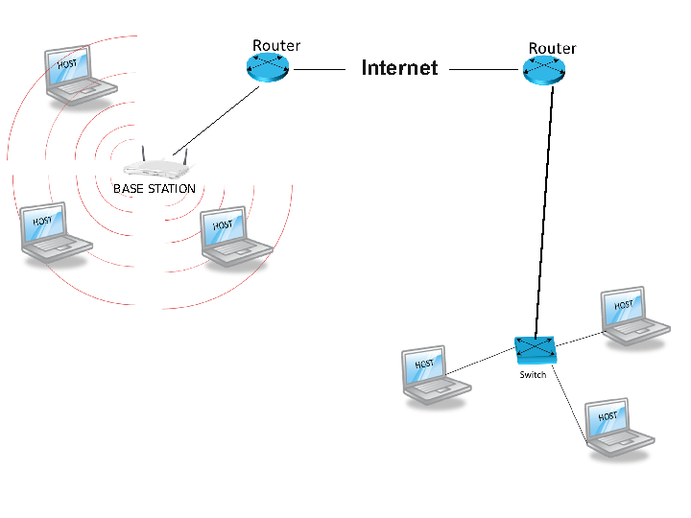
Connecting to the Internet
INTERNET
We'd like the host stations on our wireless network to be able to communicate with hosts on other networks.
To do this, the base station needs to be connected to a router — which will become the gateway router for the host stations on the network.

Slide 19
Connecting to the Internet
When sending data to a host outside of the network, data is:
  Sent via radio to the base station
  From there to the gateway router (usually by wire)
  From there things work just as before: the gateway router uses the IP address on the packet it receives to send the packet in the direction of the recipient.
When data is sent from outside to a host station, data is:
  The gateway router for that host-station's network receives the packet
  Since the gateway is on the same network (connecting to the base station by a wire rather than wirelessly, but still on the same network), it associates the recipient host station's IP address with the host-station's MAC address via its Address Resolution protocol (ARP) table [which matches IP addresses to MAC addresses].
  Then, the data is sent to the host-station, addressed by its MAC address, via the base station. Notice that the base station acts as a regular wired switch to the gateway router in this example.

Slide 20


USNA Wireless Infrastructure
The network uses WPA2 which requires a 256-bit key. But you may wonder why you haven’t had to enter a long key?
Here’s how it works:
  Your initial communication with the base station is not encrypted at the Link layer using WPA2, because you’d need the key for that and you don't initially know the key.
  However, your laptop and a server in Ward Hall communicate about your logging on (i.e. send/receive username & password) using Transport Layer Security (TLS)
    TLS is the same protocol that sits in between the Application Layer and the Transport Layer encrypting data to provide HTTPS (i.e. secure web traffic).
    So your PC and authentication server go through the logging in process, sending over the wireless network unencrypted packets that any snooper can see.
    But the contents of those packets are scrambled by TLS. So they see the IP address of the recipient from the packet, and they see the data in the packet, but they can't make sense of the data.
  If your credentials (username & password) are OK, the server will send you back the WPA2 key to use, and the rest of your session will then be encrypted at the Link layer level using WPA2.
Server in Ward Hall

Slide 21
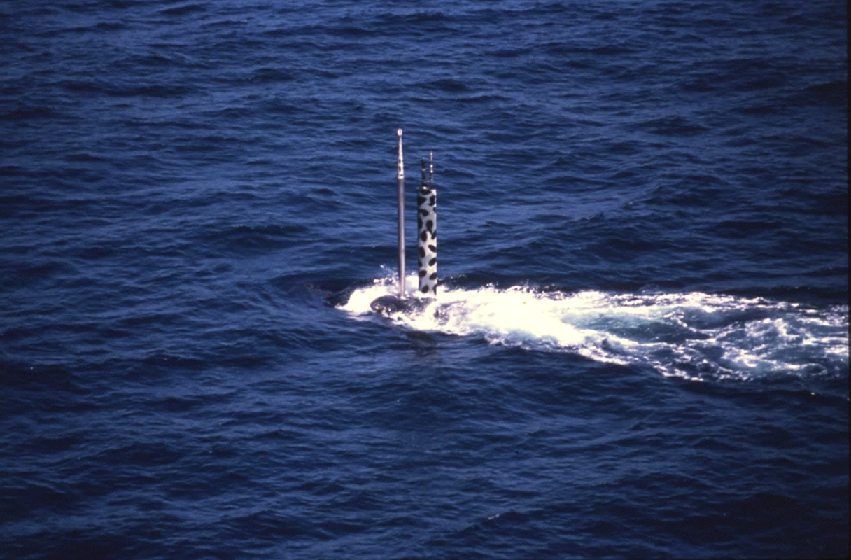
Wireless Comms at Sea

Slide 22
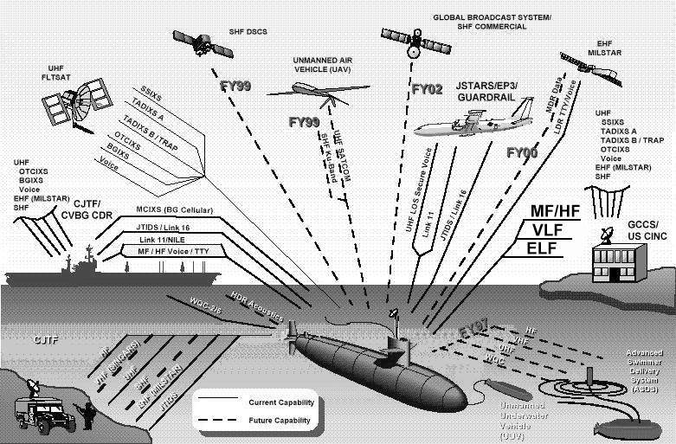
The Wireless Warfare Environment

Slide 23

Questions?

