Slide 1
Network Security usna sy110
Lcdr Brian Kiehl
Leahy 101 | 410.293.0935
kiehl@usna.edu

Slide 2
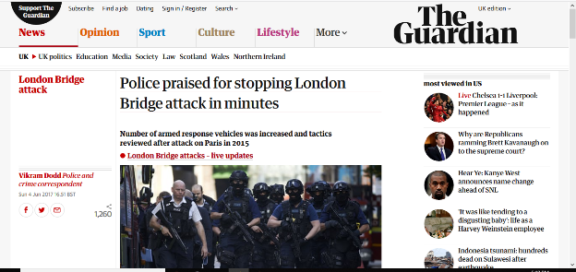
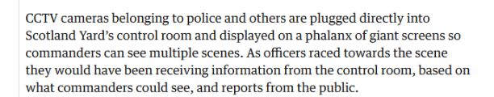

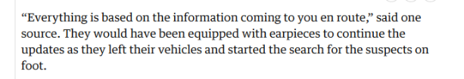
Modern Combat is Network-Centric
https://www.theguardian.com/uk-news/2017/jun/04/police-praised-for-stopping-london-bridge-attack-in-eight-minutes
Information sharing through computer networks allowed a 2015 London Bridge attack to be stopped by the police within just a few minutes.
The importance of networks to Military combat is no different!

Slide 3

Network Security
Networks are secure when they maintain the pillars of information assurance. (CIANA)
The term “Network Security” is usually applied to hardware and software implemented to maintain these pillars.
Human factors also play a critical role and will be discussed in a later lesson.
This is CIANA. She will help you remember the pillars of IA.
Hardware: the machines, wiring, and other physical components of a computer system.
Software: the programs and other operating information used by a computer.

Slide 4
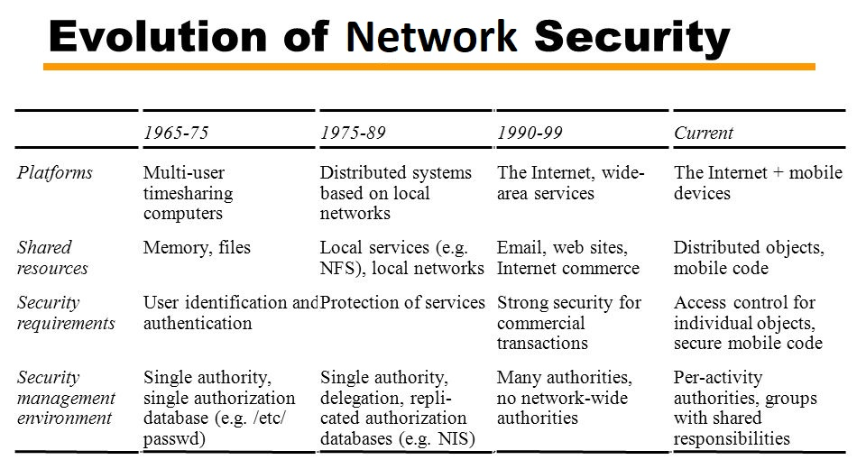
Network Security Measures Change with the Times
The Navy has had to change its network security measures over time too!
Nevertheless, there are some general principles that have remained constant.

Slide 5
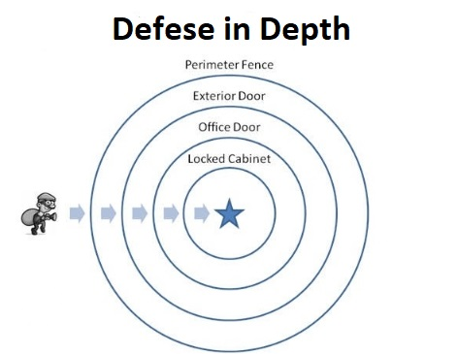
Principle: Defense in Depth
Seeks to delay rather than completely prevent the advance of an attacker
Offers a more realistic goal than 100% security
Gives defenders time to react to an ongoing attack
Before the burglar can reach his goal he must navigate four defensive layers, each slowing the burglar down and providing defenders an opportunity to maneuver against him.

Slide 6


Principle: Defense in Depth
Defense in Depth In Action! (MISSION: IMPOSSIBLE style…)
https://youtu.be/obr9mdKJs_k?t=115

Slide 7

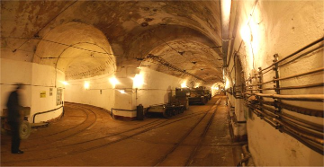
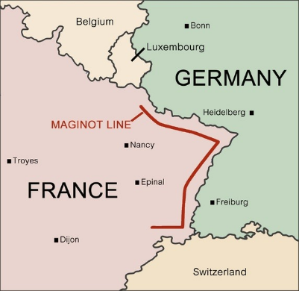
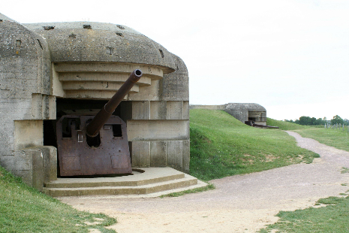
Principle: Defense in Depth
The Maginot Line
Why was this a poor means of defense?
Answer: it placed all hope in one defensive measure

Slide 8
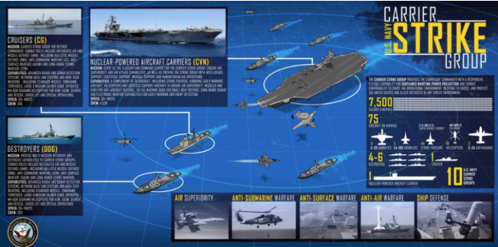
Principle: Defense in Depth
The Navy uses Defense in Depth in its defense of its aircraft carriers. Enemies must penetrate multiple defensive units before reaching the CVN.

Slide 9
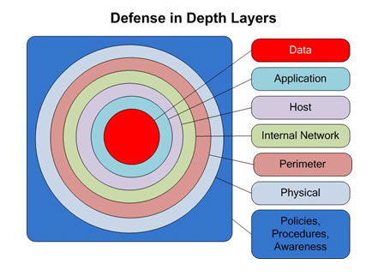
Defense in Depth in Security Architecture
Three key components, the need for visibility, need to correlate, and the need for a remediation response, are addressed using devices and software in a network security architecture. The goal is that one of these devices will detect the adversary, correlate data generated by the devices, and ultimately, help to respond to the cyber attack.

Slide 10
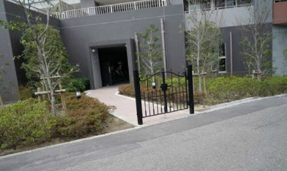
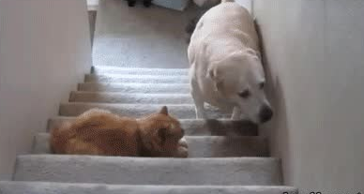
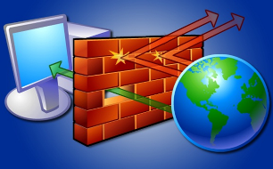
Defender’s Tool: Firewalls
Rule: skateboarders not allowed.
Rule: don’t allow dogs upstairs.
Application, device, or set of devices designed to permit or deny network transmissions based upon a set of criteria.
Used to
Protect networks from unauthorized access
Permitting legitimate communications
Can be implemented as
Software application
Specialized hardware devices

Slide 11
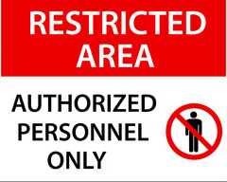

Firewalls: Access Control Lists
A set of rules (criteria) used to determine whether to allow or reject network traffic
Host reads Network and Transport layers of received packets
Looks for criteria that matches ACL rules
Whitelist = allow access to a site or service
Blacklist = disallow access to a site or service
TCP/IP
APPLICATION
TRANSPORT
NETWORK
LINK
PHYSICAL

Slide 12
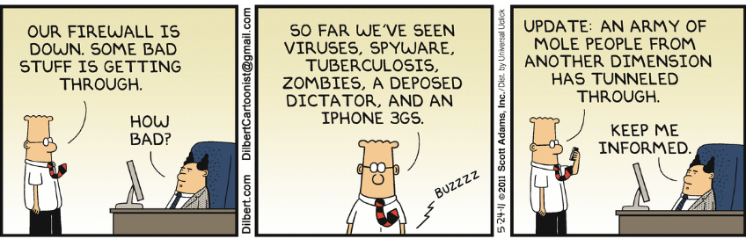
Firewalls: Rule Evaluation
Rules are evaluated in order from top to bottom
Once a packet meets a rule’s criteria
The prescribed action is taken
Remaining rules are ignored
Process is repeated for every packet received
The packets are being filtered

Slide 13
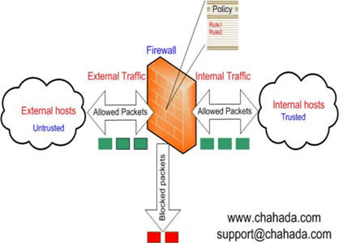
Firewalls: Rule Criteria
ACLs can filter by
IP address
TCP/UDP port number
Protocol type
More advanced ACLs can filter by
Rate of traffic
TCP connection state
Application Layer content
And others…
Try this:
To check your firewall profile, open a cmd.exe shell and type
netsh advfirewall show allprofiles

Slide 14
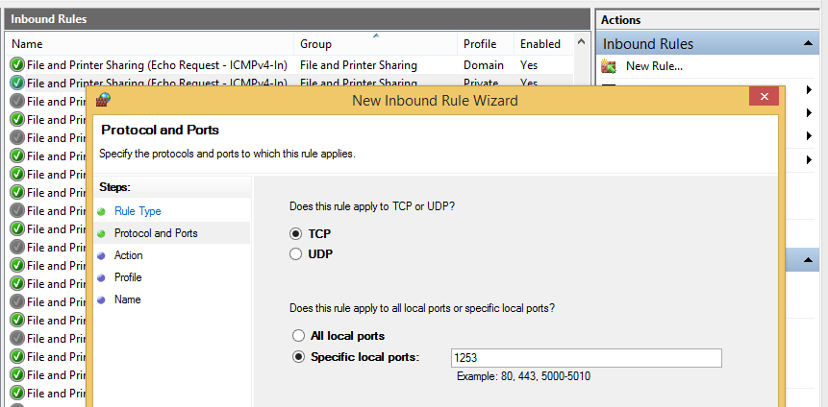
Software Firewalls
Windows Firewall screenshot
Runs as a service on a host
Integrated into the network stack
Allows application to filter network traffic
Many operating system include software-based firewalls
Windows Firewall
Linux iptables
Firewall products also available as standalone applications or integrated into security suites
Many routers also have firewall capability

Slide 15
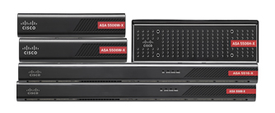
Hardware Firewalls
Packet filtering requires additional overhead
Packets must be dissected and compared against defined rules
Can significantly affect network performance
Implement the firewall as a single, specialized device
Usually placed at the network perimeter

Slide 16
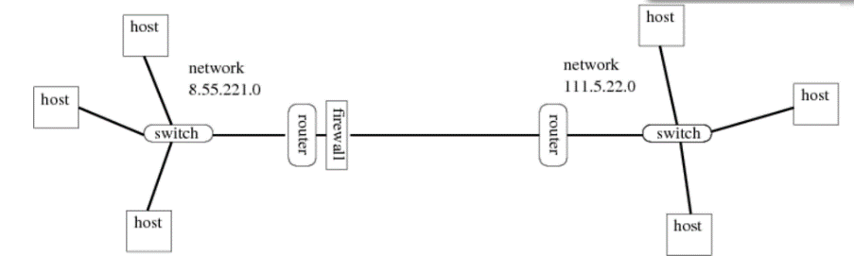

Firewall Placement Matters
inbound
webserver
outbound
Suppose the firewall in this diagram is configured with an inbound ACL rule that drops (i.e. filters out) all traffic into the router via the firewall that is bound for port 80. What is the effect in terms of services?
Hosts on network 8.55.221.0 could access a web server within their own network, since traffic within their own network never goes through the router.
Moreover, these hosts could access a web server on the 111.5.22.0 network, because that traffic, while indeed bound for port 80, is going out of the router via the firewall and so is not stopped by the rule.
However, hosts from the 111.5.22.0 network cannot access a web server (assuming it's listening on port 80) on the 8.55.221.0 network.

Slide 17


Firewall Placement Matters
webserver
Suppose we relocate the same firewall (no ACL rule changes) to sit in front of the Webserver on that network.
What effect would that have?
No hosts would be able to reach web pages hosted on that webserver since packets bound for Port 80 would all be dropped prior to reaching the webserver.
This placement/rule combination violates web service Availability!

Slide 18

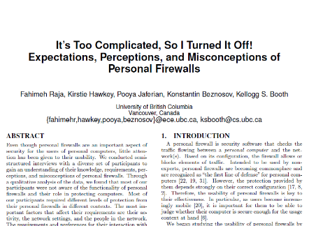
Human Factors: Firewalls Only Work if Humans Let Them
https://www.youtube.com/watch?v=H3HFOlYba-4
A 2010 study of students (High School to Ph.D.) found that despite over half rating themselves as “regular to advanced” users, many did not understand what a firewall does; when faced with firewall prompts they preferred to turn it off rather than figure out what decision best protects them (Raja et al. 2010).
Interactive Firewall Exercise
https://www.usna.edu/CyberDept/sy110/lec/firewalls/lec.html

Slide 19
Firewall Exercise
Runs as a service on a host
Integrated into the network stack
Allows application to filter network traffic
Many operating system include software-based firewalls
Windows Firewall
Linux iptables
Firewall products also available as standalone applications or integrated into security suites
Many routers also have firewall capability

Slide 20
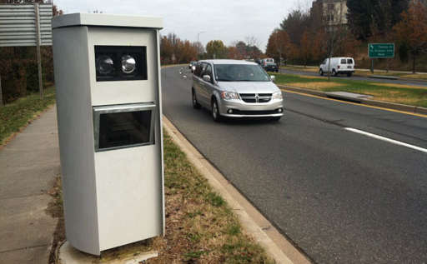
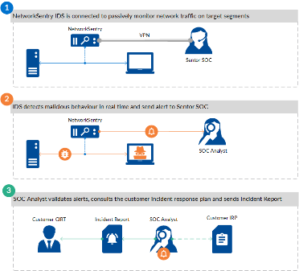
Intrusion Detection/Protection Systems (IDS/IPS)
An intrusion detection system (IDS) is a system that monitors network traffic for suspicious activity and issues alerts when such activity is discovered. This is similar to a speed camera. Cars passing the camera are automatically detected. Those cars not following a set of predefined rules (the speed limit) are flagged for suspicious behavior.
Intrusion protection systems (IPS) is similar but its responses are preprogrammed and do not require human intervention.

Slide 21
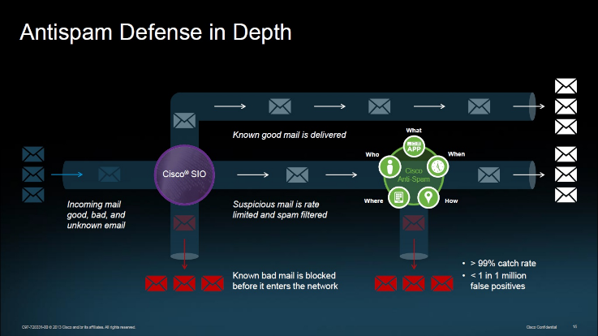
E-Mail Security Gateway
An email security gateway is a product or service that is designed to prevent the transmission of emails that break company policy, send malware or transfer information with malicious intent.

Slide 22
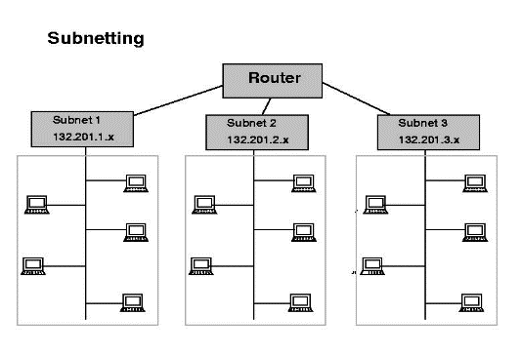
Network Segmentation
Network segmentation is the act of splitting a network into many “sub networks” known as segments. This approach allows organizations to group applications and like data together for access by a specific group (e.g., finance, operations, HR, engineering, etc.). By taking a larger connected network, and segregating it into smaller sub networks, we limit the range of access provided to an insider, partner, or a third party.

Slide 23
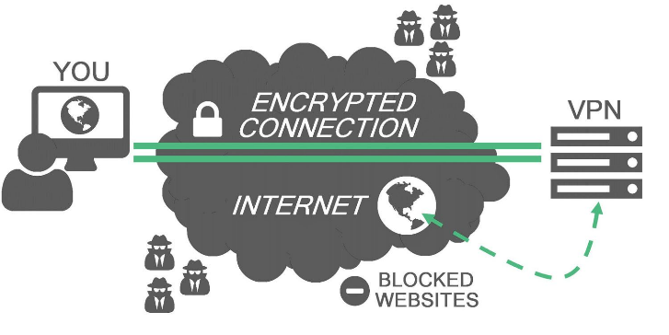
Virtual Private Networks (VPNs)
Virtual Private Networks (VPNs) allow you to connect two or more private networks over a public network. In essence, VPNs allow you to act and appear as though you are connected directly to a LAN. This is achieved by creating a connection between two endpoints and creating a virtual tunnel between the two locations. One of the primary goals of VPNs is to encrypt the data as it travels over the public networks.

Slide 24


Network Design: Putting it All Together
https://www.youtube.com/watch?v=A4FjJ9tH5HY
Just because an organization has the right hardware and software doesn’t mean the network is secure. Rather, proper network design is crucial to how well-defended an organization is from external threats. The right tools implemented in an improper manner can spell disaster for the security of an organization’s network.

Slide 25
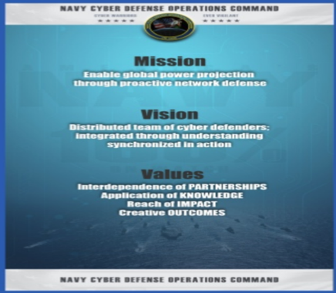

Who Handles Network Security for the Navy?
NCDOC is a Commander Task Force (CTF 1020) and operationally reports to U.S Fleet Cyber Command / U.S. Tenth Fleet (C10F).
NCDOC is responsible for using devices (hardware) and applications (software) to actively defend USN networks.

Slide 26

Questions?

