Slide 1
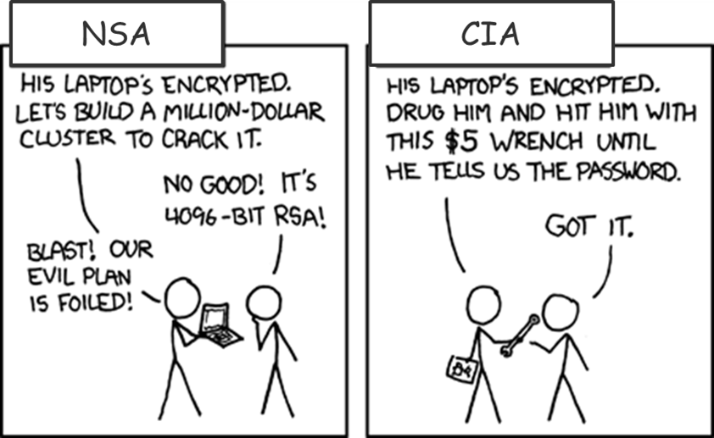
Symmetric Enryption usna sy110

Slide 2
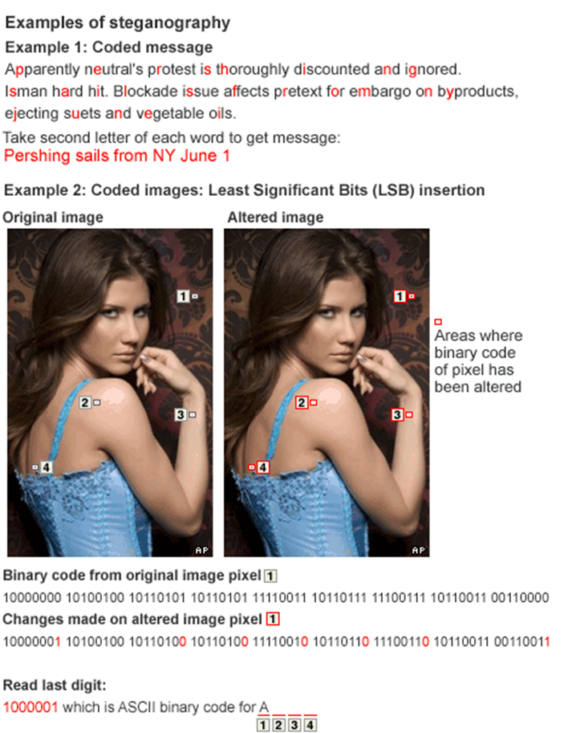
What is Cryptography?
Kryptos comes from the Greek word for "hidden“
  Crypt→ography – Study of encrypting messages
  Crypt →analysis – Study of decrypting messages
  Crypt →ology – Study of the mathematics behind encryption/decryption
Cryptography is the study & practice of hiding information:
  Provides secure communication in the presence of third parties
Often supports information assurance
  Can provide
    Confidentiality
    Integrity
    Authentication
    Non-repudiation
There are three main ways to hide information:
  Encryption: Scrambling a message in such a way that only the intended recipient can unscramble it. A method of encryption is called a cypher.
  Hashing: Uses an irreversible algorithm to obscure the original content.
  Steganography: Greek for “concealed writing”, goal is to keep the message’s existence unknown
Steganography was used by the Russian ‘illegals’ captured in 2010

Slide 3
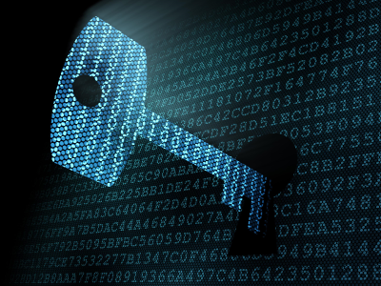
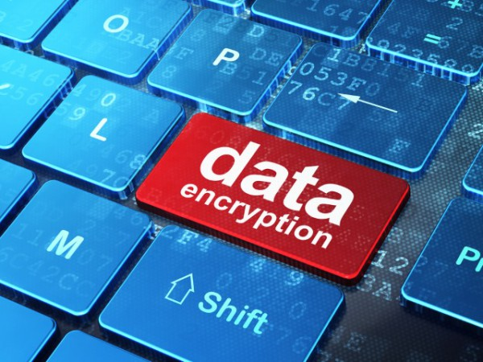
Encryption
In this lesson we’re going to focus our attention on encryption.
In fact, encryption comes in two varieties:
  Symmetric encryption – where Alice and Bob share the same keys.
  Asymmetric encryption – where Alice and Bob have different keys.
This lesson focuses on symmetric encryption, which is sometimes called “secret key encryption.”

Slide 4
Encryption
Process of transforming information to make it unreadable to anyone
  Must possess special knowledge (a ‘key’) to make the information readable
Provides confidentiality
Definitions
  Plaintext: The original, unaltered information
  Cipher: algorithm used to perform the transformation
  Key: piece of information used to control a cipher’s output
  Ciphertext: the transformed information created by combining the plaintext and key using a cipher

Slide 5
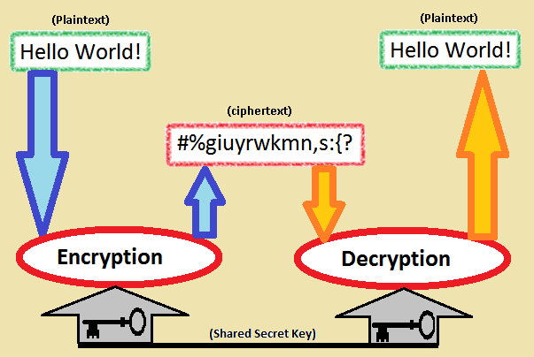
Symmetric Encryption (cont.)
Algorithms use trivially related keys for both encryption and decryption
  Keys are often identical
    May be a simple transformation between the two keys
Key represents a shared secret between two or more parties
We’ll look at two examples
  Caesar Cipher
  Vigenère Cipher

Slide 6



Our Characters
Discussion of encryption always involve the same three people: Alice, Bob, and Eve.
Alice
Bob
Eve

Slide 7
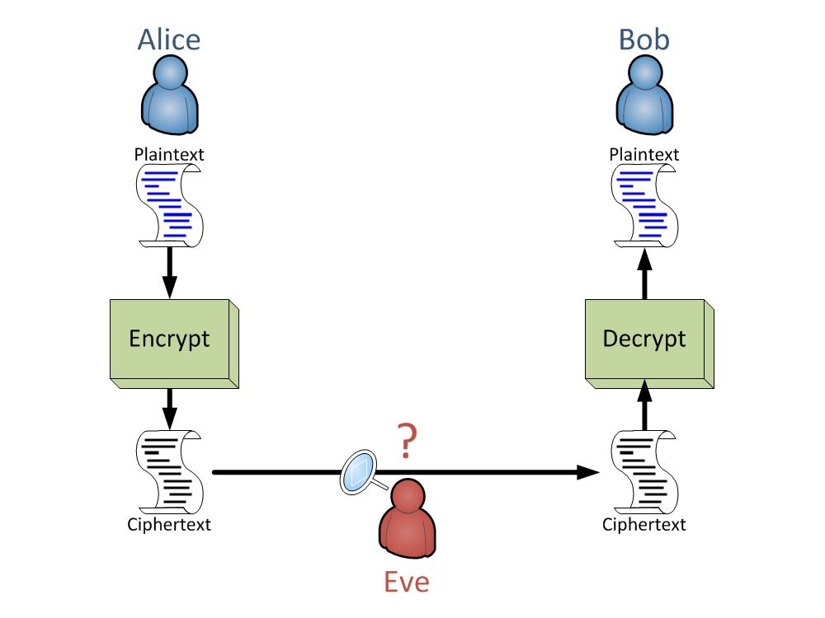



Encryption Process

Slide 8
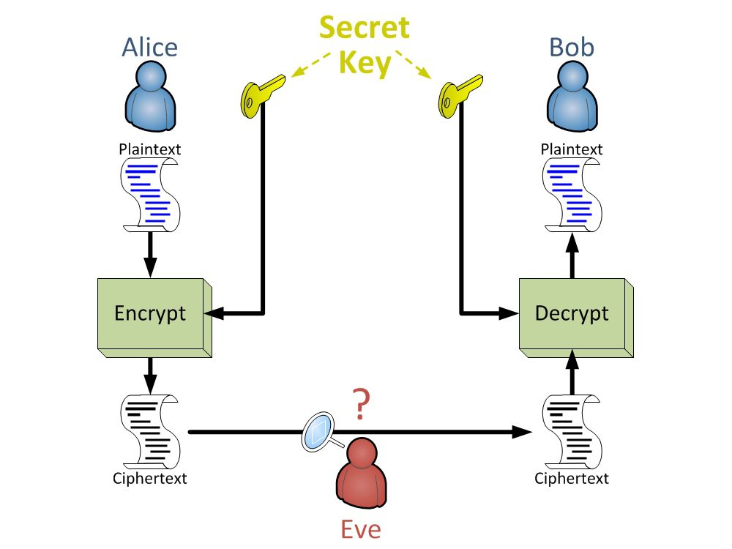
Symmetric Encryption

Slide 9
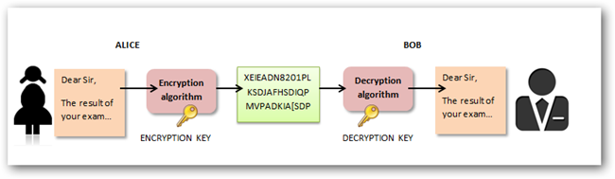
Symmetric Encryption
Alice
Bob
Eve

Slide 10
Caesar Shift Cypher
Plain Text: THE QUICK BROWN FOX JUMPS OVER THE LAZY DOG
Ciphertext: WKH TXLFN EURZQ IRA MXPSV RYHU WKH ODCB GRJ
Key: This is a substitution cipher where each letter in the original message is replaced with a letter corresponding to a certain number of letters up the alphabet (wrapping around to the beginning if necessary).
ABCDEFGHIJKLMNOPQRSTUVWXYZ
ABCDEFGHIJKLMNOPQRSTUVWXYZ
Encryption Key:
Move three letters up
Decryption:
Move three letters back

Slide 11
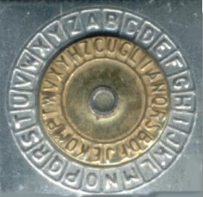

The Caesar Cipher (cont.)
Characters in plaintext are shifted a pre-determined number of characters
  Shift value is the shared key; shifting from plaintext
In mathematical terms
  Given shift value s,
  The k^{th} letter is replaced by the letter at position:
    (k + s)
Or, more simply:
http://courses.cyber.usna.edu/SY110/calendar.php?type=class&event=24
Decrypting is therefore a matter of subtracting rather than adding the shift value: (k - s)

Slide 12

The Caesar Cipher
At some earlier time, Alice and Bob agree to a secret key/shift-value s = 11.
Alice decides to send Bob the secret message "MEET ME AT NOON", i.e. plaintext = MEET ME AT NOON.
Alice encrypts the plaintext (using something like the table above) with key s = 11 to get: ciphertext = XPPE XP LE YZZY.
Alice sends Bob the ciphertext.
Eve manages to read the message in transit, but since she reads the ciphertext, XPPE XP LE YZZY, she can't make sense of it. Not knowing the key, she can't decrypt it to recover the plaintext.
Bob receives the ciphertext and decrypts it using something like the table above, in reverse, with key s = 11, recovering the plaintext MEET ME AT NOON.
Alice
Eve
Bob

Slide 13
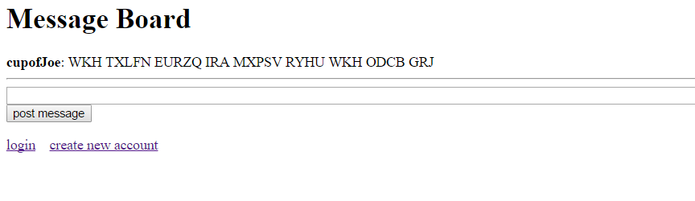
The Caesar Cipher
Class Exercise: Break into pairs
Select a shift value (s)
Each person:
  Send a secret encrypted message via the message board
  Receive and decrypt a secret message from your partner

Slide 14
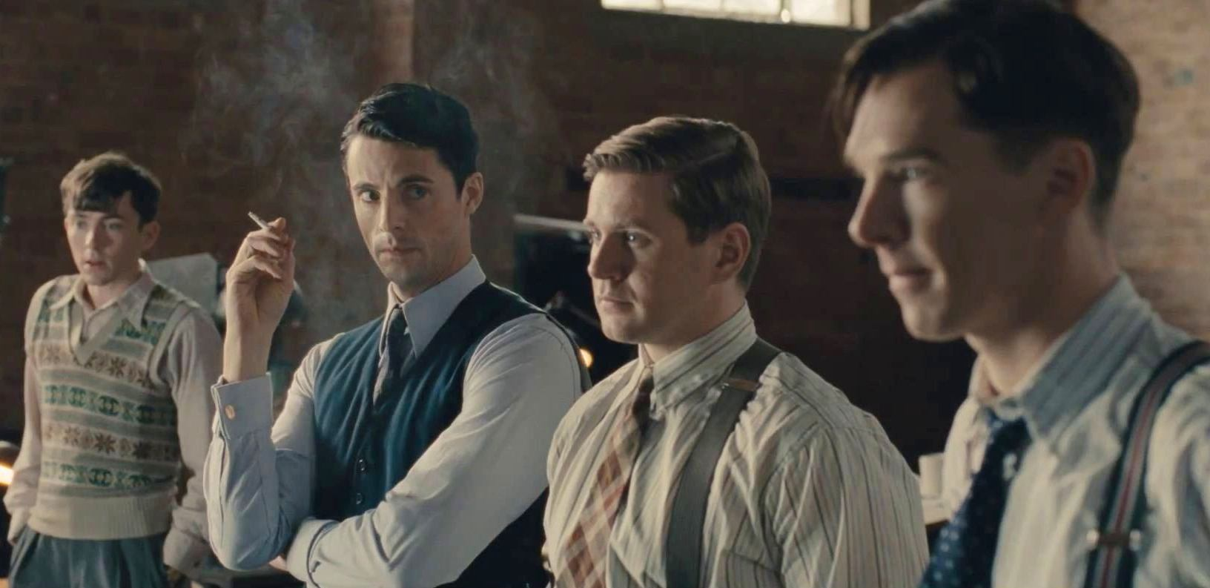
Cryptanalysis
The study of methods for obtaining the meaning of encrypted information
  Without knowledge of the key
Targets weaknesses in the actual cryptography
  Excludes methods such as bribery, coercion, burglary, keystroke logging, and social engineering

Slide 15
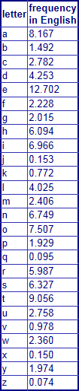
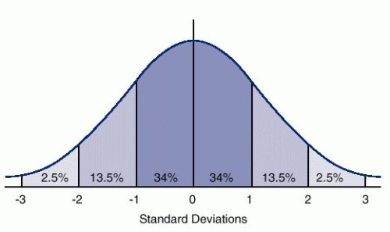
Breaking the Caesar Cipher
Frequency analysis
  Use of letters in a given language occurs with a [fairly] constant frequency:
    E’s are used a lot; Z’s not so much
  Analyzing how frequently a letter occurs in ciphertext may divulge information about the key (i.e. it should have the same distribution).
Caesar cipher is a simple shift cipher
  Shifted letters should occur at roughly the same frequency as their plaintext-counterpart
  There are only 26 key values, so trying them all is a viable option
What does this mean:
  XPPE XP LE YZZY
    “P” occurs often
    Maybe “P” is actually “E”
    If so, then the shift value is 11

Slide 16
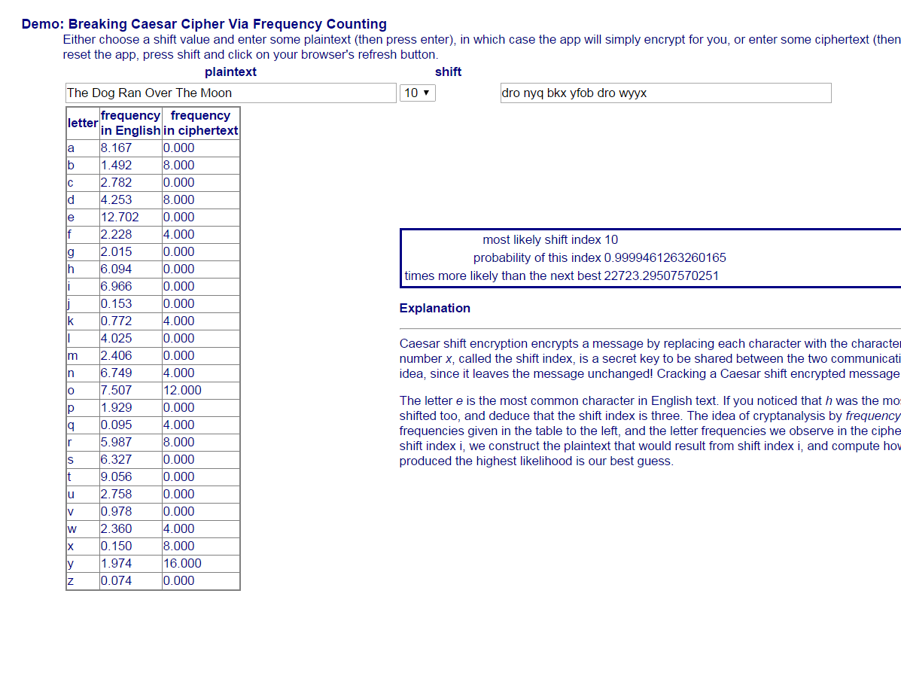
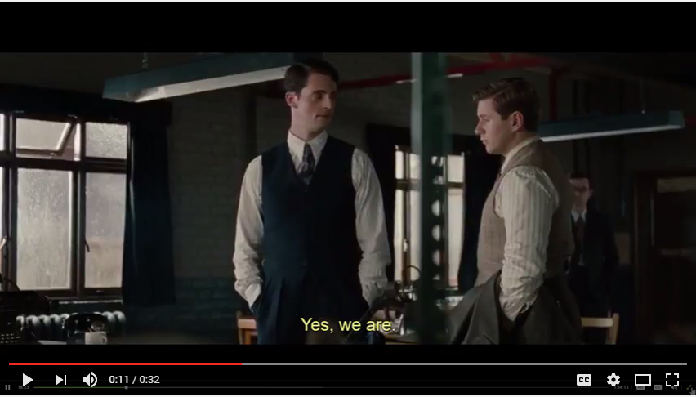
Examples: Breaking Shift Ciphers
Imitation Game: Frequency Analysis
https://www.youtube.com/watch?v=J4J8ak6tM6g
http://courses.cyber.usna.edu/SY110/resources/05.caesar-shift/freqAnalysis.html

Slide 17
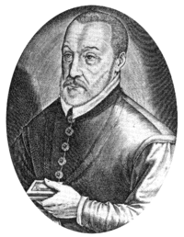
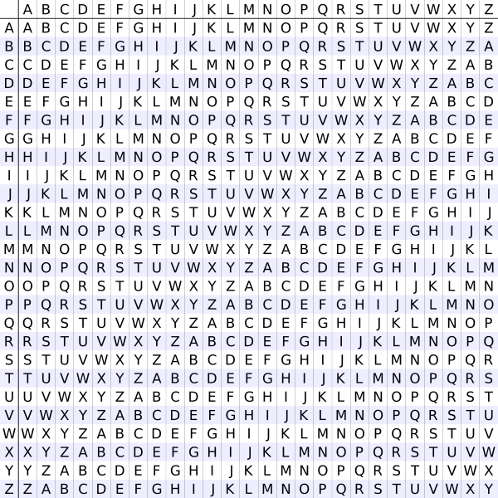
The Vigenère Cipher
Uses a series of different Caesar ciphers based on the letters of a keyword. How so?
  The key is a string of letters like “JOE”
  To encrypt:
    Write down plaintext under your key
        JOEJ OE JO EJOE ← key (repeated as needed)
        MEET ME AT NOON ← plaintext
    Next, write down the table on the right
    The encrypted value a plaintext character is the table entry whose row = plaintext & column = key
  To decrypt a character in ciphertext:
    Write down the ciphertext with the key written above it
      JOEJ OE JO EJOE ← key (repeated as needed)
      VSIC AI JH RXCR ← ciphertext
    Identify the column given by the key character above the ciphertext character.
    Find the ciphertext character in that column.
      The row at which it appears is labeled with the decrypt value (i.e. the corresponding plaintext character at the beginning of that row)
Blaise de Vigenère
1523-1596
key column
plaintext row
Encrypting “M” results in “V”
Vigenère Cipher Demo
http://courses.cyber.usna.edu/SY110/resources/27.vigenere/VigenereCipher.html

Slide 18
The Vigenère Cipher
Class Exercise: Break into groups
Use this Vigenère Table (post to MSG board)
  http://rona.academy.usna.edu/~sy110co/inst/sy110/resources/vigenere/vctable.html
Groups:
  Agree on a key
  Encode
  Read aloud to transmit
  Then decode a very short message

Slide 19
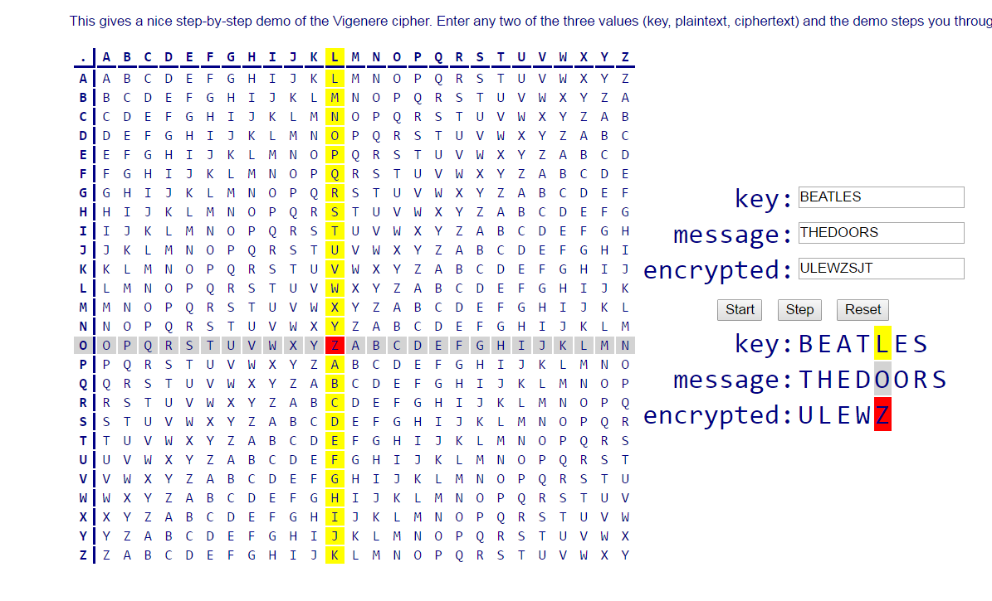
The Vigenère Cipher
key column
Blaise de Vigenère
1523-1596
plaintext row
Vigenère Cipher Demo
http://courses.cyber.usna.edu/SY110/resources/27.vigenere/VigenereCipher.html

Slide 20
The Vigenère Cipher
A Vigenère Cipher addresses the flaws in the Caesar Shift.
  The key is a string of characters
  Since there are about 6 trillion strings of less than 10, for example, the problem of too few keys is eliminated.
  The same letter at different positions in the plaintext does not get mapped to the same character in the ciphertext
    This is because the key-character written above plays a role in the encryption.
  So letter frequencies in the plaintext do not get carried over to the ciphertext.
I’m so clever!
Blaise de Vigenère
1523-1596

Slide 21
Breaking the Vigenère Cipher
Still vulnerable to frequency analysis
  If the length of the key is known
For key of length n, perform frequency analysis using every n^{th} character
  Becomes a simple Caesar cipher
    Shift value is the first key character’s alphabet position
  Start at the next character and repeat using every n^{th} character
  Can eventually recover the entire key
Finding the key length can be a problem
  But we can use frequency analysis to narrow down likely candidates
  For each possible key length n, form a string consisting of every n^{th} character starting from the first.
  Give that as our ciphertext input to our Caesar Shift Frequency Analysis page.
  Make a note of the probability of the shift index it gave you for that n.
  Whichever n value gave you the highest score is probably the actual length of the key.
This type of approach requires a large sample of characters to test every n^{th} possibility.
One Time Pad
The Vigenère Cipher is unbreakable if:
The key is a random sequence of letters,
The key is as long as (or longer than) the message, and
The key is never re-used.
However, this makes the Cipher impractical because key distribution becomes a huge problem. A new key must somehow be distributed confidentially after each use.
  If the message length is short OR the key is long this approach fails

Slide 22
An Alternative Approach:
Chosen Plaintext Attack
Encryption/decryption requires three things:
  Plaintext, Key, and Ciphertext
Knowing two is enough to get the third
  Plaintext + Key = Ciphertext
  Ciphertext + Key = Plaintext
What if we know the plaintext and ciphertext?
  Plaintext + Ciphertext = Key
But if all we have is the ciphertext, how can we get my hands on the plaintext?
What if I could choose the plaintext that gets sent?

Slide 23
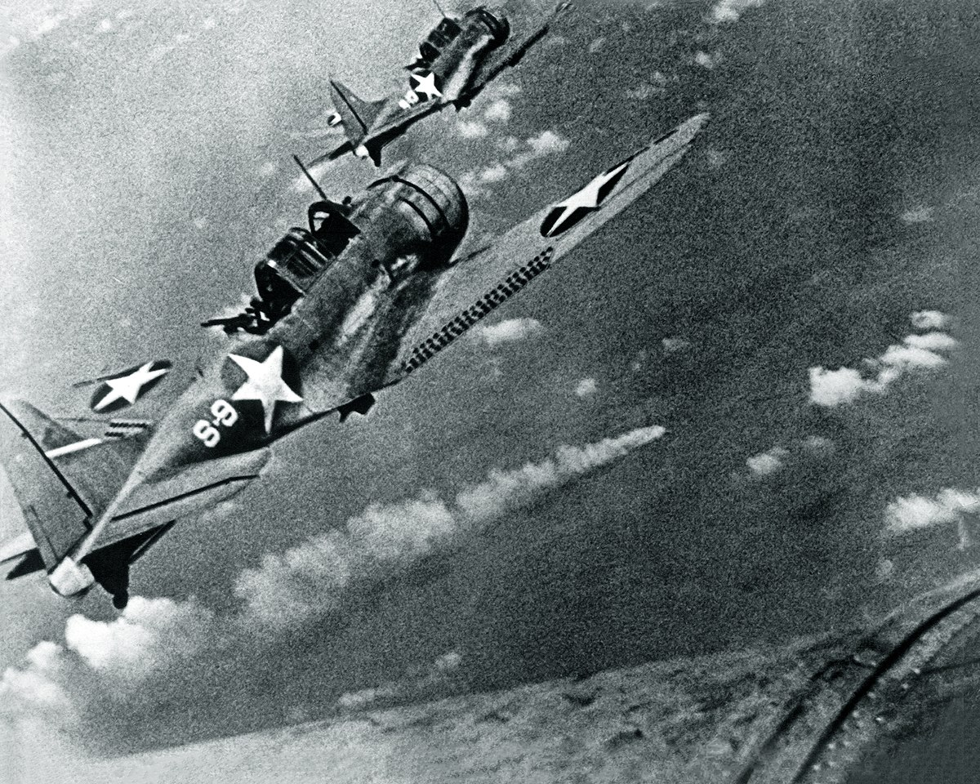
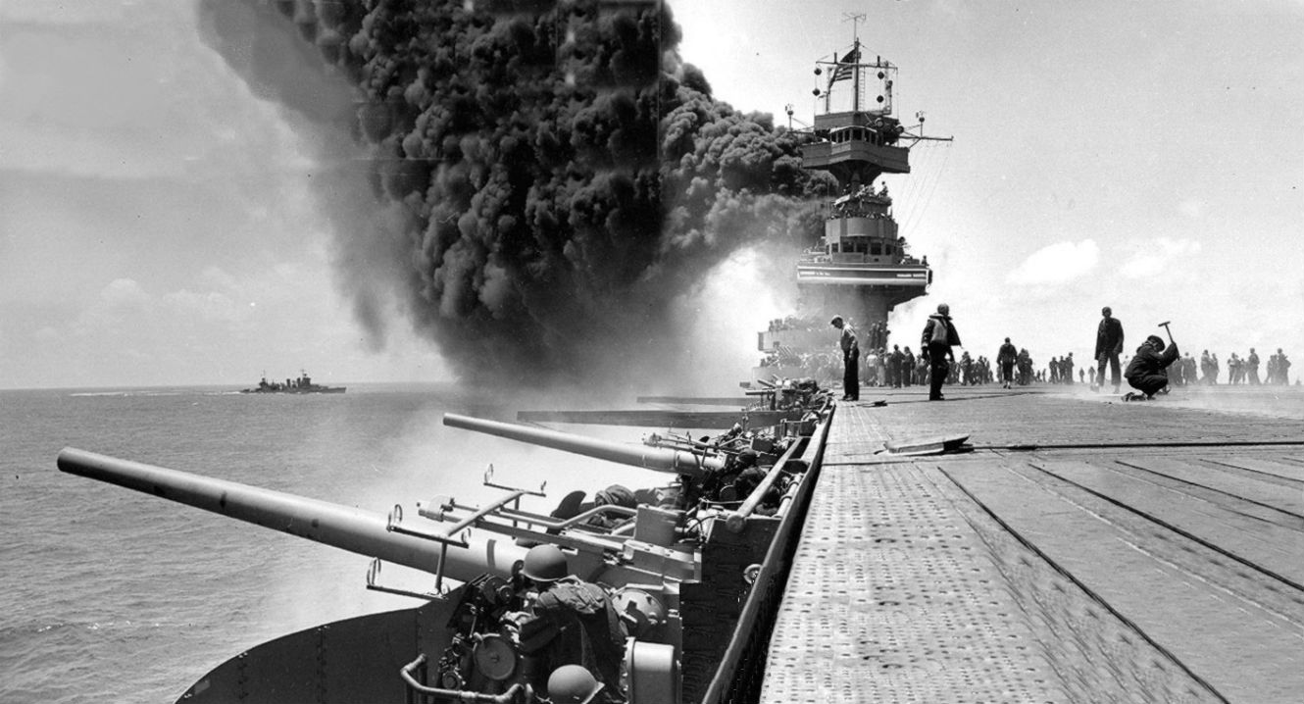
Chosen Plaintext Attack
What if we can induce a user to send a message of our choosing
  Or at least some text the attacker knows
Combining the ciphertext with known plaintext can reveal the key
  Key can be used to decrypt the rest of the message or other messages
Used during WWII Battle of Midway
Many WEP-cracking tools based on chosen plaintext attacks

Slide 24

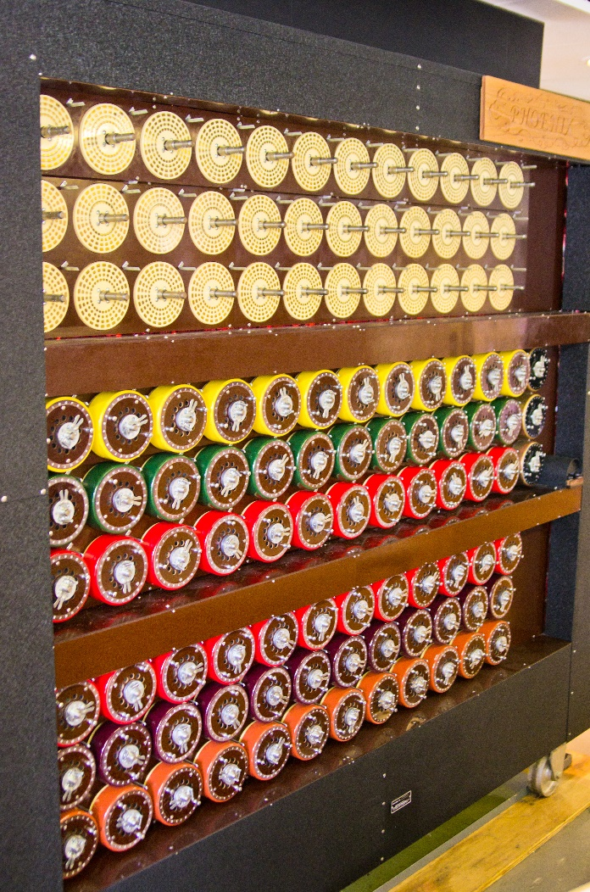
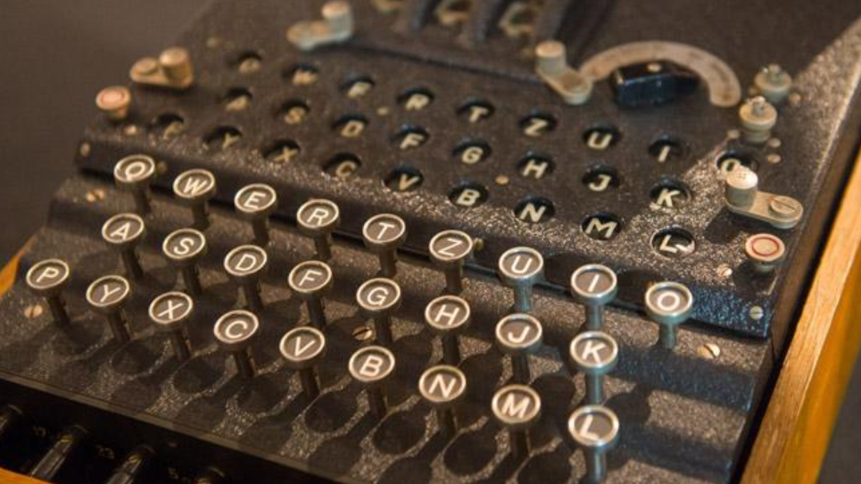

Enigma vs The Bombe
https://youtu.be/9kvYlEFDuSc
https://youtu.be/zZuqLLdx2YQ

Slide 25
Chosen Plaintext Attack against the Vigenère Cipher
Ciphertext:
  JZFDEYNFUDS MB KLNFI CVIH KMUZ ECHELY
Suppose that we know that "ALBUQUERQUE" is in fact the first word.
Perhaps we did something to provoke an encrypted communication with that word.
A L B U Q U E R Q U E
↓ ↓ ↓ ↓ ↓ ↓ ↓ ↓ ↓ ↓ ↓
J Z F D E Y N F U D S
We work through to recover the key like this:
  row A has a J in the J-column, so J is the first letter of the key.
  row L has a Z in the O-column, so we have an O as the second letter, and so on. In this way we recover JOEJOEJOEJO and deduce that the key was JOE.
key column
plaintext row

Slide 26
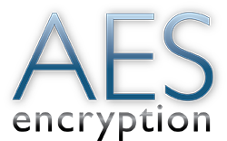
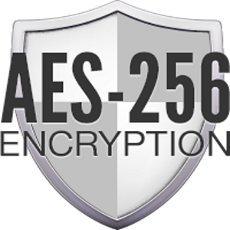
Symmetric Encryption - AES
The Advanced Encryption Standard (AES) is a symmetric key algorithm.
  Numerous variants and key lengths.
  Used to encrypt Top Secret information
  Basis for many modern VPNs
AES utilizes a large hexadecimal key, which is hard to remember
  We can combine hashing of a password with AES to allow us to use easy to remember pass phrases.

Slide 27
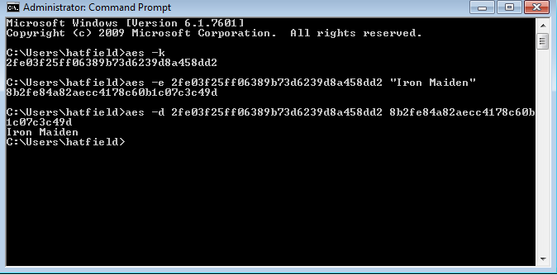
In Class: AES Encryption
AES Command
-k = Generate a key
-e = Encrypt
-d = Decrypt
Hint: right click and select “copy all” to copy/paste in a Shell

Slide 28
Historical Lessons
(Additional Content)

Slide 29
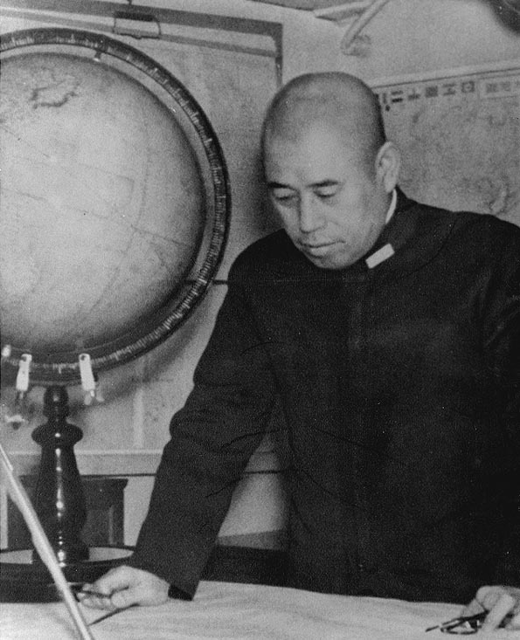
Chosen Plaintext Attack:
Battle of Midway June 1942
May 1942, Admiral Yamamoto was assembling a carrier task force to launch a diversionary raid off the Aleutian Islands and lure the US Navy to into a decisive battle that would destroy what remained of the US fleet after Pearl Harbor, allowing them to invade Midway Island.
From decrypted JN-25 messages, US commanders knew the general outlines of the plan, even the timetable.
The messages, however, did not say where the Japanese intended to strike; the target was simply designated "AF."

Slide 30
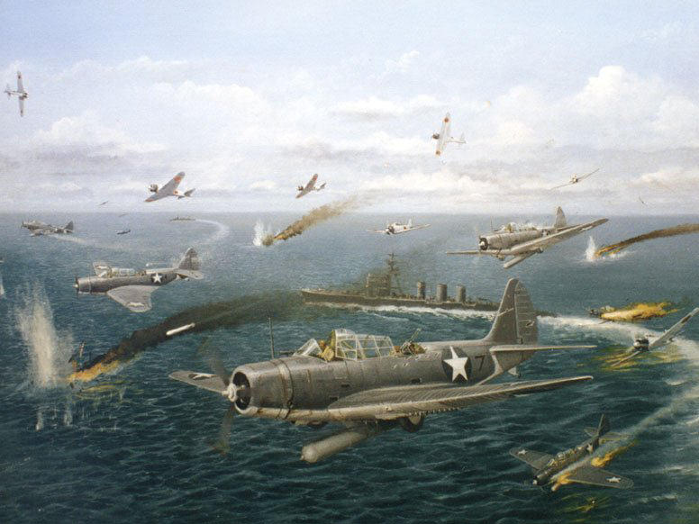
Chosen Plaintext Attack:
Battle of Midway June 1942
A ruse to determine what AF stood for was used, although Naval Intelligence already suspected it was Midway, they arranged for US forces at Midway to send a clear radio message that they were running short of fresh water
  Japanese intercepts took the bait, and US codebreakers in turn intercepted an encoded Japanese message stating: AF was running short of fresh water.
Knowing that the assault was be at Midway, US forces were ready, and on June 4, 1942, U.S. Navy pilots sank all four Japanese aircraft carriers in Yamamoto's task force, effectively turning the tide in the Pacific and the entire war.

Slide 31
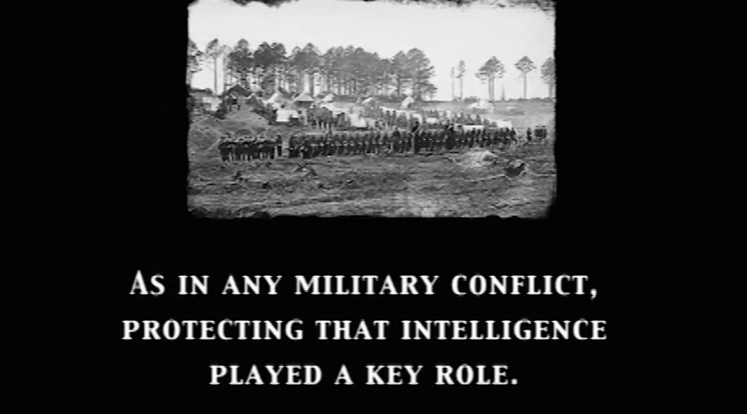
Encryption in the Civil War
(8min Video)
https://www.youtube.com/watch?v=JY9afJ3moxg

Slide 32
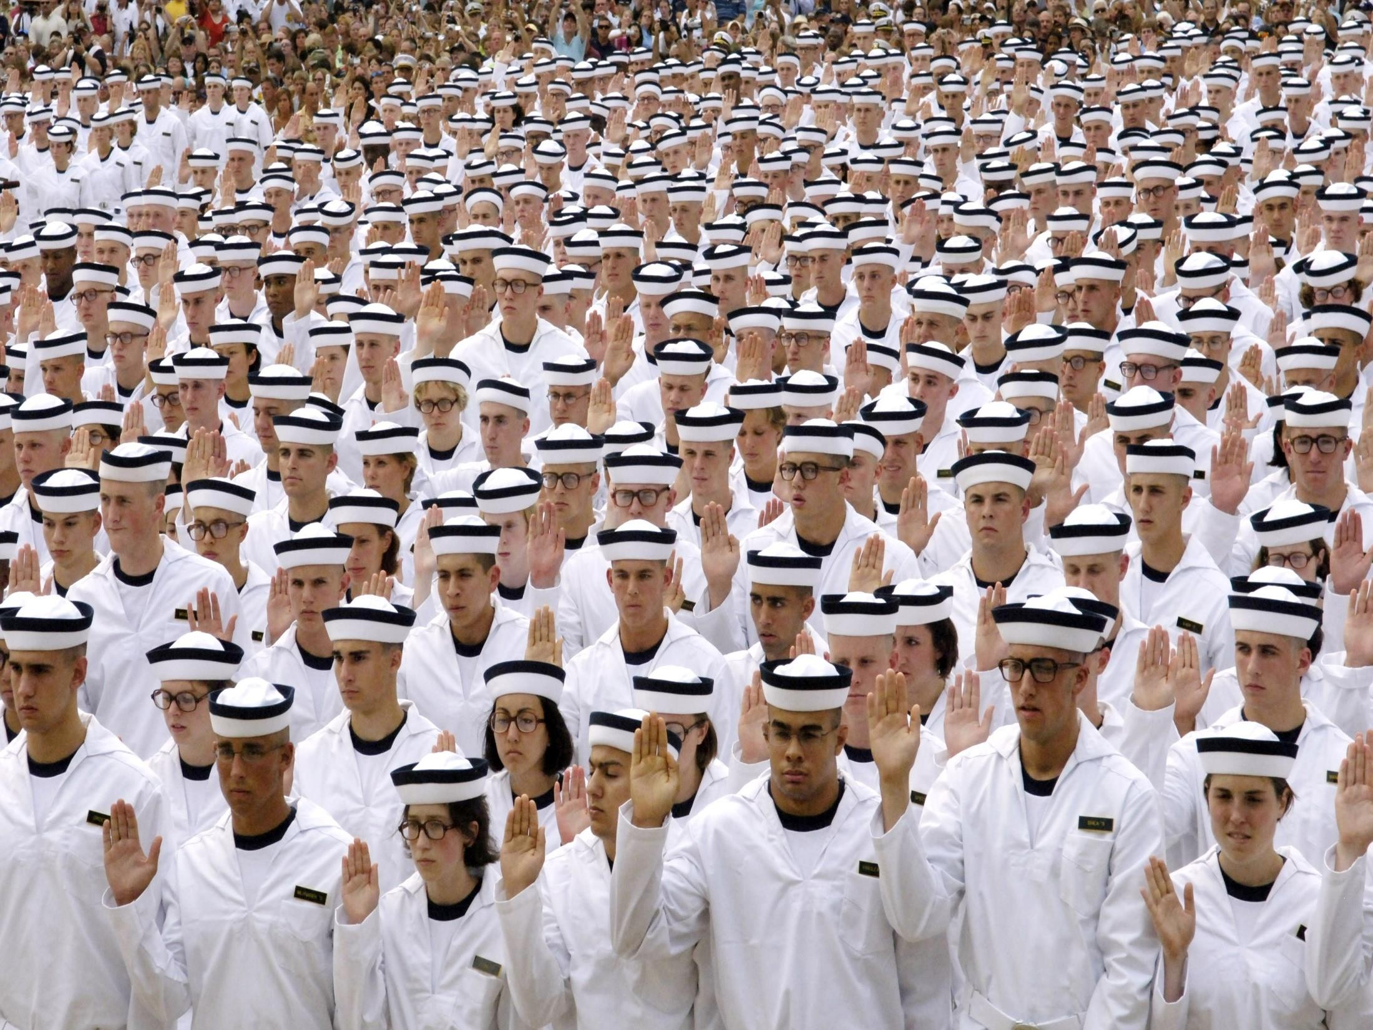
Questions?

