Slide 1
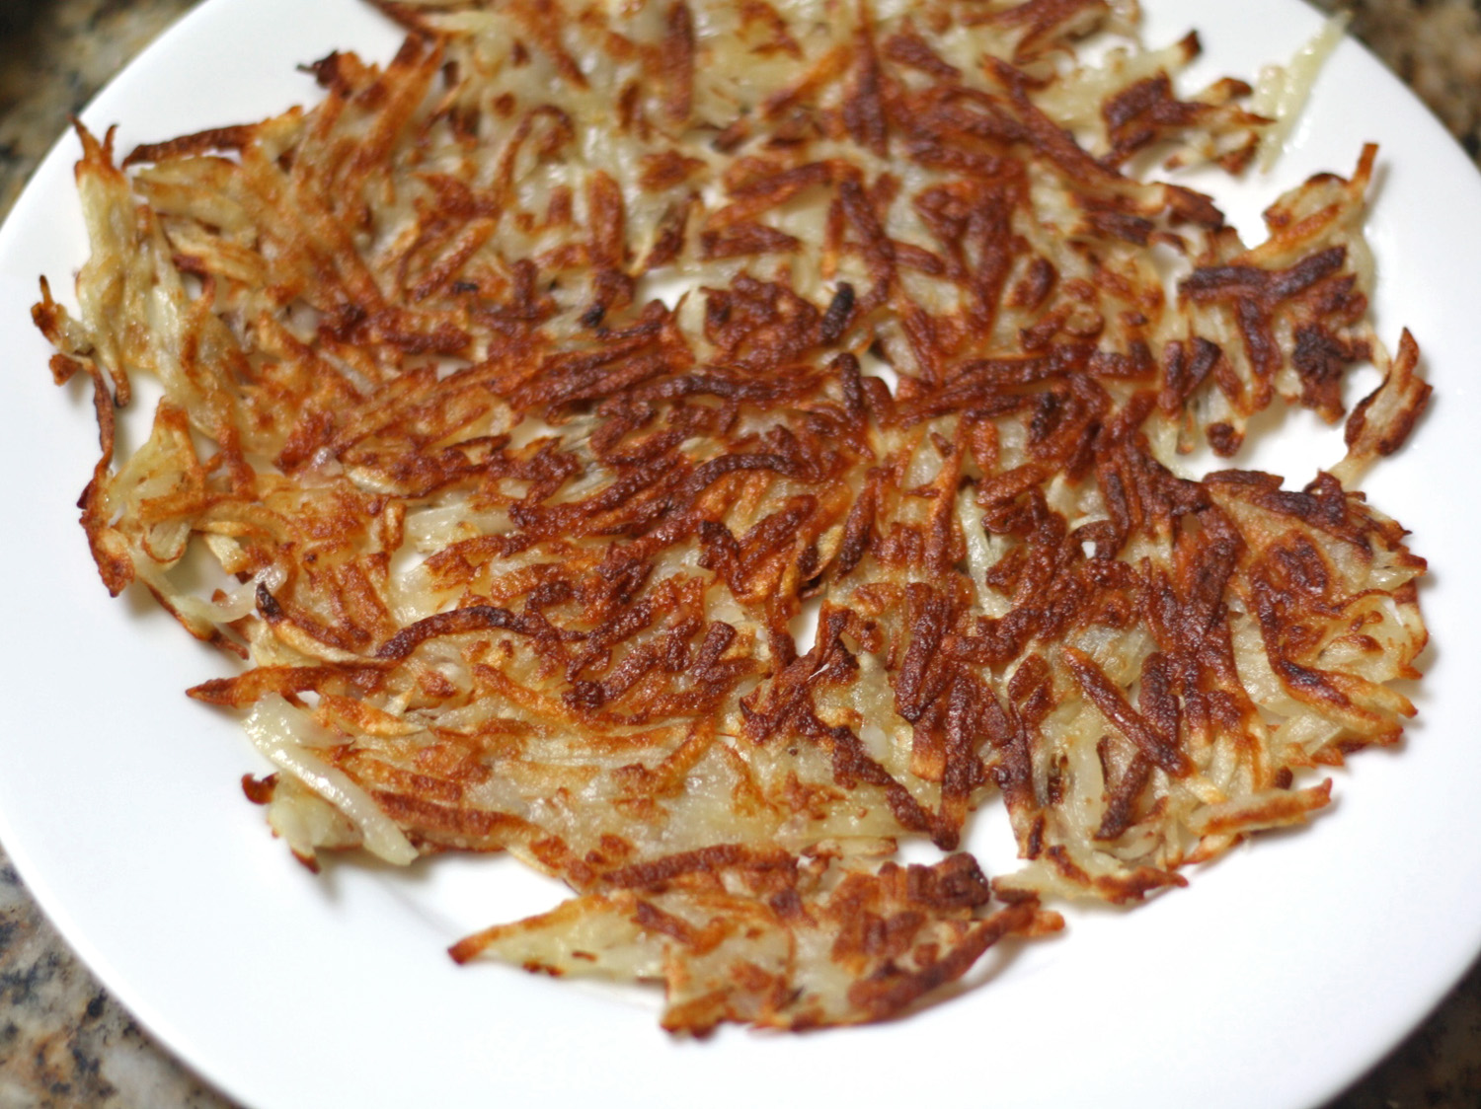

Hashing & Passwords USNA SY110
Hungry Yet?
LCDR Brian Kiehl
Leahy 101 | 410.293.0953
kiehl@usna.edu

Slide 2
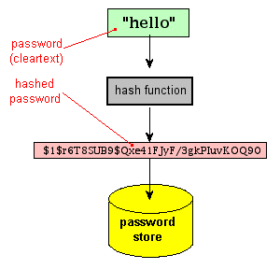
Hash Functions
Based on cryptographic methods
Takes an arbitrary-size input
Called the message
Returns a fixed-size output
Called the message digest or hash value
Change to the data will change the hash value
Accidental or intentional

Slide 3
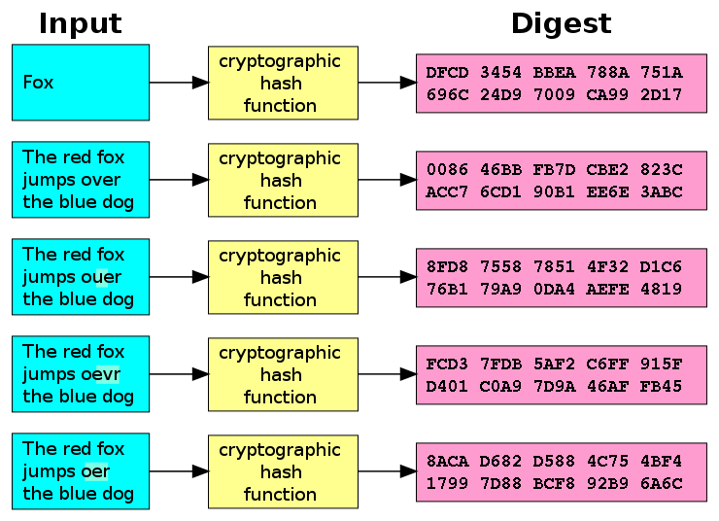

Slide 4
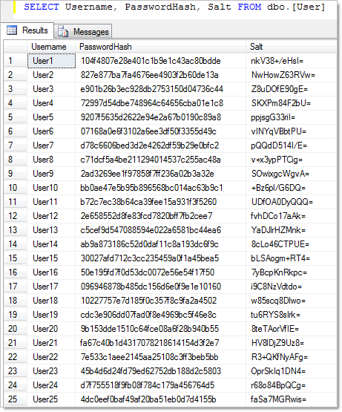
Key Hash Properties
Easy to compute the hash of a message
Not necessarily quick
Infeasible to generate a message that has given a hash
Infeasible to modify a message without changing the hash
Infeasible to find two different messages with the same hash
Meaningful message even more difficult
It’s not impossible to find the original input to a given hash, just hard to do fast.

Slide 5
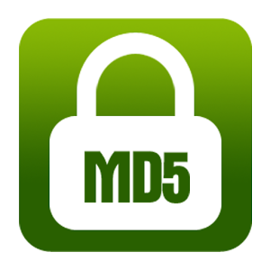
Common Hash Algorithms
Message Digest Algorithm
MD4
MD5
Secure Hash Algorithm
SHA-1
SHA-256
SHA-512
MD5 has actually been “broken”
Takes a sequence of bytes of any length and produces from it a 128-bit (16 byte) hash value, which is then written as a string of 32 hex digits.
People have discovered how to construct different strings that hash (MD5) to a given hash value.
So SHA-2 series algorithms are actually preferred.

Slide 6
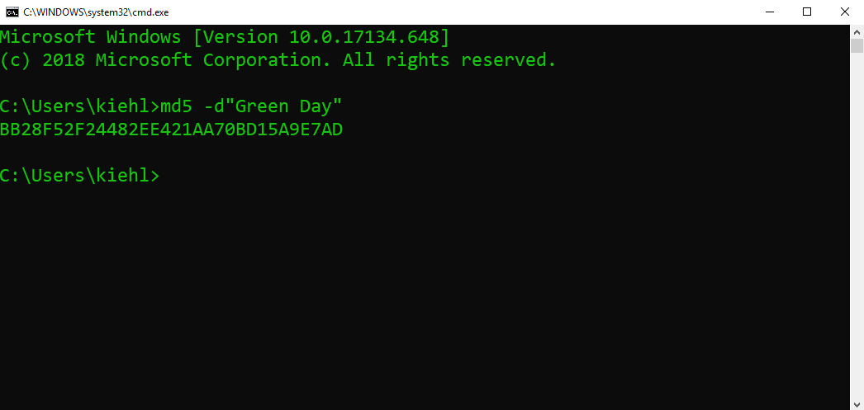

MD5 Shell Exercise
Open a Windows shell on your laptop
Input: Md5 –d”Green Day”

Slide 7
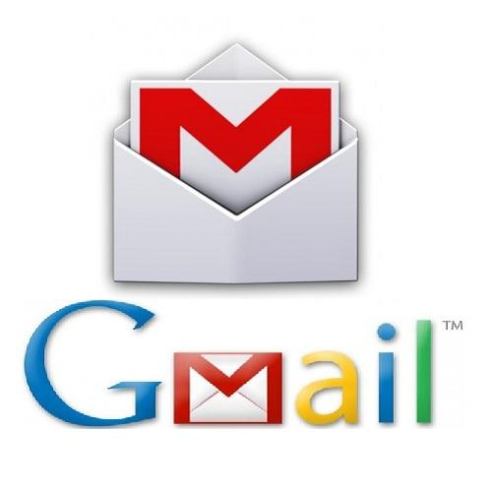
Hashing for Authentication
Hashing can be used for password checking
User creates an account or changes password
Server hashes the password and stores the hash
User attempts to log on to the system
User enters username/password
Password is hashed and sent to server
Hash is compared to the stored hash
Reasonable assurance the correct password was used if hashes match
Server does not need to store user passwords “in the clear”
Hash can be used to verify password
Can’t reverse hashes to discover passwords
Began using hashing and encryption on passwords in 2010

Slide 8
Storing a Password
Start
Take User Password
Convert PW to MD5 Hash
Database

Slide 9
Allowing Access
Start
Take User Password
Convert PW to MD5 Hash
Compare hash with the stored hash
Create User
Session

Slide 10
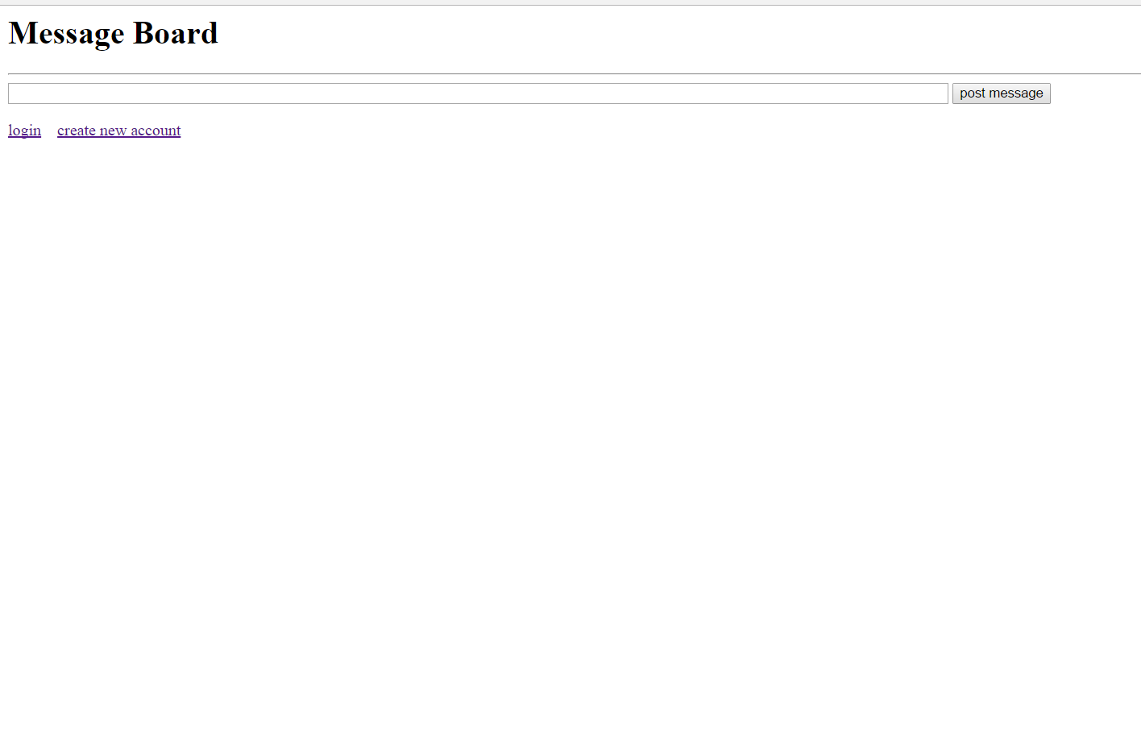
Steal My Password File
Go to my message board and see if you can steal my password file.
What can I do to better secure my website?

Slide 11
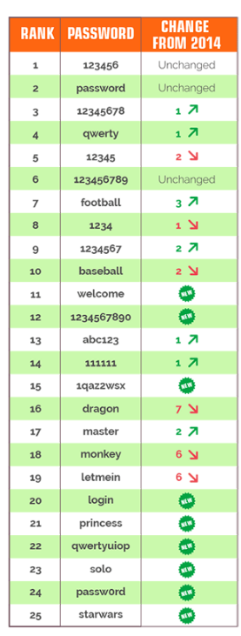
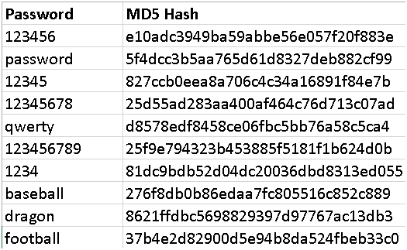
Rainbow Table Attack
People aren’t very creative about choosing passwords.
This means there is a relatively small pool of likely passwords.
Therefore, it is easy to find the original message
Try every possible input “under the rainbow” and compare to the hash value
Can be enhanced using a dictionary of common words, called a “dictionary attack”
Top Yahoo Passwords 2015

Slide 12
Dictionary Attacks
There are many websites that store billions and billions of pre-computed hash libraries.
Note the terminology! Often these sites use incorrect terms such as “decrypted” hashes!
http://hashtoolkit.com/
Potential Credential Harvester
This site adds whatever hashes you compute to its dictionary!

Slide 13
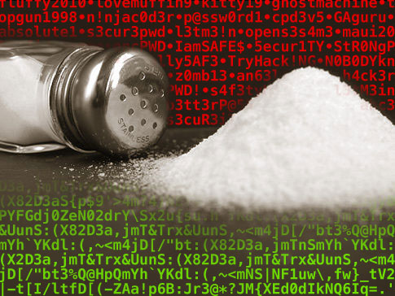
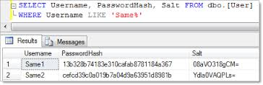
Salt
Solution to Rainbow Table attack: employ salt
Random sequence of bits concatenated with the hash function input (password)
Salt is randomly chosen when the account is created
Attacker must try every combination of message+salt against the hash
Sufficiently large salt make this infeasible
Salt must be known by both parties
Verifying a message hash without the salt will (most likely) fail

Slide 14
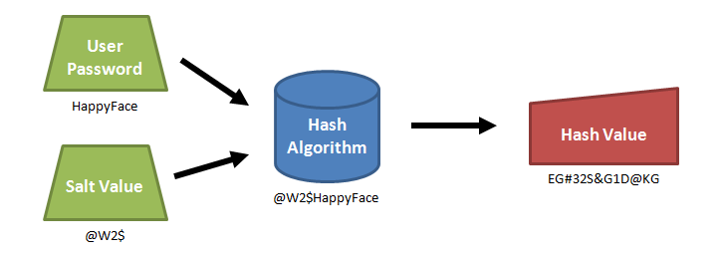
Salt
Typically, a server will store a user’s login name, salt input (randomly created by the server), and a hash of “password+salt”
For a Rainbow table to be effective, it has to store the hash value for every possible password+salt combination!
Using a 10-byte salt there would be 1,208,925,819,614,629,174,706,000,000 potential entries in the Rainbow Table (a 1.2x10¹⁸ terabyte file)!
That size of Rainbow Table is impractical.

Slide 15
The Advantages of Salt: Steal My Password File Again
Go to my message board and steal my password file again.
What did I do to better secure my website?

Slide 16
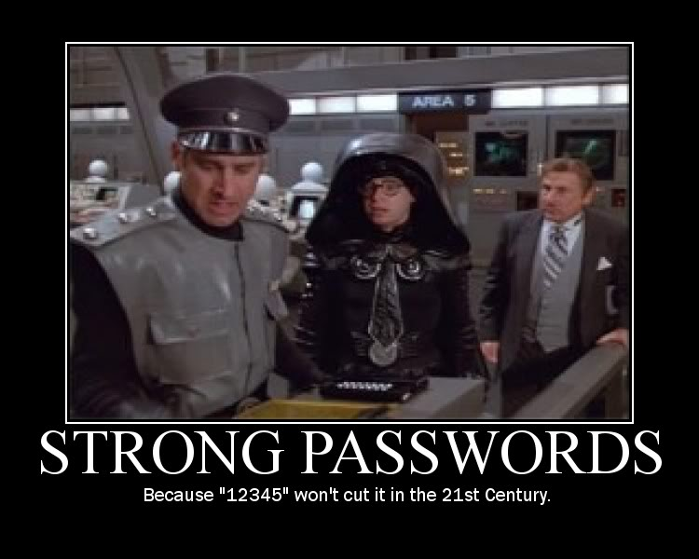
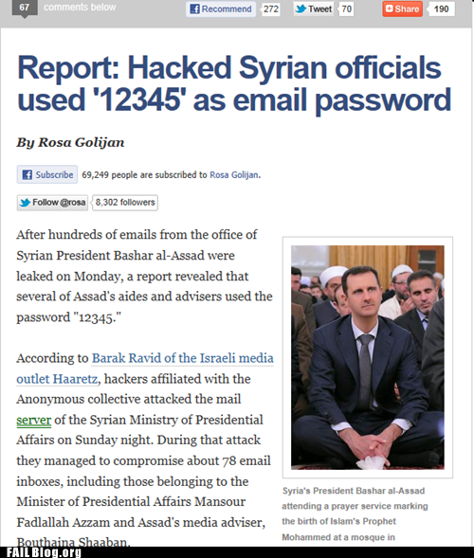
Do’s & Don’ts Of Passwords
Simple Sequences
abc123
qwerty
12345
Personal
Employer
School
Car
Children’s Names
Maiden names
Pet’s names
https://www.youtube.com/watch?v=a6iW-8xPw3k

Slide 17
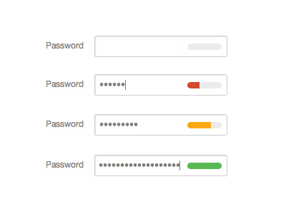
Password Strength
Number of passwords of length n is k^{n}
k = # of possible characters used in the password
Lowercase only = 26^{n}
Lowercase and uppercase = 52^{n}
Lowercase, uppercase, and digits = 62^{n}
n is the more important factor
Adding a salt to a password effectively increases n!
DoD Password Length => 14 Characters!
Possible Combinations:
94¹⁴= 475,920,314,814,253,376,475,136
Time to crack -> approx. 7.5 million years!
Do the Arithmetic
To increase the security of your passwords, focus on length. So a long pass-phrase of random words is the way to go.
https://www.duffelblog.com/2017/02/dod-to-require-passwords-using-27-different-letters-minimum/

Slide 18
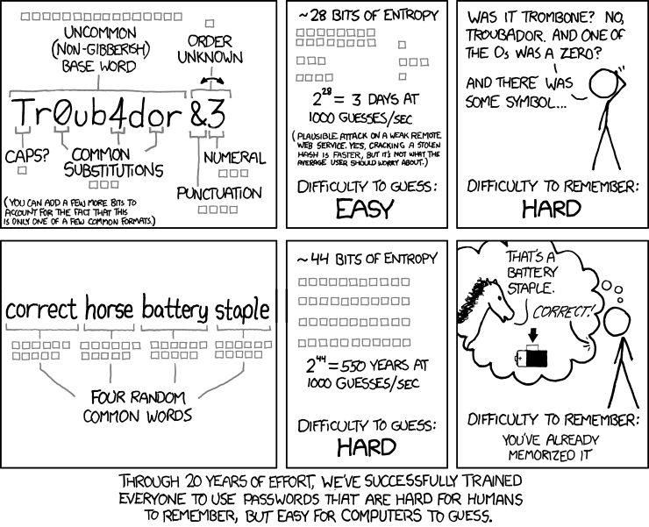
Everyone Should Know This

Slide 19
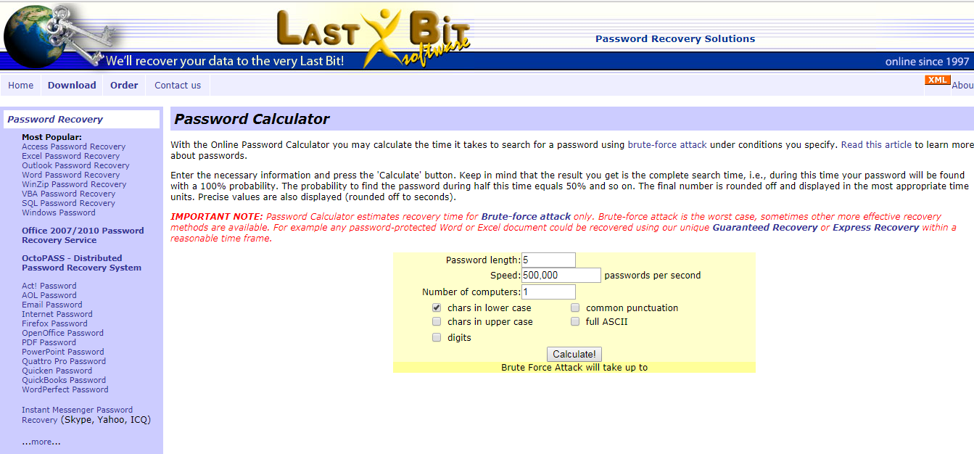
Everyone Should Do This
http://lastbit.com/pswcalc.asp

Slide 20

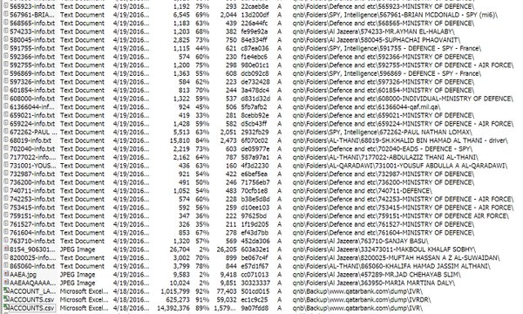
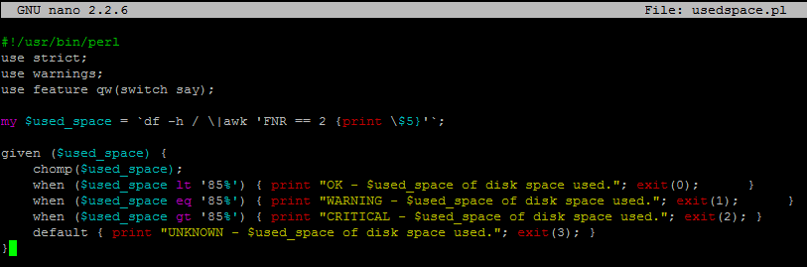
Offline Attacks
Offline attacks are scenarios in which someone has somehow acquired or stolen a password file.
They can then try to guess passwords without any online server thwarting their attempts.
Brute Force Attack
Dictionary Attack
Rainbow Table Attack
Once a password is cracked, the attacker owns the database information
One way to guard against this is called password stretching
One stores a hash of a hash of a hash of a hash…

Slide 21

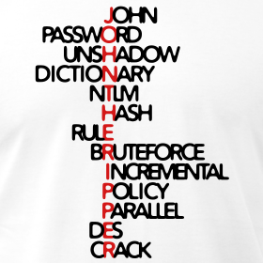
Automated Tools
Offline attacks have been automated in programs such as John the Ripper.
Hacking toolkits such as Kali Linux come pre-installed with these sorts of hacking programs.
Stronger password attacks:
Get the file containing password hashes.
Search for a string (e.g. ‘123456’) whose hash matches what’s in the file
This is important because login attempts are slow and are logged by system administrators, and so your activity may be noticed.
Types of password attacks:
Brute Force attack (all possible passwords)
Dictionary attack (starts with a list of hashed dictionary words)
Rainbow Table attack (looking up hashes you’ve found in a large table of precomputed hash values)
Brute Force & Dictionary

Slide 22
Keyloggers
Programs or devices that capture every keystroke that a user makes
Collected information is later sent to or retrieved by attacker
Attacker searches for useful information, keywords, etc.
Can Collect:
Usernames & Passwords
Credit card numbers
Social Security Numbers
Personal information
EVERYTHING
Brute Force & Dictionary

Slide 23
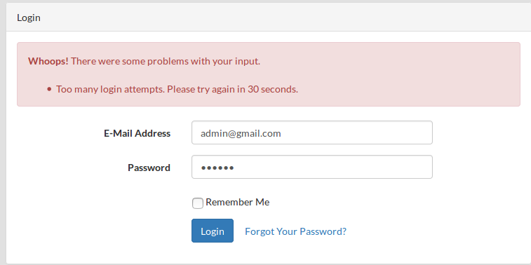
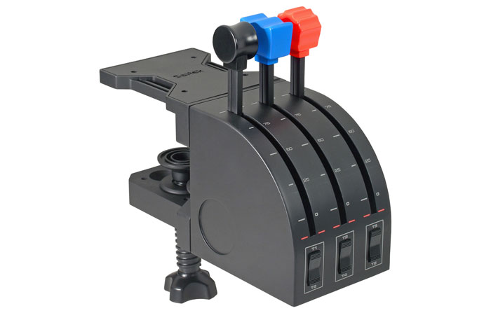
Online Attacks
Most systems take a long time (in computer terms) to respond to a login attempt – especially an incorrect login.
This limits the effectiveness of brute force attacks.
Many systems employ throttling, in which a server starts introducing longer and longer delays as the same user tries more and more logins.
Often, systems lock an account if there are too many unsuccessful attempts in a short period of time.
iPad Throttling: https://www.cnn.com/2019/04/09/tech/locked-ipad-boy-trnd/index.html

Slide 24
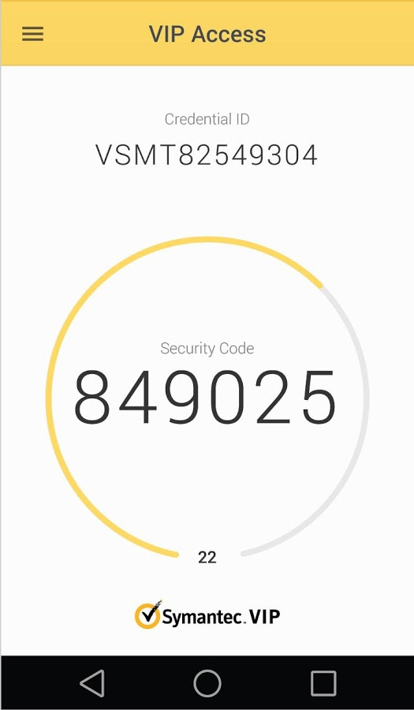
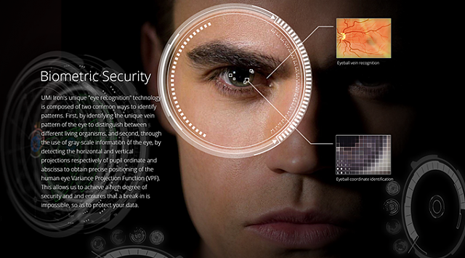
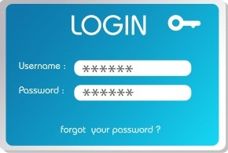
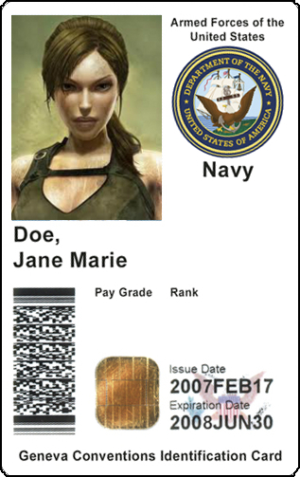
Multi-Factor Authentication
It’s really difficult to remember long passwords, especially if they contain special characters, upper/lower-case, and numbers.
Another option is to authenticate using more than one means!
Something You Know
Login/Password
Something You Have
Smart card (with PKI certificates)
One-time password token
Something You Are
Biometrics
Fingerprints
Retinal scans
Hand geometry
Facial recognition
Etc.

Slide 25
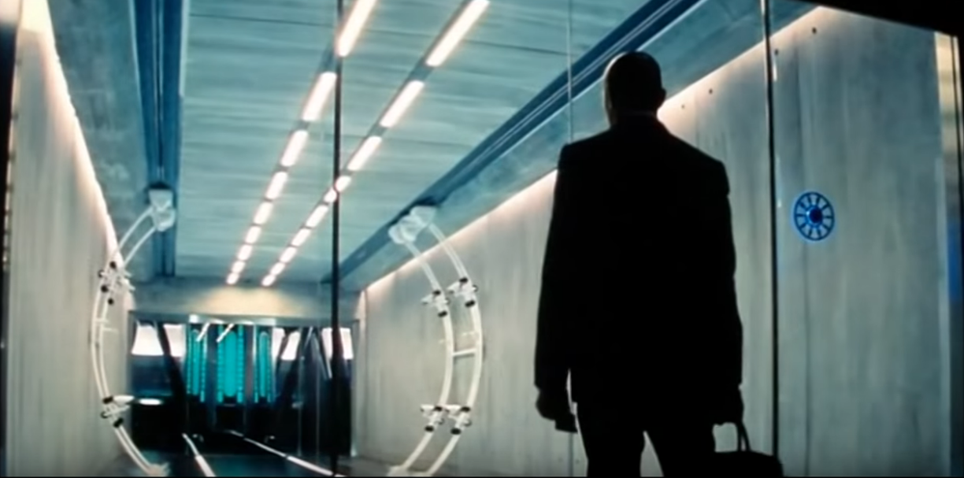
Multi-Factor Authentication
https://www.youtube.com/watch?v=0iZ-nQ4yFn4&feature=youtu.be&t=51

Slide 26
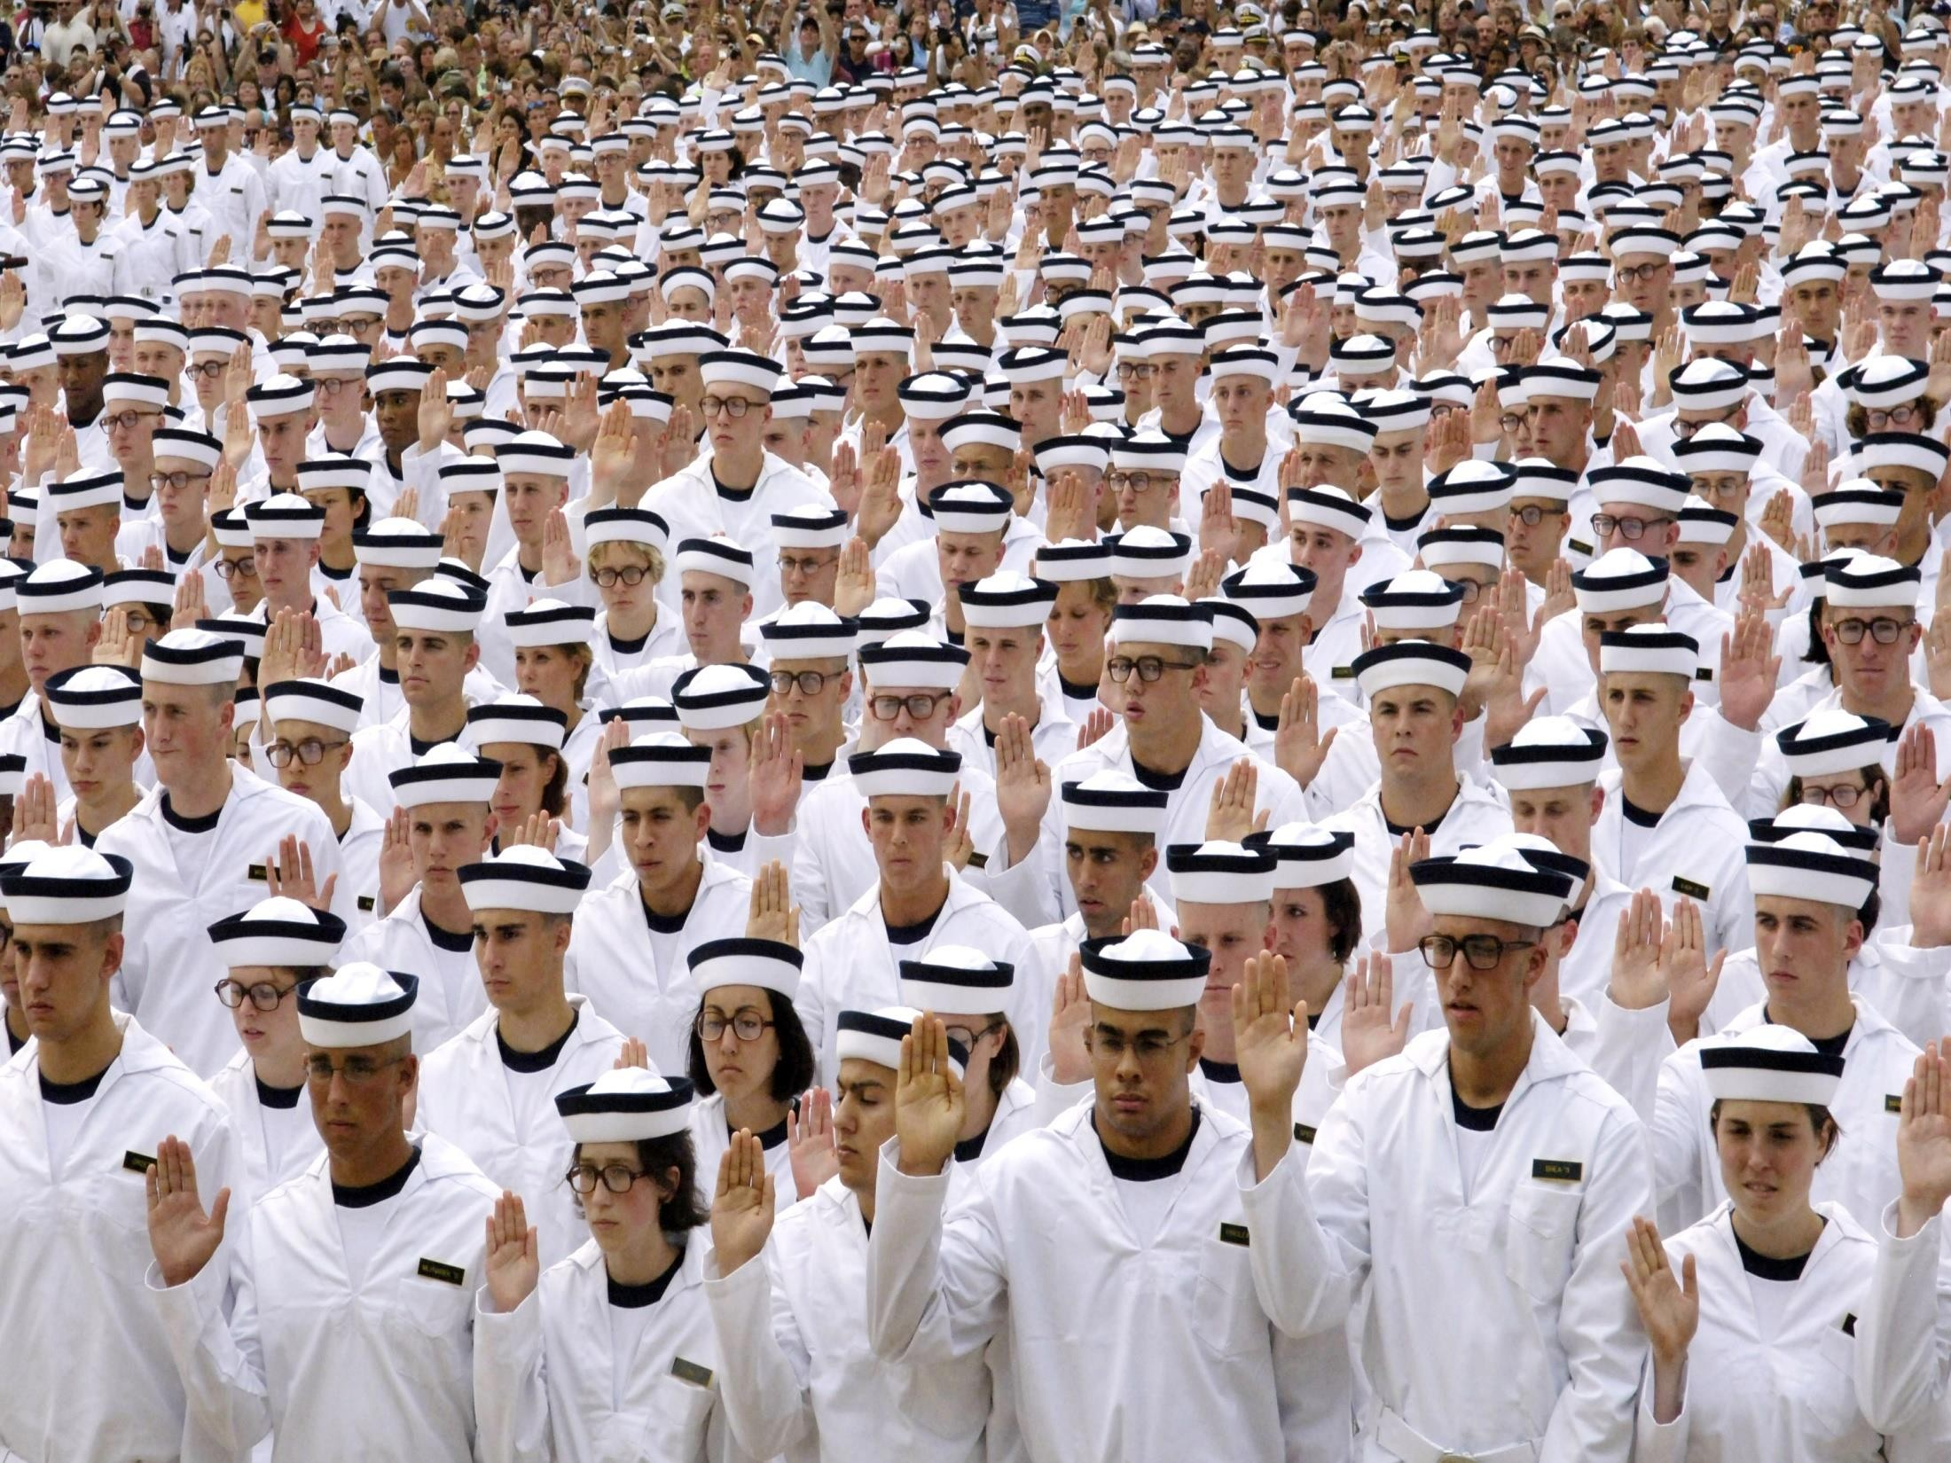
Questions?

