Slide 1
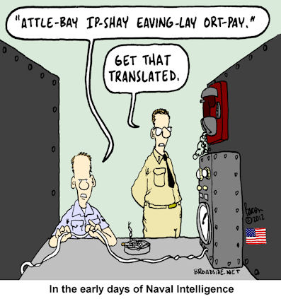
Asymmetric Encryption USNA SY110
LCDR Brian Kiehl
Leahy 101 | 410.293.0953
kiehl@usna.edu

Slide 2
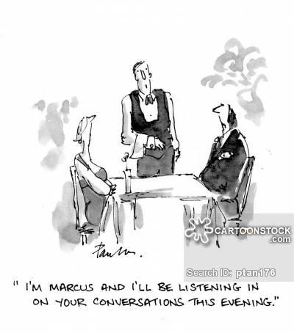
Symmetric Encryption Limitations
Symmetric encryption algorithms use the same key for encryption and decryption
Both parties must agree to a secret key
Fundamental limitation
How do you exchange a secret key?
Requires secure communication
…Need a system to establish secure communications over an insecure channel
Ex: Browser-to-server communication

Slide 3

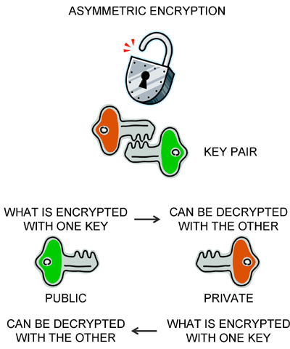

Asymmetric Encryption
Also known as “public-key” encryption
Each party has two distinct keys
Public key – shared with the world
Private key – known only to the user/owner
Combination of a public and private key known as a key pair
Public and private keys are mathematically related such that
Something encrypted with a user’s public key can only be decrypted with that user’s private key
Something encrypted with a user’s private key can only be decrypted with that user’s public key
Because only the private key needs to be protected, public keys can be shared openly.
Alice
Bob

Slide 4

Integer Factorization
Every integer can be written as a multiplicative product of prime numbers.
Example: 50 is 2 x 5²
In school you probably used a method called “trial division” to factor:
You divide the number you are trying to factor by each prime number and work your way up.
This works well for small numbers that factor into simple primes, like the ones you used in school.
It doesn’t work well for really large numbers.
Computer algorithms make this process faster, but only incrementally so.
Prime Factorization of 72
2.2361741e+17
472,882,027
472,882,027
Prime Factorization of a very large number!

Slide 5

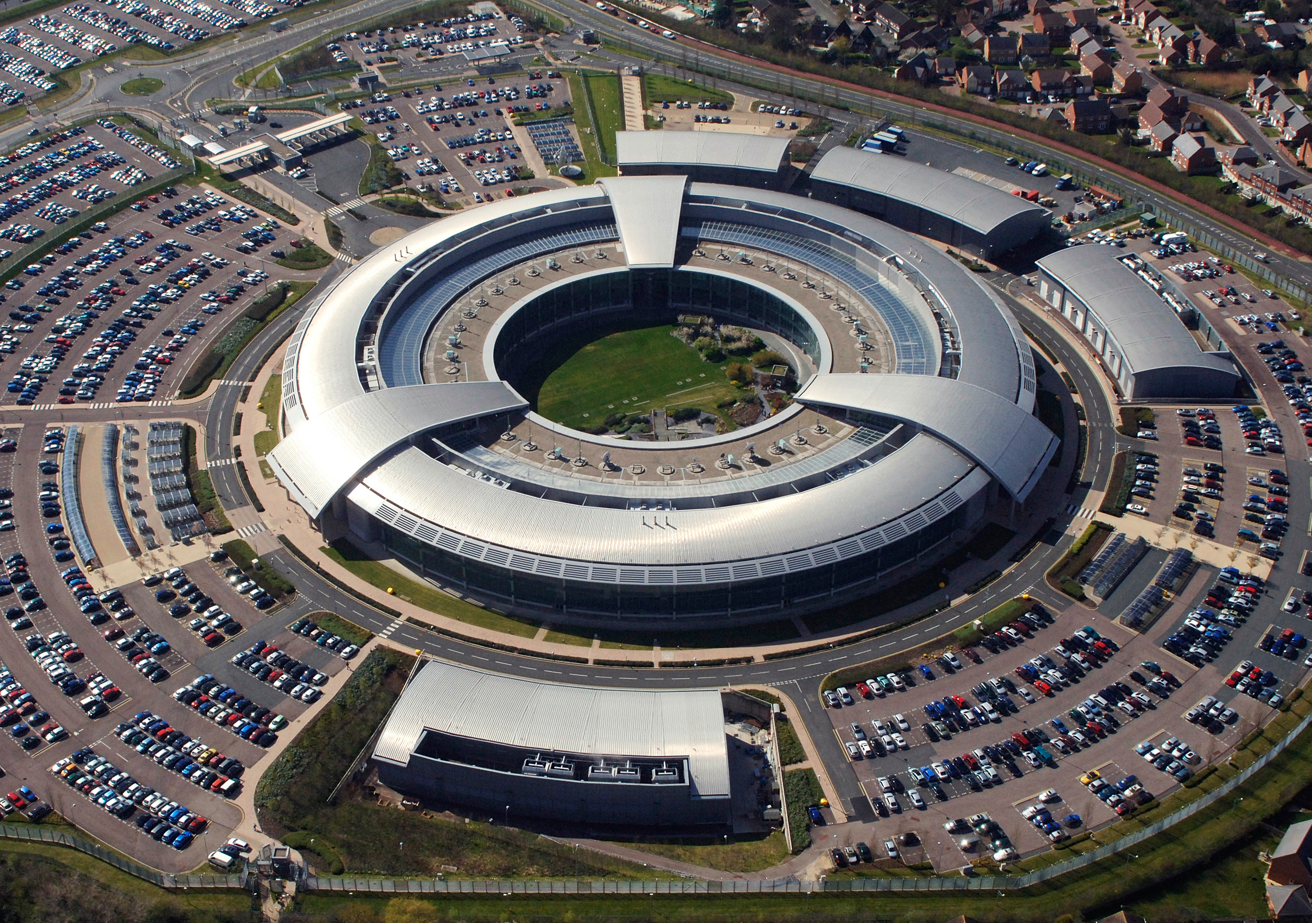
Integer Factorization (cont.)
Public key
Two integers (e, n)
Private key
Two integers (d, n)
The value of n is selected so that n = p x q, where p and q are both prime numbers.
Therefore, if you know e and n, and you’ve found the factorization of n into p x q, then you can compute d.
In other words, the public and private keys are linked to each other in a way that algorithms cannot easily figure out.
n is common to both
Asymmetric encryption was first devised by the British spy service GCHQ in 1973.
The size of n in bits is the key length, and it gives an indication of how strong the key is—the longer, the better.

Slide 6
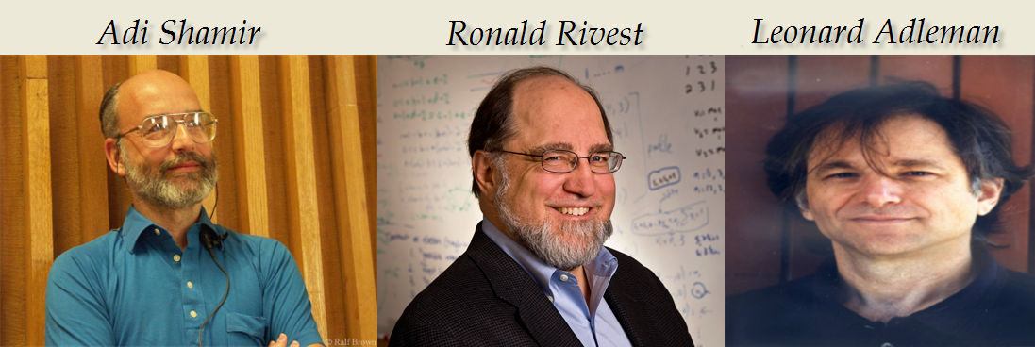
RSA Standard Encryption
Asymmetric encryption was kept secret by GCHQ from 1973 until 1997.
However, three MIT researchers—Ron Rivest, Adi Shamir and Leonard Adleman—independently discovered the technique in 1977.
The technique is named after them: RSA encryption.
It is possible to crack RSA by computing someone’s private key from their public key.
All it takes is being able to factor the n that’s common to both the public and private key.
However, it is not feasible because the time and computing power required to do it simply too great.
As computers and algorithms get faster, we simply use larger numbers for n-factorization.
In 1990, 512-bit RSA keys were deemed pretty secure; today 2,048-bit RSA is deemed secure.

Slide 7
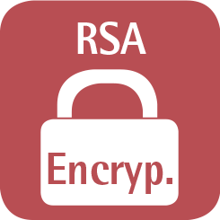

RSA Security
If n is 300 bits or shorter
Factored in a few hours on a personal computer
512-bit keys
Factored in a few weeks using common hardware
Largest (known) number factored by a general-purpose factoring algorithm: 768 bits
State-of-the-art, distributed implementation
RSA keys are typically 1024-2048 bits
1024-bit keys may be breakable in near future
Recommend key length is 2048 bit to be considered “secure”

Slide 8
Encryption Process
Data is encrypted using the recipient’s public key
Public key is available to anyone
Data is decrypted by the recipient using their private key
Only the recipient’s private key will successfully decrypt the message
Only the recipient should have the correct private key

Slide 9
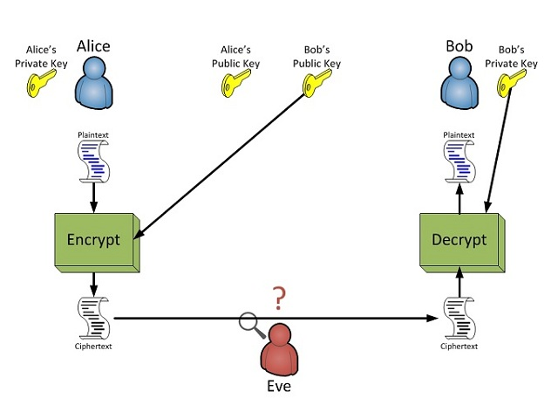


Alice Sends Message to Bob Using Asymmetric Encryption

Slide 10



Authentication
This provides a solution to Alice's confidentiality problem
She knows only Bob can read her message
However, Bob has an authentication problem on his hands.
Yes, he's received a message only he could read
And the message claims to have been sent by Alice
But he has no guarantees that it really did come from Alice.
Anyone can send a message to Bob using Bob's public key, since it's freely available.
We need a way to ensure authentication!
Eve
Alice
?

Slide 11
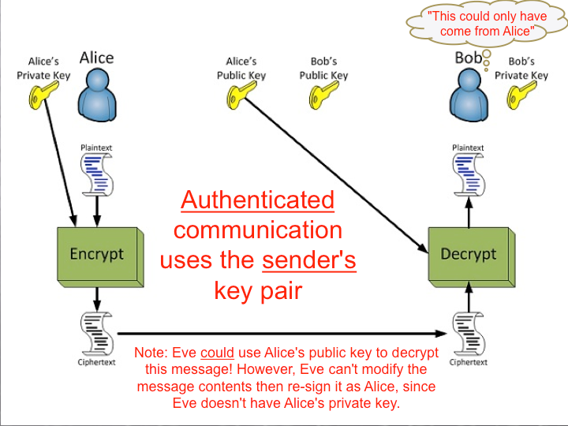


Authenticate Using the Sender’s Key Pair
Alice encrypts her message with her private key. Bob decrypts the message with Alice’s public key.
If the message correctly decrypts with Alice’s public key, what does Bob know?
That the message could only have been encrypted by someone possessing Alice’s private key.

Slide 12
Authentication
Now Bob’s authentication problem has been solved
He knows the message must have been sent by Alice
However, Eve or anyone else seeing the encrypted message could decrypt it using Alice’s public key—which is freely available.
The confidentiality is not guaranteed.
Can we combine the first two techniques to achieve both authentication and confidentiality?
Eve
Alice
Alice sent this!

Slide 13
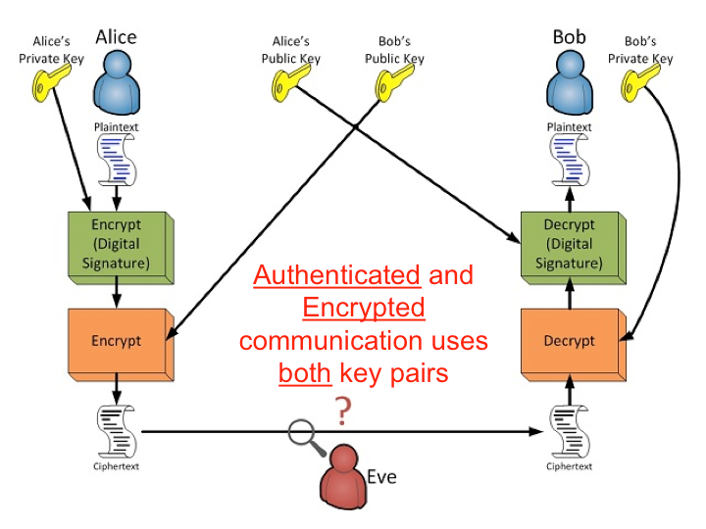


Confidential and Authenticated Communications
In this scenario, the previous methods are combined.
Alice encrypts the message first with her private key, then Bob’s public key.
Double encryption
Bob decrypts the message, first with his private key, then with Alice’s public key.
Double decryption
Now, both authentication and confidentiality are achieved!

Slide 14

Digital Signatures
Alice
Lawyer (Sponge) Bob
Now, suppose Alice and Bob are negotiating a legal contract.
Alice sends Bob the contract, and Bob uses asymmetric encryption to guarantee both authentication and confidentiality.
However, Bob wants a way to be able to prove that Alice sent the contract—non-repudiation.
He also wants a way to ensure the content of the contract has not been altered—integrity.

Slide 15
Digital Signatures
Method for providing non-repudiation and integrity
The sender computes a hash of the original message (providing integrity)
Encrypts that hash with their private key (providing non-repudiation)
Sends the result (which is the digital signature) along with a copy of the un-encrypted message.
Verify the signature
Take the contract, hash it, and compare the result with what you get when you decrypt the digital signature with the sender’s public key.
If it matches, then the message must be the same as what the sender sent.
Only the sender can encrypt something that decrypts properly with the sender’s key.
The message can’t have been modified because the hash value would’ve changed.
One can combine digital signatures and asymmetric encryption!
Digital Signature:
11DC41900F524363F
AAE2C3EB41292811
Digital Signature:
11DC41900F524363F
AAE2C3EB41292811
Combining digital signatures and asymmetric encryption results in data authentication, confidentiality, integrity, and non-repudiation.

Slide 16

A Problem Remains
Public key encryption provides us with tools that guarantee confidential, authenticated between owners of public keys. What it doesn't provide is a way of guaranteeing that the entity behind that public key is who we think it is.
Intended path
Alice’s Public Key
Bob’s Public Key
Alice’s Private Key
Actual path
Actual path
Bob’s Private Key

Slide 17

Man-in-the-Middle Attack
Intended path
Alice’s Public Key
Bob’s Public Key
Alice’s Private Key
Actual path
Actual path
Bob’s Private Key
fake-Bob’s Public Key
fake-Alice’s Public Key
fake-Bob’s Private Key
fake-Alice’s Private Key
Eve has established herself as a “(wo)man in the middle” by presenting public keys claiming to be someone else. She can intercept, read, and even alter all communication from Alice. She can then encrypt the message with Bob’s real public key and send it to him as if Alice had sent it all along!

Slide 18
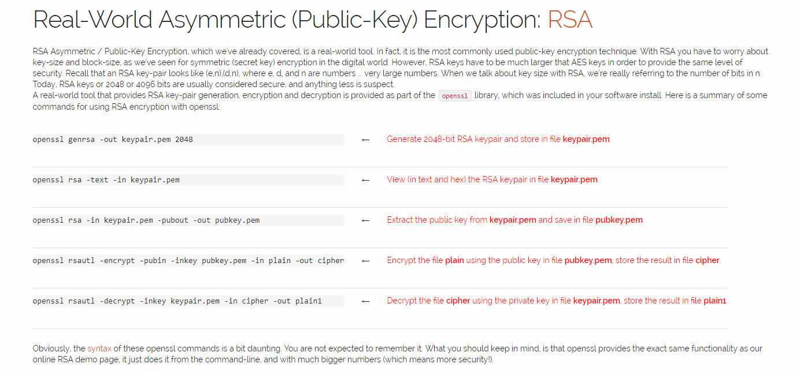
OpenSSL Tool Activity
Follow the instructions in the course notes to: [http://courses.cyber.usna.edu/SY110/calendar.php?type=class&event=26]
Generate keys
Encrypt a file called “plain” [note that the file extension is missing but it works just as well with plain.txt]
Open your GUI to view the creation of a file called “cipher”
Decrypt “cipher” into a new file “plain1”
Open plain1 and see the message

Slide 19

Questions?

