Slide 1
Digital Certificates USNA SY110
LCDR Brian Kiehl
Leahy 101 | 410.293.0953
kiehl@usna.edu

Slide 2
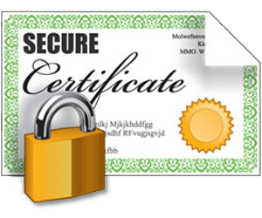

Don’t Confuse…
Digital Certificate
with a…
Digital Signature

Slide 3
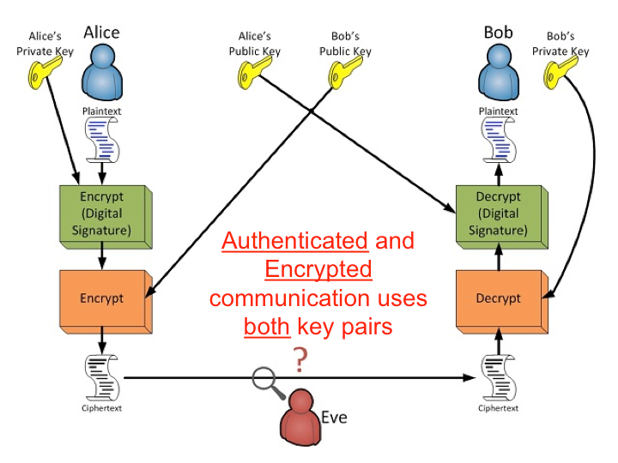



Review
Asymmetric Encryption
Method for providing confidentiality and authentication
Alice uses double-encryption during sending.
Bob decrypts in reverse order.
Digital Signature
Method for providing non-repudiation and integrity
The sender computes a hash of the original message (providing integrity)
Encrypts that hash with their private key (providing non-repudiation)
Receiver verifies by hashing the message and comparing it to the digital signature.
Digital Signature:
11DC41900F524363F
AAE2C3EB41292811
Digital Signature:
11DC41900F524363F
AAE2C3EB41292811
Queen of Hearts
Combining digital signatures and asymmetric encryption results in data authentication, confidentiality, integrity, and non-repudiation.

Slide 4



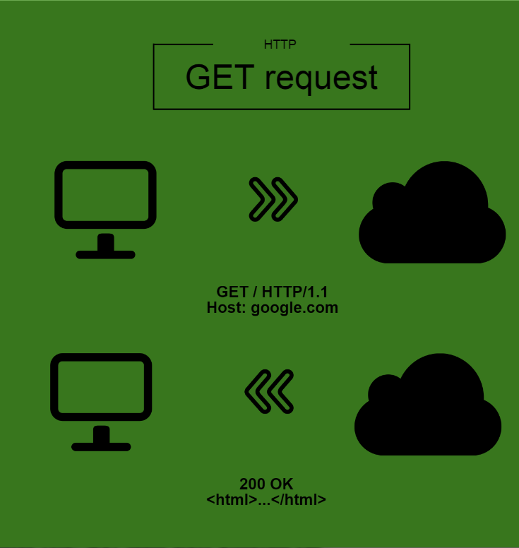
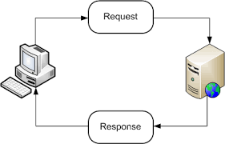
How Alice Uses The Web
Alice’s Private Key
Alice’s Public Key
Website Public Key
Website Private Key
Within Alice’s “GET request” will be her Public Key. Once the web server responds with its Public Key, the two sides can establish asymmetric encrypted “handshake” for that session (i.e. that login period).
Once established, a symmetric key for that session is passed and the two can communicate securely using symmetric encryption.
The symmetric key utilizes information from both hosts in a process known as a Diffie-Hellman key exchange.

Slide 5


The Problem
Public key encryption provides us with tools that guarantee confidential, authenticated between owners of public keys. What it doesn't provide is a way of guaranteeing that the entity behind that public key is who we think it is.
Intended path
Alice’s Public Key
Bob’s Public Key
Alice’s Private Key
Bob’s Private Key
Actual path
Actual path

Slide 6

The Problem
Intended path
Alice’s Public Key
Bob’s Public Key
Alice’s Private Key
Actual path
Actual path
Bob’s Private Key
fake-Bob’s Public Key
fake-Alice’s Public Key
fake-Bob’s Private Key
fake-Alice’s Private Key
Eve has established herself as a “man in the middle.” She can intercept, read, and even alter all communication from Alice. She can then encrypt the message with Bob’s real public key and send it to him as if Alice had sent it all along!

Slide 7
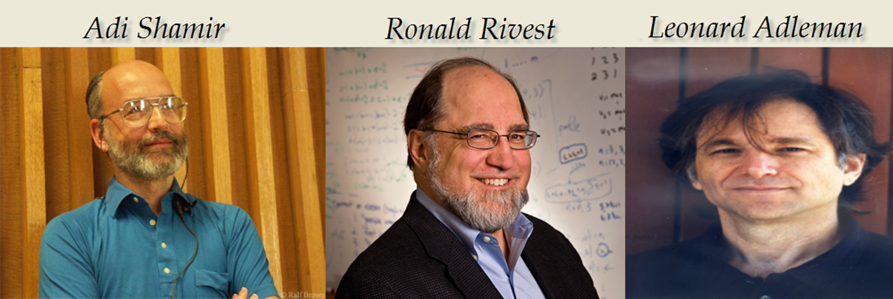
Asymmetric Encryption Weaknesses
With RSA, you can communicate with the owner of a public key and be sure that:
Messages you receive can only be read by you, and can only have come from the owner of that public key
Messages you send can only be read by the owner of the public key and vice versa
Public key encryption can guarantee confidentiality and authentication between owners of public keys
Does NOT guarantee that the person using a public key is who we think it is
It does not guarantee a match between public keys and identities.
Can be vulnerable to a Man-in-the-Middle attack

Slide 8
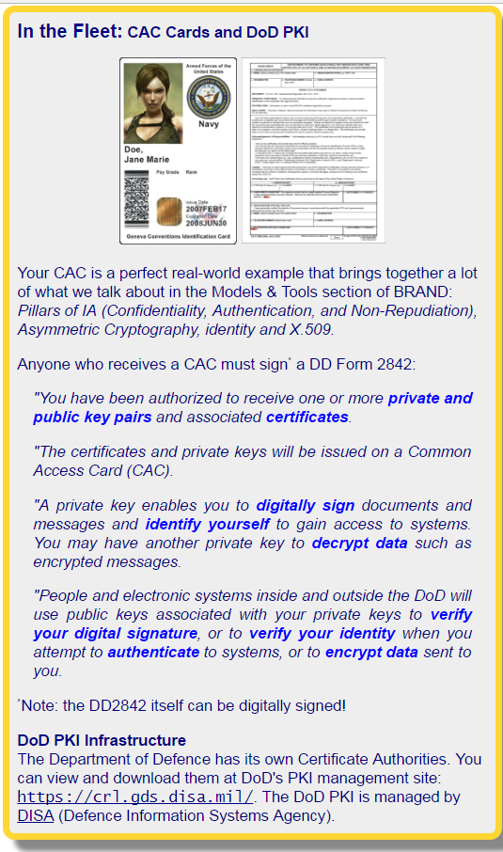
Mitigating Factor: Digital Certificates
How do we verify someone’s identity?
Passport, Driver’s License, etc.
Issued by a proper authority.
Digital certificates can serve as a trusted means to verify someone’s identity
Digital certificates are issued by certificate authorities that verify that Bob’s public key really belongs to Bob.
Example: DoD Common Access Card
Comes with digital signatures and public/private keys
The card, signatures, and keys are issued to you by a trusted central authority: DoD
Therefore, the assumption is, you ARE who you SAY you are

Slide 9

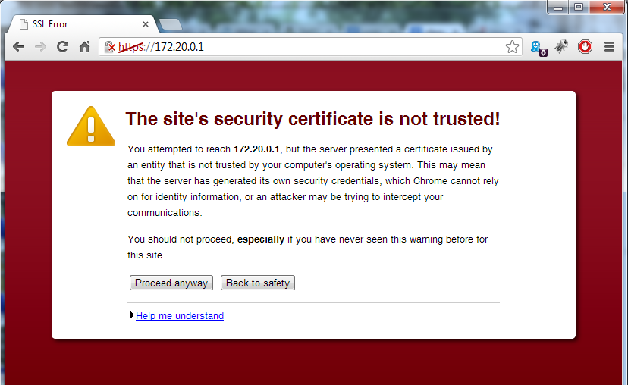
Mitigating Factor: Digital Certificates
X.509 Certificate:
A public-key encryption standard
Specifies format, algorithm, etc.
Used by many websites to help others verify their ID
Contain the following:
Subject’s Name
Subject’s Public Key
Issuer Identity (Who verified the site in question as good to go)
Would you trust a site that signed its own digital certificate?
Most browsers check for valid certificates!

Slide 10

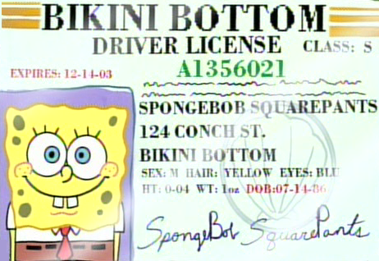

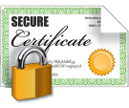

Acquiring A Digital Certificate
Trusted Relationship
PrK
PuK
Bob
1.
PuK
PrK
PrK
PuK
Alice
PuK
bob.org
Cedric
2.
Background:
Alice wants to connect via https to bob.org (Bob's server)
Alice trusts a Certificate Authority named Cedric
Alice, Bob, and Cedric have public/private key pairs
encryption
PrK
Digital Certificate
encryption
encryption
=
bob.org + PuK
encryption
encryption
Bob acquires a Digital Certificate:
Bob submits to Cedric: proof of his identity, the domain name he wants a certificate for, and his public key
Cedric verifies Bob's identity, then uses his (Cedric’s) private key to encrypt (domain name, public key) or (bob.org,Bob's-public-key)
That encrypted "thing" is the actual certificate bob.org will use to prove its identity

Slide 11


How Digital Certificates Work
2.
Cedric
Bob
PuK
browsing
1.
PrK
PrK
PuK
PuK
PrK
bob.org
Alice
PuK
encryption
PrK
Digital Certificate
encryption
encryption
=
bob.org + PuK
encryption
Communication:
When Alice browses to bob.org, it sends Alice its certificate
Remember: a certificate is bob.org,Bob's-public-key encrypted with Cedric's private key
Alice decrypts the certificate with Cedric's public key (remember, Cedric is a certificate Authority she trusts). She now has (bob.org,Bob's-public-key). She knows Cedric must indeed have created this certificate, because his private key is required to make something decryptable by his public key
Because she trusts Cedric, Alice trusts that the public key in the certificate really belongs to bob.org. She can then use it to send data and ensure no man-in-the-middle exists.
The actual scheme used by X.509 is a little more complicated that what we described, but conceptually the same.
encryption

Slide 12
Putting It All Together: Asymmetric/Symmetric Encryption & Digital Certificates
Bob
https://
2.
1.
PrK
symmetric session
established
PrK
PuK
3.
PuK
bob.org
Alice
PrK
Digital Certificate
encryption
encryption
encryption
=
bob.org + PuK
Alice receives and verifies Digital Certificate
Alice sends a GET request to Bob’s server (https://bob.org)
Bob’s web server sends its digital certificate back to Alice.
The browser checks that the server's certificate was issued by a trusted party (usually a trusted root Certificate Authority), that the certificate is still valid, and that the certificate is related to the site contacted.
Alice and Bob move from asymmetric encryption to symmetric encryption.
Alice’s browser uses the public key from the certificate to encrypt a random symmetric encryption key (a session key, used only until the connection is lost) and sends it to Bob’s server with the encrypted URL required for the session as well as other encrypted http data (in other words HTTPS!).
Bob’s web server decrypts the symmetric encryption key using its private key and uses the symmetric key (session key) to decrypt the URL and http data.
Bob’s web server sends back to Alice the requested html document and http data encrypted with the symmetric key (session key).
The browser decrypts the http data and html document using the symmetric key (session key) and displays the information.
encryption
encryption

Slide 13


Questions?

