Slide 1
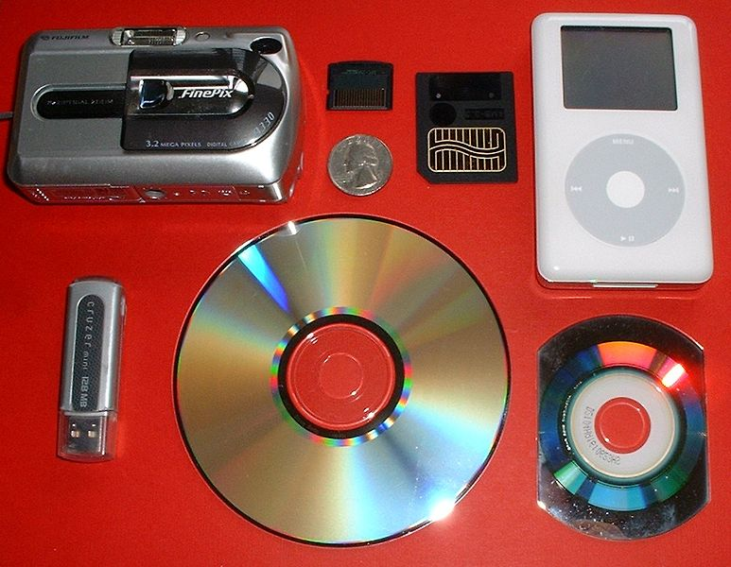
Digital Forensics
USNA SY110
LCDR Brian Kiehl
Leahy 101 | 410.293.0953
kiehl@usna.edu

Slide 2
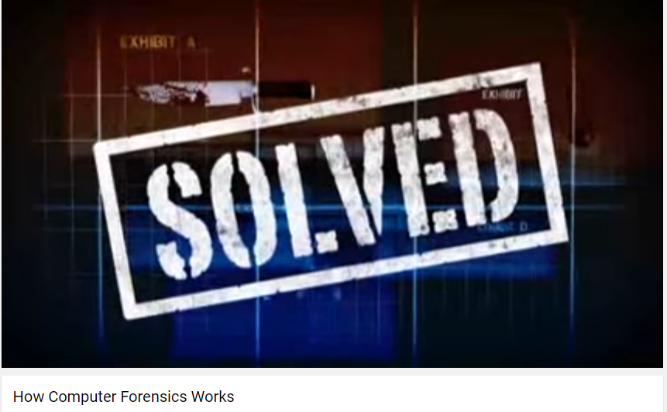
https://www.youtube.com/watch?v=NUSuMWR88Bk

Slide 3
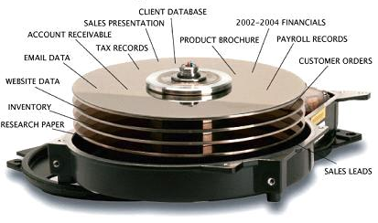
What is Digital Forensics?
Digital Forensics
  The application of science to reconstruct a sequence of events involving computers and information
  We can figure out after the fact what happened in an information system.

Slide 4
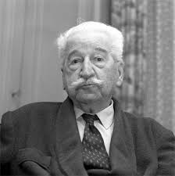
Forensics
Locard's Exchange Principle
  Postulated by Edmond Locard
    Director of the first crime laboratory in existence (Lyon, France)
  States that everywhere you go
    You take something with you
    -AND-
    You leave something behind
  Used in the world of traditional forensics
Piece the artifacts together for attribution
Collect corroborating evidence
Applies to computer forensics as well
Edmond Locard (1877-1966)
“Every contact leaves a trace.” – Locard

Slide 5

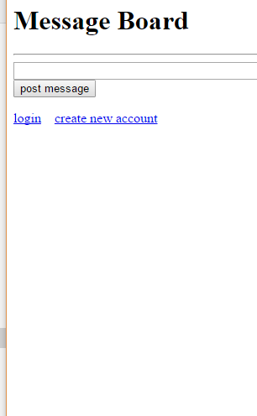
Leaving a Trace: Examples
Visiting a website:
  You leave an entry in the web server log
  You take a cookie from the server
  Your browser caches a copy of the web page you visit
  Your browser keeps a history of the pages you’ve visited
Message board injection attack:
  Recall that you brought down the class message board by posting a “message” that included bad JavaScript code
  The web server log lists the URL you requested in your GET request, and includes the JavaScript you injected
  The HTML source (view source) also shows the inject.
Man-in-the-middle Attack:
  Recall that in class we intercepted communications between two members of the class (Student 1 & 2).
  (Trace) Public keys were posted to the message board.
  (Taken Away) Private keys that matched the public keys used in the attack.

Slide 6
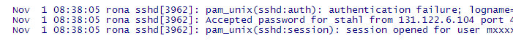
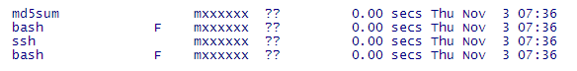
“Things you leave” on Remote Hosts
Secure Shell (SSH) is another way to go somewhere in the cyber world.
What do you leave behind?
  Login attempts
    Every time you make an attempt it is logged
    On RONA, for example, there is a file /var/log/auth.log that the sysadmin has access to, that contains a log entry for every attempted login.
  Commands executed
    Every command you execute is logged on RONA using a tool called ‘lastcomm’ that lists every command executed by any user.

Slide 7
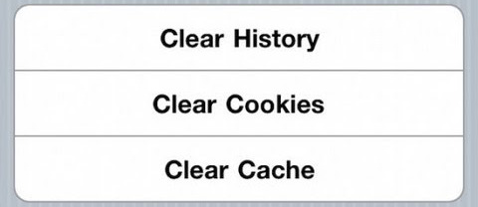
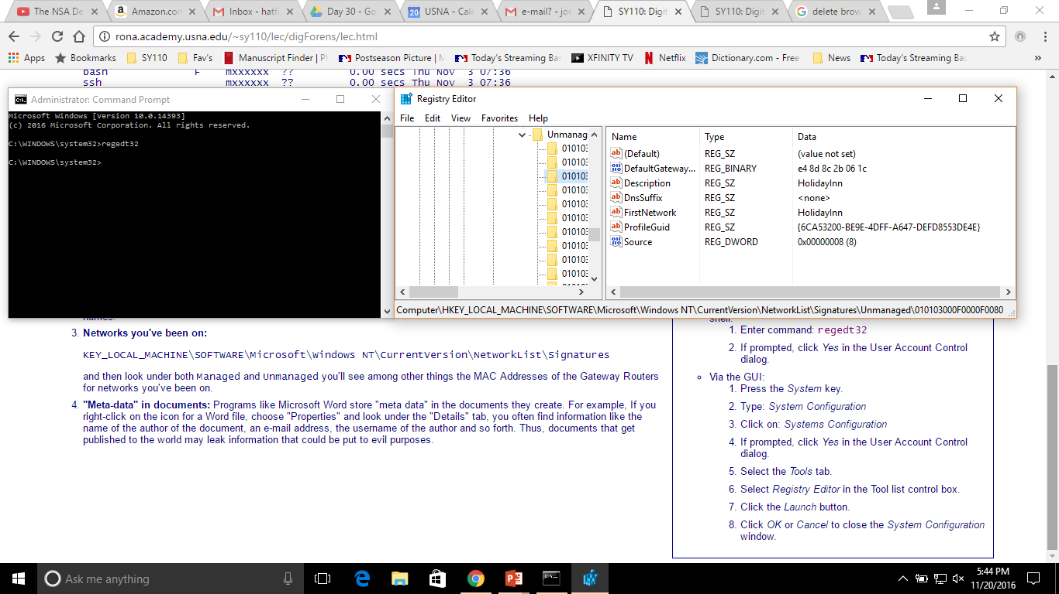
Things That Stay with on Your Machine
Browser cache
  Copies of web pages saved to your computer’s memory for speedy loading.
Recently accessed files
Meta-data in documents
  Name of document author, e-mail, etc.
Networks you’ve been on

Slide 8
“Recycle Bin”
https://www.youtube.com/watch?v=EWOIf0_tCnk

Slide 9
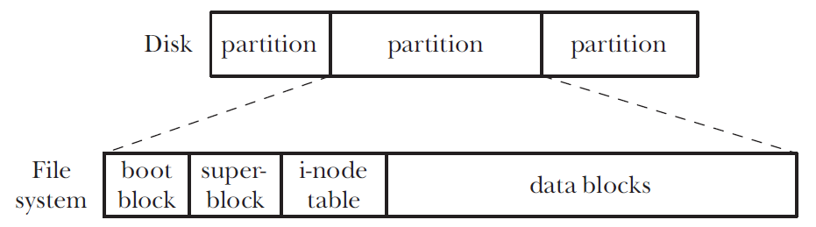

“Delete” Doesn’t Always Mean Forever!
When information is stored on your computer it is stored in a “chunks” or “blocks” of data.
An i-node table specifies:
  The offset (or beginning location of the block)
  The block size (which gives the end of the block)
  File Addresses
  Etc.
Deleting a file simply removes the i-node information and returns the bytes in the data block from being “assigned” to being “unassigned”.
Unless further work overwrites the data in the data block, the original “deleted” information is still there and can be retrieved during Digital Forensics.
Wiping Program

Slide 10
Deletion Example:
11010001001010 is a .doc file saved to your harddrive
Before Deletion
i-node Table
Data Block
Referenced part of the data block
Address Information
Offset 9; end 20
Offset 47; end 60
Etc.
01011100010101100100101010010110111000010101110100010010101101010010010011001100010111011101110101011001110100
After Deletion
.doc deleted
i-node Address Deleted
OS cannot find data in data block
i-node Table
Data Block
Data block remains unchanged; bytes now an unassigned fragment
Offset 9; end 20
?????????????
Etc.
01011100010101100100101010010110111000010101110100010010101101010010010011001100010111011101110101011001110100

Slide 11
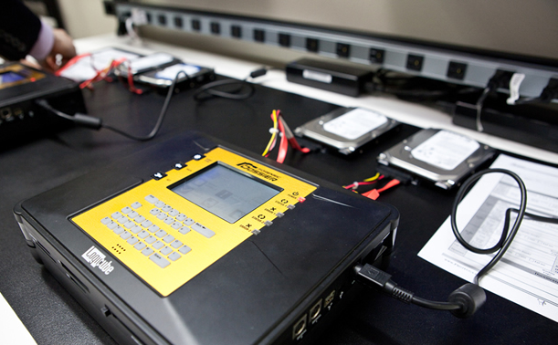
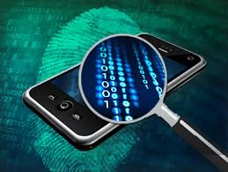
Categories of Computer Forensics
Disk Forensics
  Hard drives and other storage media
Network Forensics
  Log files
  Network traffic
Memory Forensics
  Capture the contents of RAM and analyze
Mobile Device Forensics
  Cell phones
  PDA's
  iPods
  GPS devices

Slide 12
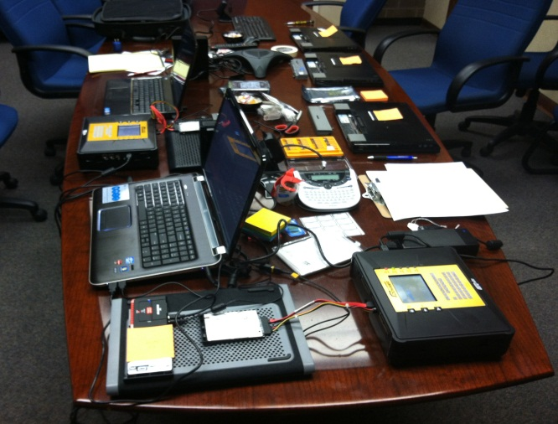
The Process
Investigations generally progress in a certain manner
Three stages:
  Acquisition
  Analysis
  Reporting
Each step is critical to an investigation
Must be carried out in a sound manner
  Investigative work must be capable of being repeated by an independent investigator

Slide 13
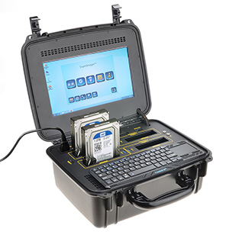
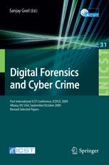
Acquisition
Collection of evidence
  Evidence must be properly preserved
    Chain of custody
Create a copy of the original evidence
  All investigative work done on the copy
  Create a logical image
    Copy of files on the hard drive
  Create a physical image
    Exact mirror of the storage device (at the bit level)
Create a hash of the original evidence
  Prove that evidence has not been tampered with
All actions (through reporting) should be logged!

Slide 14
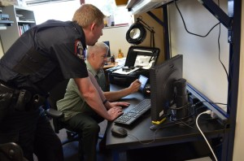
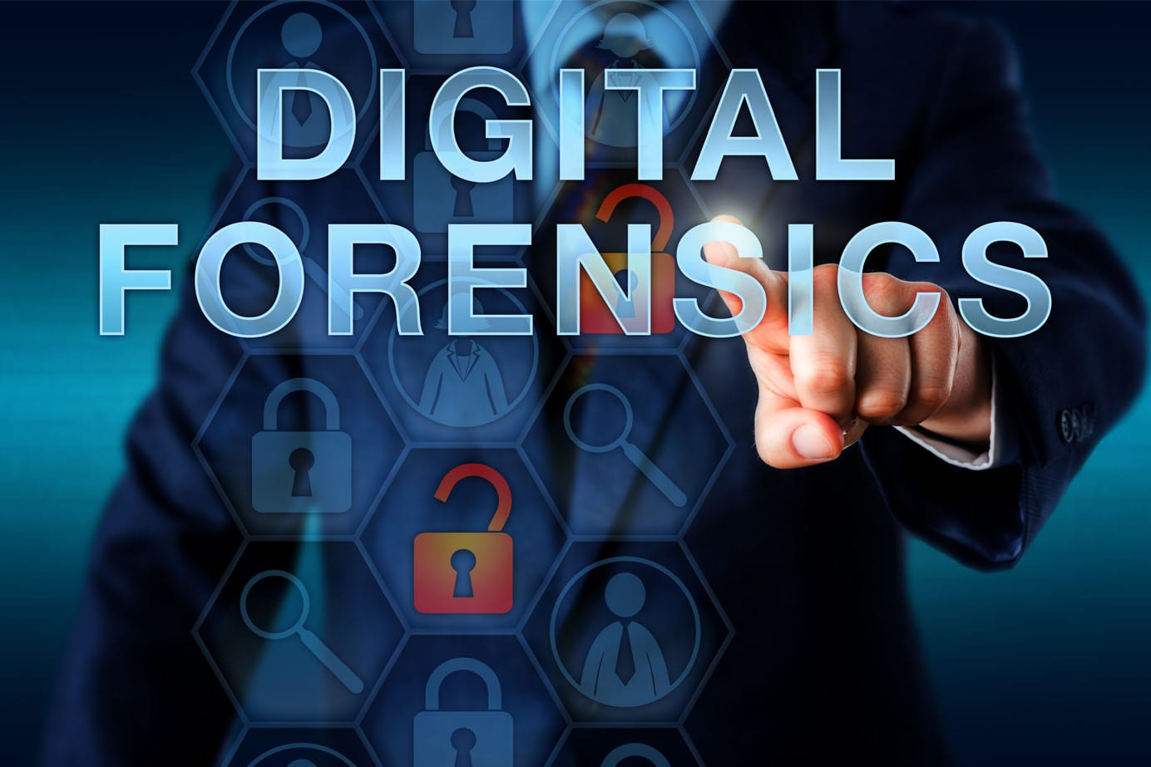
Analysis
Evidence examined and information extracted from the data
  Basis for the report
Construct a timeline of events
  Attempt to reconstruct the event using all available evidence
  Must convert date/time stamps into a common time
Hash evidence periodically to ensure you aren’t changing it
  Evidence MUST NEVER BE ALTERED
    Often set media to read-only to prevent inadvertent changes
Consider additional evidence that must be collected

Slide 15

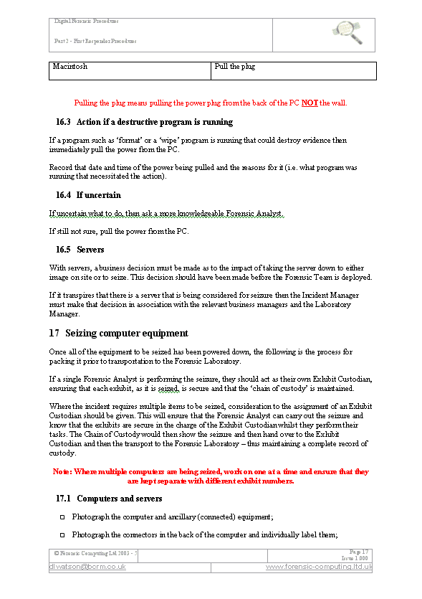
Reporting
Communicate the findings
Should be organized, concise, and UNBIASED
Adjudication venue will dictate format
  Criminal court vs. internal investigation
Should include
  Executive summary (easy to understand version of findings)
  Timeline of events
  Hashes of evidence
  Unbiased detailed findings

Slide 16
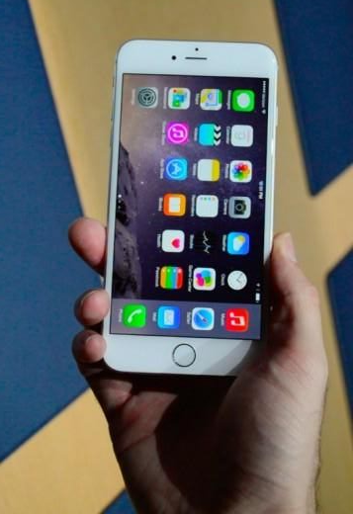
Analysis Techniques
Registry analysis (Windows)
File carving
  Recovery of deleted files
Crack passwords/defeat encryption
Examine log files
  Establish patterns/determine deviations from norms
Run images in virtual machine
  Observe behavior
Memory capture/analysis
  See what was running on the machine
  https://www.youtube.com/watch?v=Ej-Nr79bVjg

Slide 17

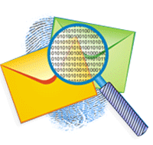
Analysis Techniques (cont.)
Web Browser Forensics
  History, cache, stored passwords, cookies, etc.
Examine hard drive using a Live CD
  Usually Linux distribution
  Examine hard drive without booting the machine
Packet Capture Analysis
  Router span port or intrusion detection system
Email Analysis
  Determine user activities
Search for hidden or encrypted files, steganography, alternate data streams

Slide 18
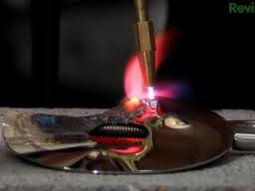
…how to prevent recovery
Writing over existing data with "junk" data
Re-format the drive (7 times!?!?)
Software “file-shredders”
Magnetically degaussing the hard drive with a degausser
Giving the hard drive an acid bath.
Damaging the disk with fire…destruction is the only guarantee…
Part 1: https://www.youtube.com/watch?v=4WIMSP_lMGs
Part 2: https://www.youtube.com/watch?v=RDZyQ4WEb7Y

Slide 19
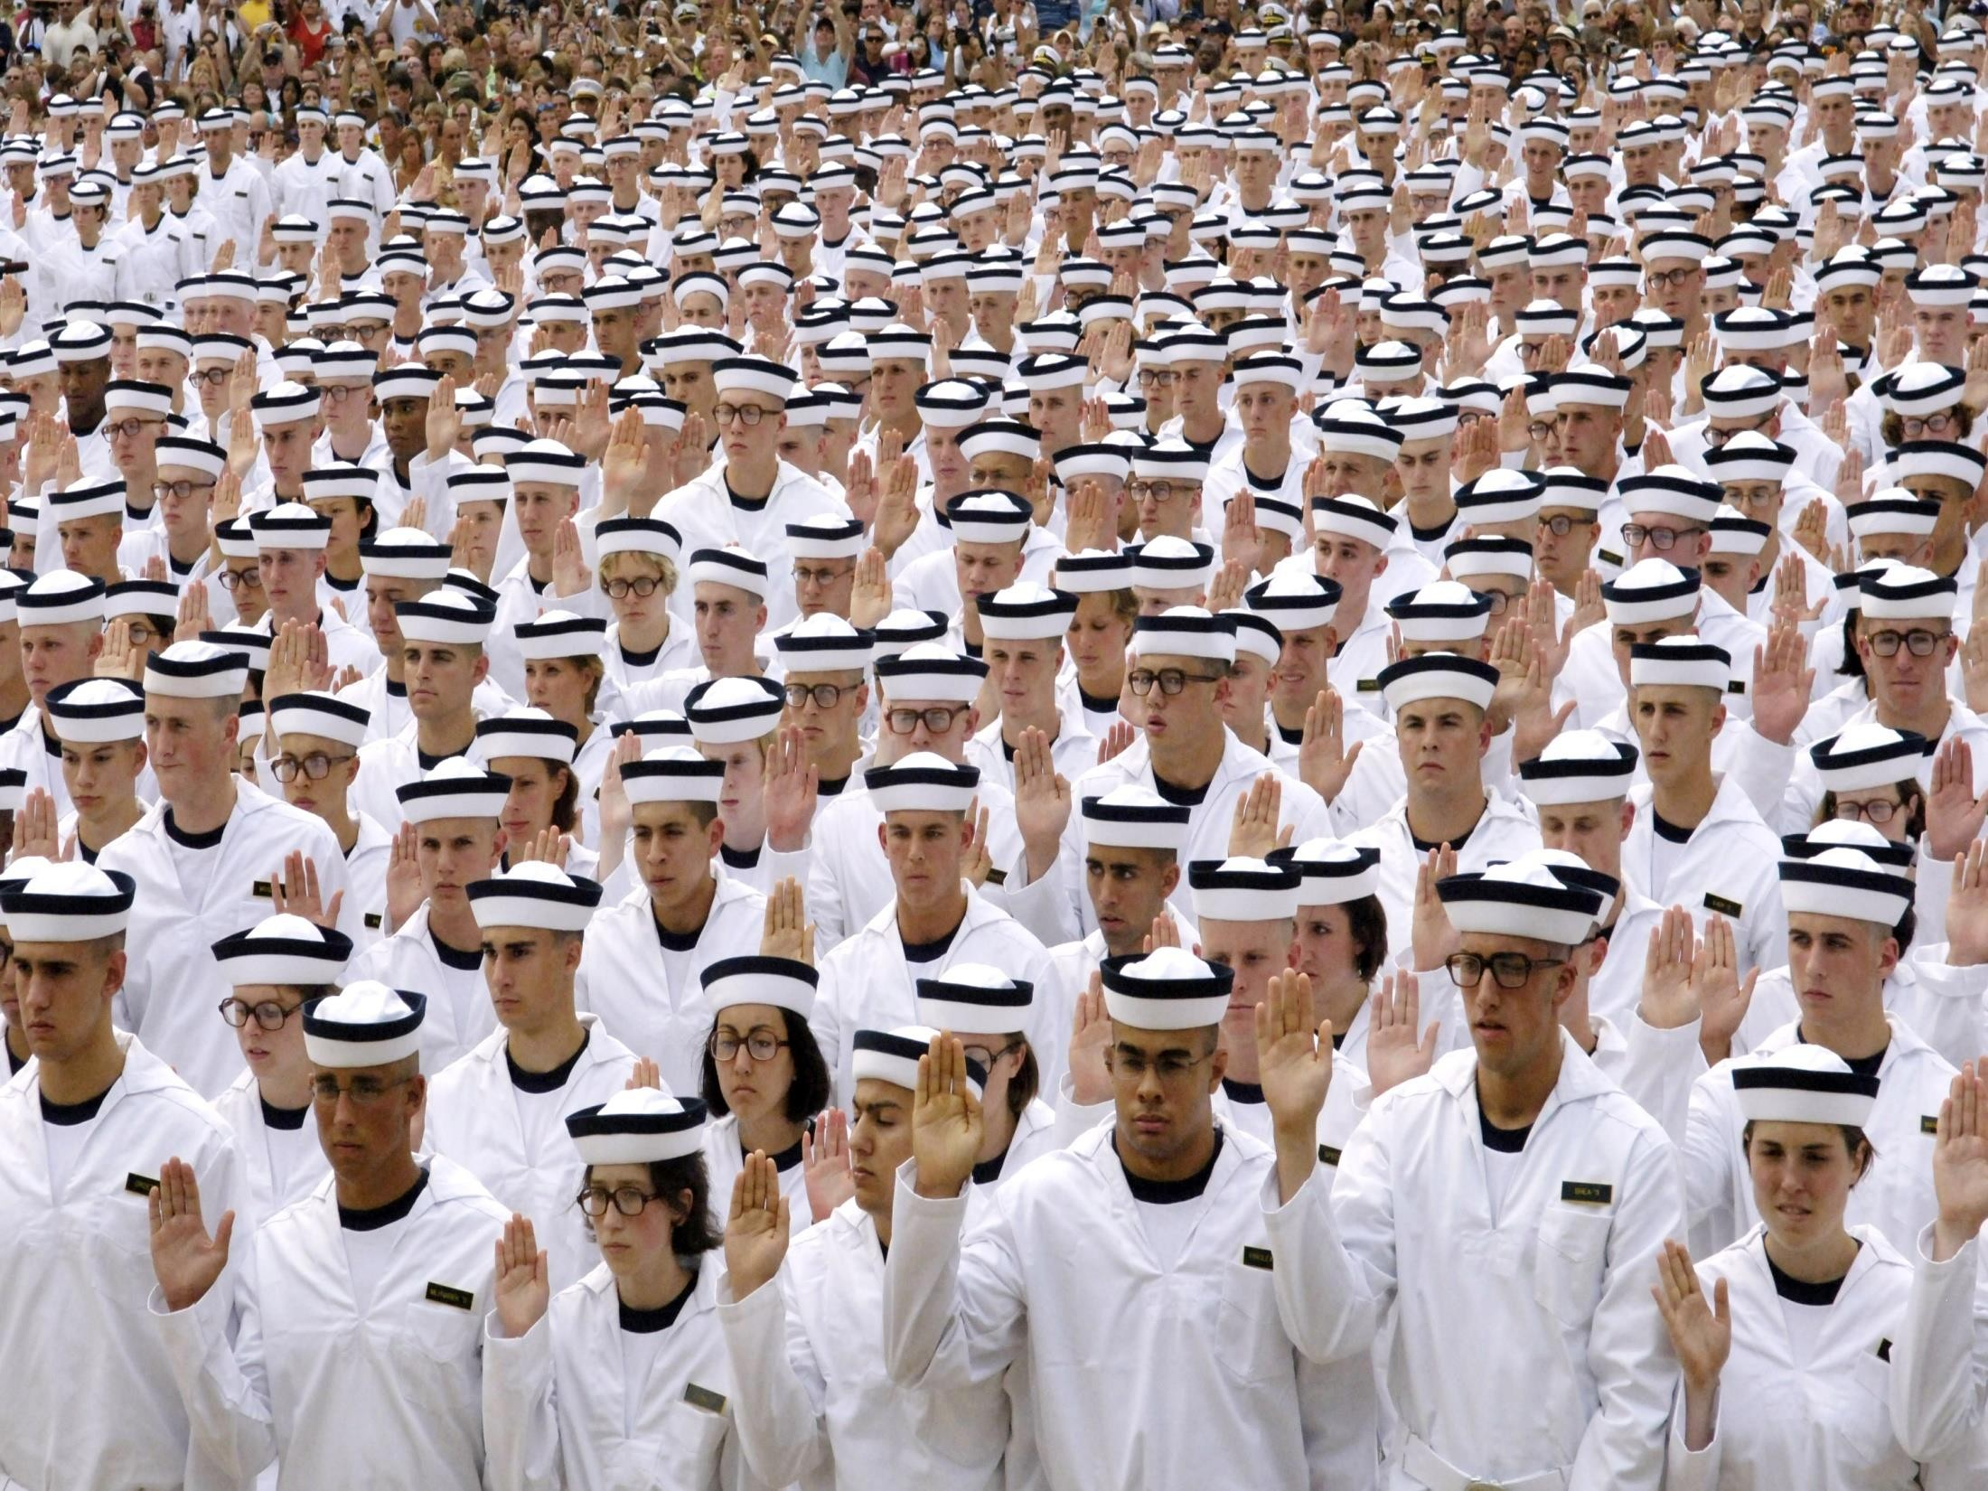
Questions?

