Slide 1
Cyber Operations: Reconnaissance USNA SY110
LCDR Brian Kiehl
Leahy 101 | 410.293.0953
kiehl@usna.edu

Slide 2
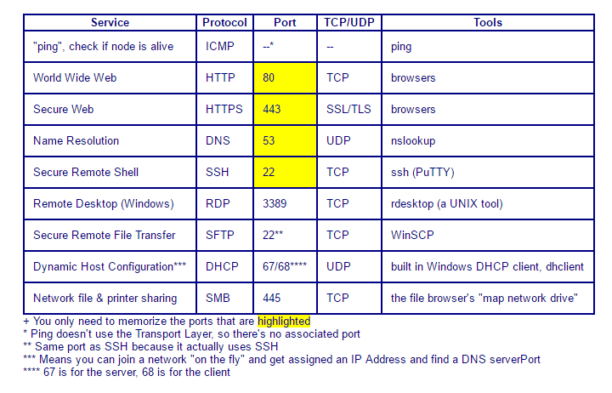
For This Lesson: You May Want to Remember…

Slide 3
What is a “Cyber Attack”?
Terms:
“Security”: is a system’s ability to provide services while maintaining the five IA pillars
“Attack”: an action that violates one of the IA pillars
Examples
Goal | Pillar Violated
Steal a file | Confidentiality
Deface a webpage | Integrity
Bring down DNS server | Availability
Send an email from someone else’s account | Non-repudiation
Use stolen login credentials | Authentication

Slide 4


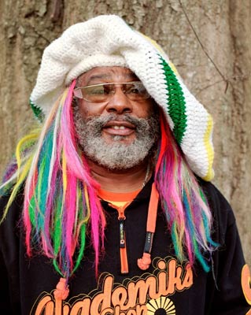



Cyber Attack Thwarting
Rick keeps the secret recipe for his award-winning BBQ on his office computer, and your goal is to steal the recipe. What's stopping you?
Password authentication! You need his username and password to login to his computer and access the recipe.
You want to view a webpage with sensitive planning information housed on George’s internal webserver. What's stopping you?
A firewall! Your competitor's network sits behind a firewall that doesn't allow port 80 bound traffic in.
There's a lady, Cyndi, on your WiFi network whom you want to discredit. You want to snoop in on her browser traffic to see what webpages she's searching for. What's stopping you?
Encryption! She's accessing sites via HTTPS and all the traffic is AES encrypted!
Rick
Award-winning BBQ
George
Sensitive Information
Cyndi
Encryption

Slide 5
Cyber Attack Thwarting
Bottom Line:
If you want to attack a system, you need to violate a pillar.
In order to (successfully) violate a pillar, you need to defeat the tools employed to protect the pillars.

Slide 6
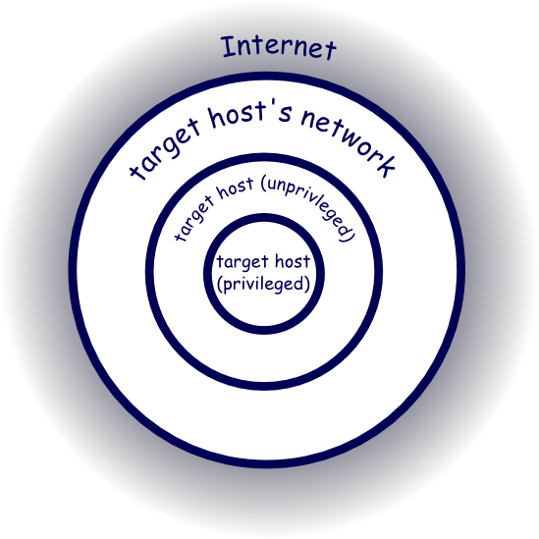
Defense in Depth: Network Barrier
Multiple layers of defense
Each layer presents a new set of challenges to an attacker
Network Barrier (outermost)
Between the internet and the host’s network.
Threats: phishing e-mail, remote code execution
Protection: Perimeter Firewall, Network Address Translation
Network Barrier

Slide 7
Defense in Depth: Host Barrier (Attacker does not yet have Admin / root privileges)
Host Barrier (middle):
Now the attacker is in your network; they’ve gotten around your firewall somehow and past your Router (through the NAT table)
Protection:
Authentication (username & password)
Host-Based Firewall
Threats:
Password Cracking Tools
Network Packet-Sniffing Tools
Phishing E-mails
Host Barrier

Slide 8
Defense in Depth: Privilege Barrier
Privilege Barrier (inside):
Now the attacker has Standard User credentials on a host. Their next goal is to get Administrator (Windows) or root (UNIX) credentials on the host (or network).
This is referred to as “privilege escalation”
Protection:
Administrator Account / Password
Encrypting sensitive files
Threats:
Password cracking tools
Malware attacks against the OS
Privilege Barrier

Slide 9
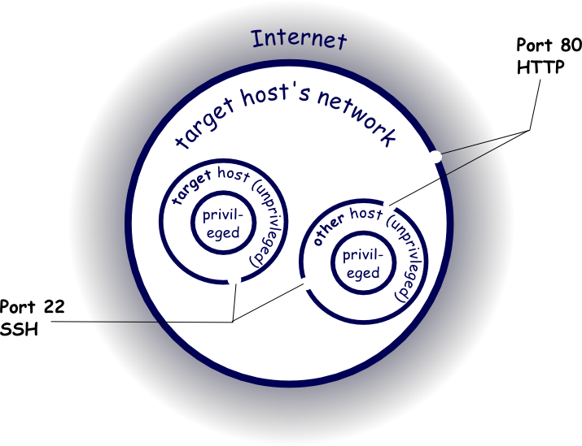
A More Realistic View
There are always gaps:
Ports open on the firewall
Services running on hosts
Many hosts reside on the network!
Different hosts may have different operating systems and applications (perhaps outdated)
Different hosts will have different services running
These allow different paths in from the outside
Here’s a diagram with two hosts: the target and a host running a web server

Slide 10
A More Realistic View
Notional Attack:
We send port 80 traffic into the network (which the firewall allows) to the webserver with some carefully crafted content that exploits a bug in the webserver, ultimately allowing us to execute commands on it.
2. We use this to make an SSH connection from the webserver to the target host, which is allowed since both parties are inside the firewall.
3. Now we have some degree of access to our target host. Subsequent steps in the attack would have to take advantage of that to pursue the ultimate goal of stealing a copy of the file secret.txt.

Slide 11
A More Realistic View
Pivoting:
This type of attack is referred to as a “pivot” attack, because the attacker pivots from one host to another (either because the first host was more accessible from the outside, or because it was more vulnerable for some other reason)
The attacker had no way to SSH on port 22 from the outside. But the firewall allowed port 80 traffic in – to the webserver. Once in the webserver, the attacker “pivots” from the webserver to the target host.
But how did the attacker know he could get in on port 80, and subsequently SSH using port 22 into the target host?

Slide 12


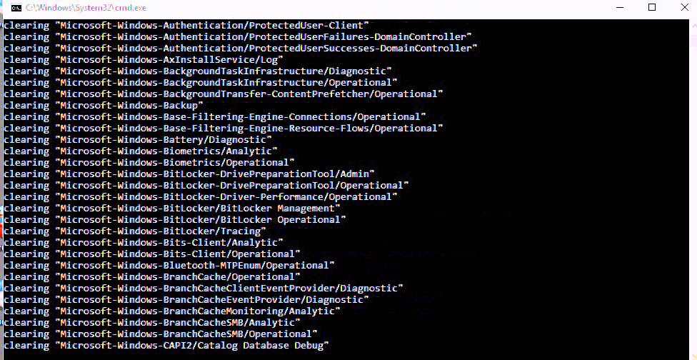
Phases of an Attack
Reconnaissance
Discover the information necessary to gain access to the target
What traffic does the firewall let through?
What hosts are on the network?
What services are running?
Infiltration & Maneuver
Gain the accesses needed to achieve your goal
Get into the network, infiltrate the target host, and escalate privileges necessary for the attack.
Exfiltration & Maintaining Access
In this phase, the attacker takes the action that actually violates a Pillar of Cybersecurity.
The attacker takes whatever steps are necessary to cover his tracks.

Slide 13



Reconnaissance Phase
Goal: identify possible targets and vulnerabilities
Any information gathered may prove crucial to discovering a critical vulnerability
Two Methods:
Passive
Gathering information without alerting the subject of the surveillance
Active (netcat, port scanning, etc.)
Gathering information using techniques that may alert the target
= friends
Minimize interaction with target network
Interacting with target network directly

Slide 14


Reconnaissance Phase: Critical Information
Human Information
home address
home telephone number
frequent hangouts (physical and online)
computer knowledge
hobbies and interests
Network Information
IP Addresses
subnet mask
network topology
domain names
Host Information
user names
group names
architecture type (e.g. x86 vs SPARC)
operating system family and version
TCP and UDP services running with versions
Security Policies
password complexity requirements
password change frequency
expired/disabled account retention
physical security (e.g. locks, ID badges, etc.)
firewalls
intrusion detection systems

Slide 15


Passive Recon: Footprinting
Passive Reconnaissance:
Gathering information in a manner that is unlikely to alert the target
In Cyber Realm:, the attacker minimizes any interaction with the target network which may raise flags on network security devices (i.e. firewall, IDS, etc.)
Google is an Attacker's Ally:
Lots of information freely available via the Internet.
View the source HTML files of a target website to find any clues
Users may provide personal information on their company website or a social media site, which could give hints as to what their user account password is
Names can be entered in a white pages search to reveal home addresses and telephone
Public Network Information:
Network information can also be obtained freely via public records online
Every IP Address and Domain Name must be registered in a public database
Queries to the right places will provide anyone with the target domain's IP Address range, DNS servers, and a contact address and telephone number.

Slide 16
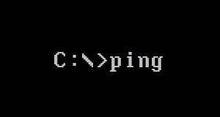
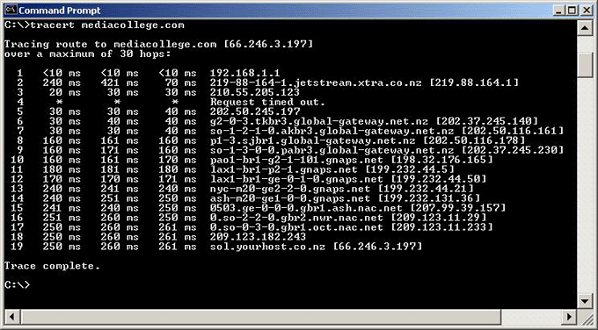

Active Recon: Scanning
Active Reconnaissance:
Gathering information while interacting with the subject directly
Ping, Traceroute, and Netcat (nc):
If we know the range of potential IP Addresses for our target network:
Ping can determine which IP's are actually in use by hosts on the network
Traceroute can help determine network topology of the network
Netcat(nc) can determine which ports are open with servers listening on them
Active reconnaissance is commonly referred to as scanning
Example: ping every IP Address owned by the target network to see which ones belonged to real hosts.
NMAP - The Network Mapper:
Network scanner that discovers hosts on a target network

Slide 17
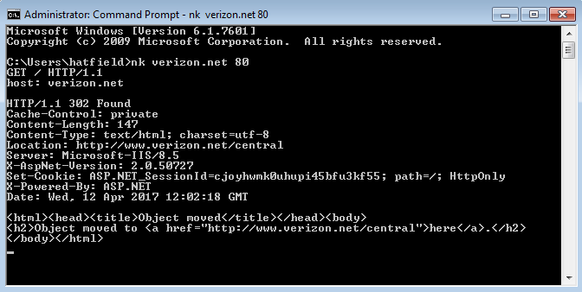
Passive vs. Active: Sometimes Difficult to Tell
The distinction between passive and active reconnaissance is a conceptual distinction.
In practice it is often difficult to tell the difference.
For example:
Open a Shell:
Is this active or passive reconnaissance?
Most companies won’t notice this type of scan, but a robust Intrusion Detection System might
Hit <enter> after each line
Hit <enter> twice
Recon Question: What type of server is my target running?

Slide 18
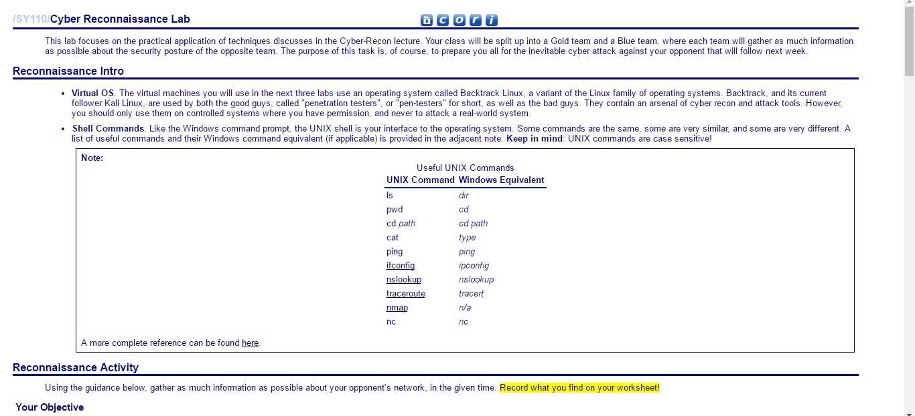
We’ll Conduct Scanning in the Cyber Reconnaissance Lab

Slide 19

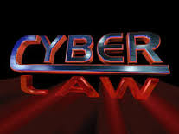
Legal Issues
Network reconnaissance is a legal “grey area”
Footprinting makes use of information that is publicly available
Many scanning tools use public accesses
No authentication required
Guest / publicly known accounts
Is collecting information or connecting to a host with public accesses a crime?
What is the threshold?

Slide 20
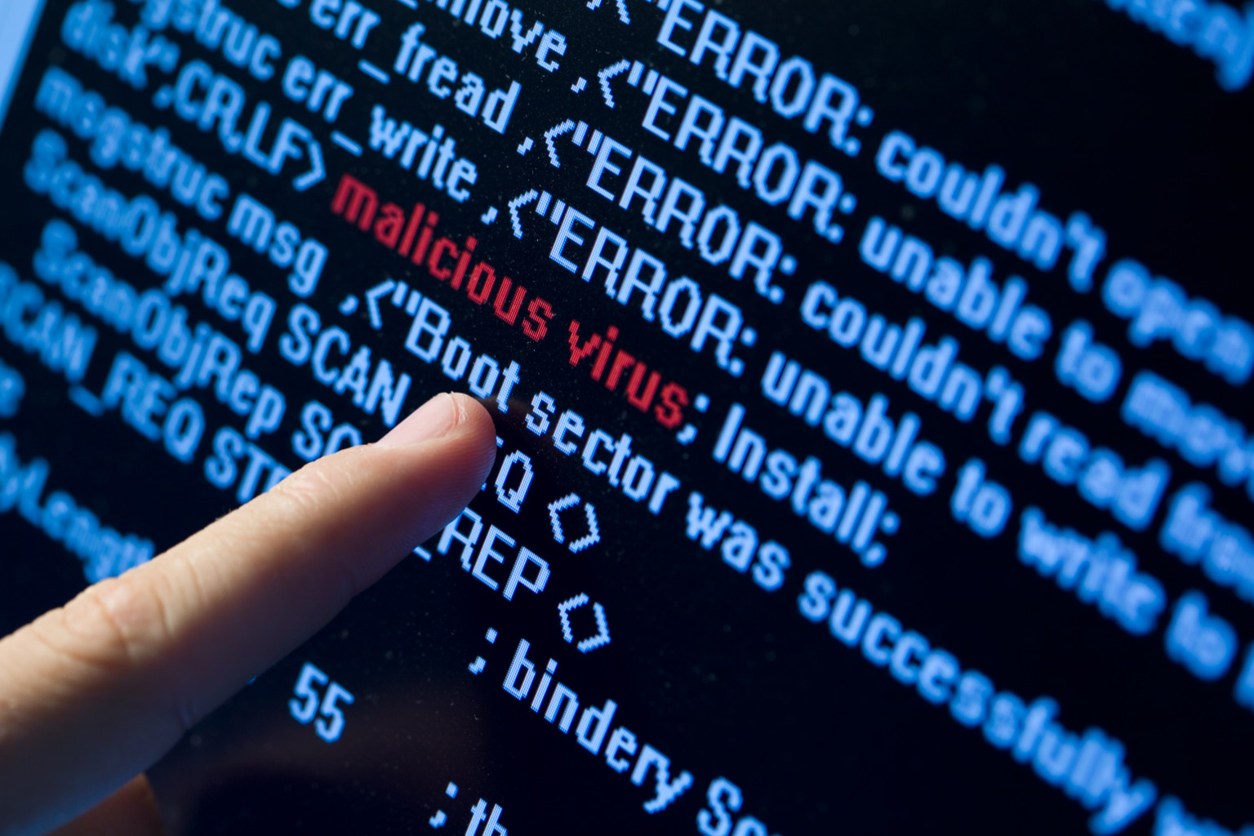

Infiltration Phase
Goal: gain control of a host on the target's network
Typically gaining remote access to a shell or terminal with administrator privileges
Knowledge of a vulnerability is not enough
Must have the ability to exploit the vulnerability
Does not necessarily require advanced knowledge or skill
Many tools openly available
Including automated tools

Slide 21

Conclusion Phase
Goal: achieve the intended objective and eliminate traces of the attack
Set up data exfiltration paths
Hide tools and programs uploaded to the target
Eliminate logs
Logon, logoff
Startup, shutdown
Network connections
Program execution
Privilege uses
Errors
Terminate connections
May create a backdoor for future access

Slide 22

Questions?

