Slide 1
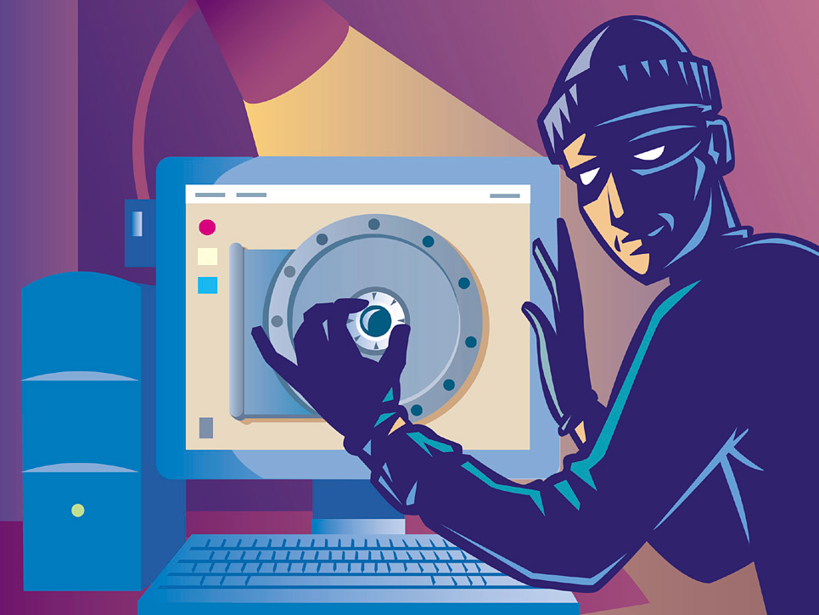
Cyber attack usna sY110
Lcdr Brian Kiehl
Leahy 101 | 410.293.0953
kiehl@usna.edu

Slide 2
What is a “Cyber Attack”
Cyber Attack
“Cyberspace actions that create various direct denial effects in cyberspace (i.e. degradation, disruption, or destruction) and manipulation that leads to denial that is hidden or that manifests in the physical domains.”
Cyber Attacks:
Deny – prevents adversary’s use of resources.
Degrade – limits operational function as a percentage of capacity.
Disrupt – denies resources for a period of time.
Destroy – irreparably deny access.
Manipulate – to control or change the adversary’s information systems that supports attacker’s objective.
Joint Publication 3-12(R), II-5

Slide 3
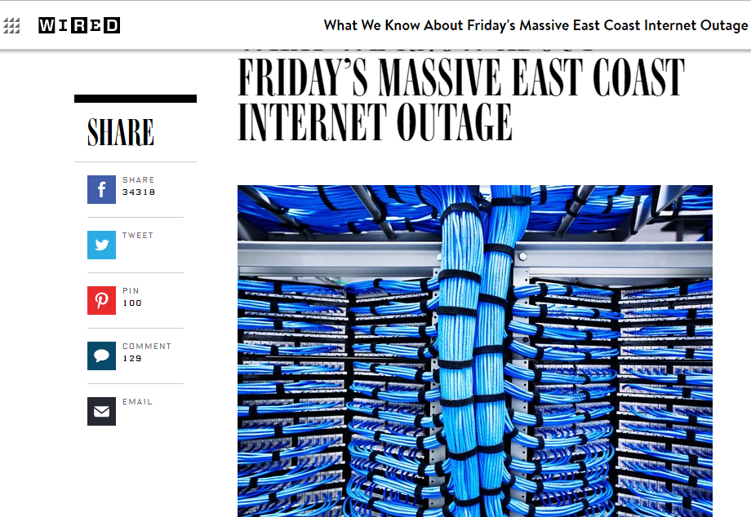
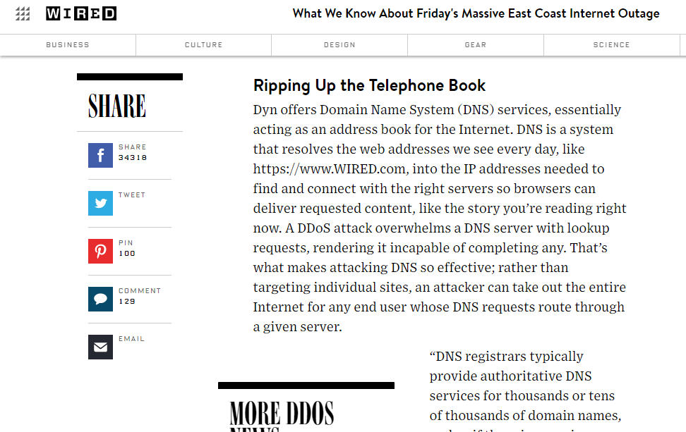
Attacking Availability: Denial of Service Attacks
Denial of Service (DoS) attacks brings down a service provided by the target’s system.
Example: October 2016 DNS outage
“A DDoS attack overwhelms a DNS server with lookup requests, rendering it incapable of completing any.”

Slide 4
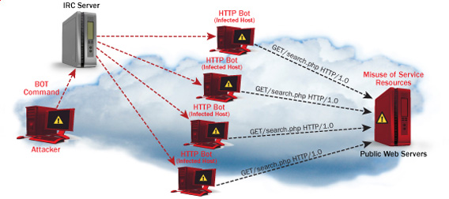
Attacking Availability: Distributed Denial of Service Attacks
Distributed DoS attacks occur when many hosts send spurious requests.
Botnets can be created; infected hosts are “slaves” to Bot commands sent by the attacker.

Slide 5
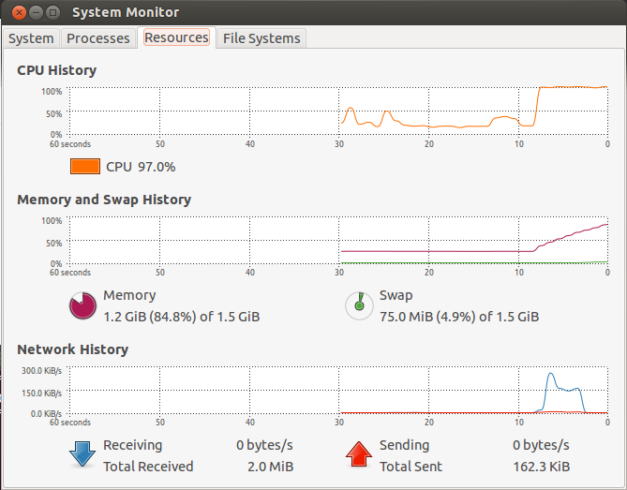
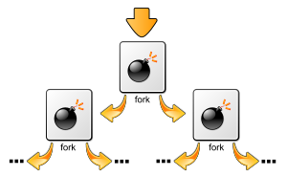
Attacking Availability: Fork Bombs
There is a limit on the number of processes (executing programs) a host can have running at the same time.
A fork bomb does nothing but spawn new processes, which spawn new processes, etc.
Eventually, the host simply locks up, denying availability.

Slide 6
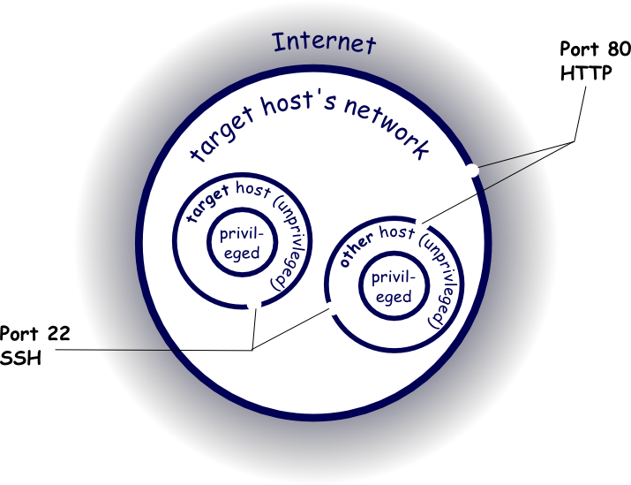
Infiltration
Let’s assume we’re attackers and have as our evil goal to steal a file (secret.txt) in the account of user timvic on a target host.
Here’s the target network:
The network firewall only lets in port 80 traffic.
Port 22 SSH is allowed between hosts.
Target host
Web server

Slide 7
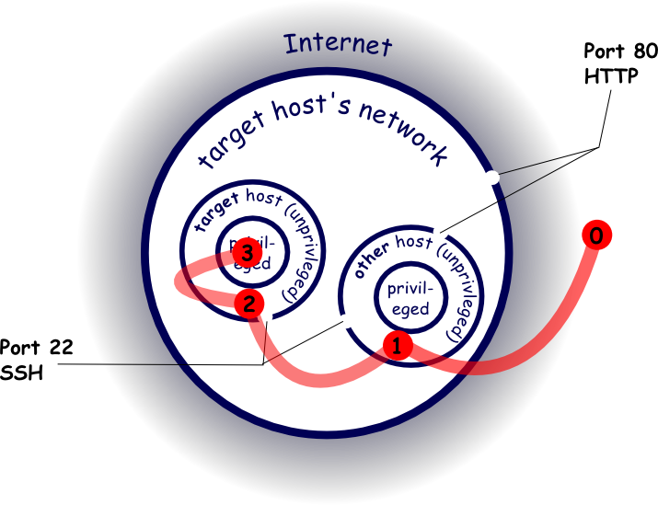
Infiltration
Infiltration must proceed in several steps, since the target isn’t directly accessible.
Send port 80 traffic to the web server inside the network; open up a shell on this host.
SSH connect to target host via port 22. This requires either knowing the SSH username/password or exploiting a vulnerability.
We’ll discuss these below.

Slide 8
Infiltration
At this point, we have a shell on the target system. However, we can only access the file secret.txt if we are logged in as user timvic or the system administrator.
Therefore, we need to escalate privileges so that we can access the file.
In the diagram: a dot at a given location means we can execute commands at that location.

Slide 9

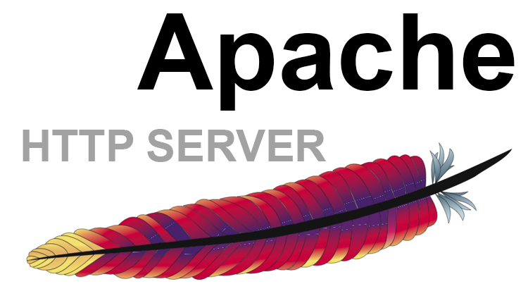
Looking for Vulnerabilities
Recall that it is difficult to write a program that anticipates every code injection users might input—leaving it vulnerable to injection attacks.
If network reconnaissance reveals what web server (and version number) is being used…
We can grab our own version of that software and start looking for bugs.

Slide 10
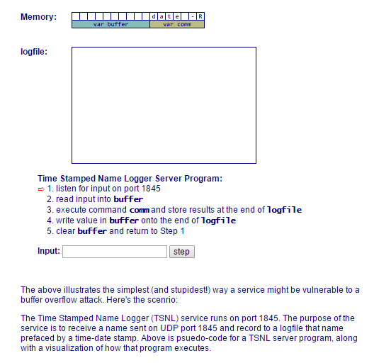
Remote Code Execution: Buffer Overflow Attack
A client connected to a web server sends a sequence of bytes to the web server as an HTTP request.
The web server copies those bytes into the computer’s memory (to a fixed size region called a “buffer”) and processes those bytes.
If the server isn’t careful and the client sends lots of bytes, eventually the bytes the server is copying will start to overwrite bytes in memory that contain important data.
Remote Code Input:
Ironmaidenkill
Ironmaidenopnshel
Date Command
Name input
Worse, it might start to overwrite what the program was going to do with what an attacker wants it to do next: like open up a shell!
http://courses.cyber.usna.edu/SY110/calendar.php?key=a25f8885aa6ee573c7f3dfa08f803dcf9b6f0d41&type=class&event=32

Slide 11
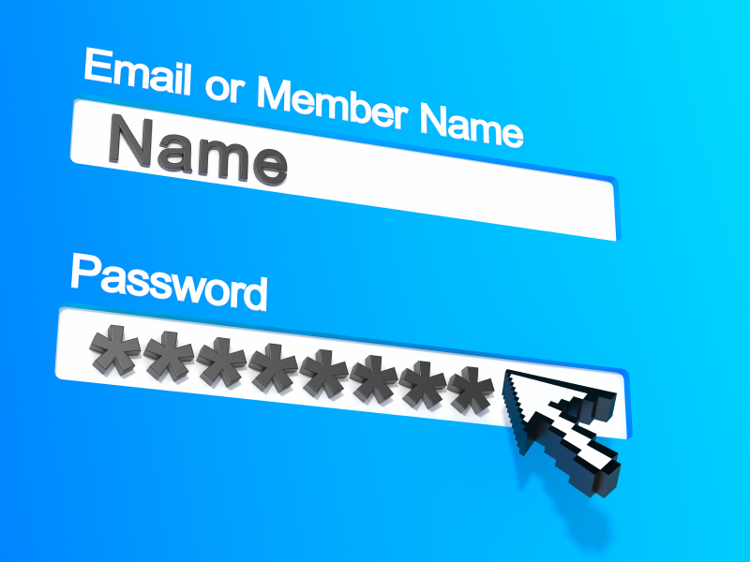
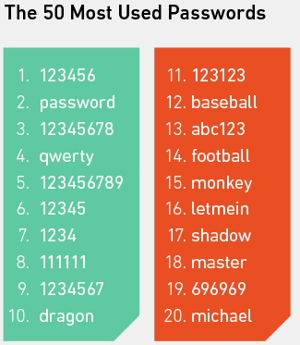
Getting a Username/Password
Websites:
Identify individuals and e-mail addresses (often contains username)
Social media sites: hobbies, interests, significant dates, etc.
Violence / Threats
Trickery:
Phishing attacks
Stealing passwords from weak accounts, since people reuse these often.
Unchanged Defaults:
Most devices and accounts begin with default passwords.
Internet searches usually reveal these
Predictable passwords:
iloveyou, 123456, etc.

Slide 12
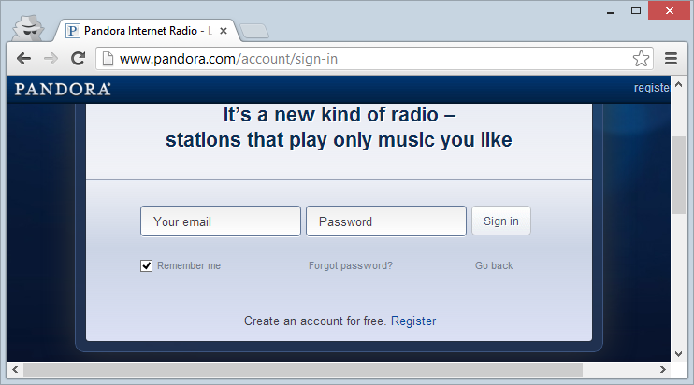
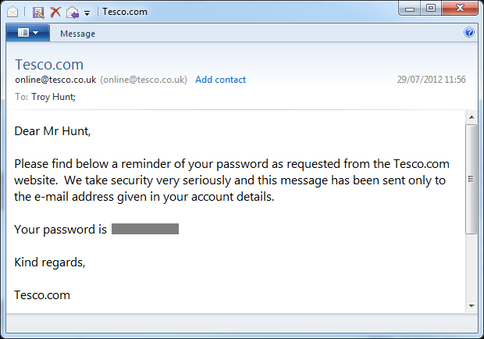
Getting a Username/Password
Passwords sent in clear:
Sometimes passwords are sent over networks without encryption (sent “in the clear”)
Anyone able to snoop the network traffic can simply read them.
Any website that you log into which use ‘http’ instead of ‘https’ are probably sending passwords in the clear.
Any site that can e-mail you back your password is storing them without any hashing or salting too.

Slide 13

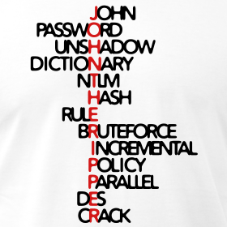
Escalating Privileges
Simply gaining access to a host is not necessarily enough for an attacker to accomplish his/her goal (secret.txt).
The attacker may have to escalate privileges to those of another user (timvic).
Stronger password attacks:
Get the file containing password hashes.
Search for a string (e.g. ‘123456’) whose hash matches what’s in the file
This is important because login attempts are slow and are logged by system administrators, and so your activity may be noticed.
Types of password attacks:
Brute force attacks (all possible passwords)
Dictionary attack (starts with a list of hashed dictionary words)
Rainbow table attack (looking up the hashes you’ve found in a large table of precomputed hash values)
Brute Force & Dictionary

Slide 14
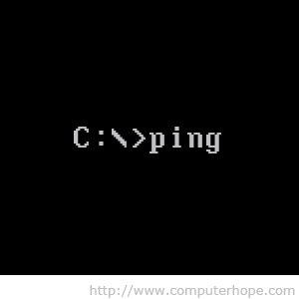
Escalating Privileges
Some programs—such as ping—run with Administrator privileges.
Other processes—such as device drivers, a host’s DHCP client, or the program that logs users on—also run with Admin privileges.
Similar to a buffer overflow attack, we might trick the server program or process into executing a command for us.
If we can hijack a process that is running with Admin privileges we can access any file or service on the host.
For example, perhaps we can find a process that runs as Admin/root and carry out a buffer overflow attack on it.
We might then be able to trick it into executing code for us.

Slide 15
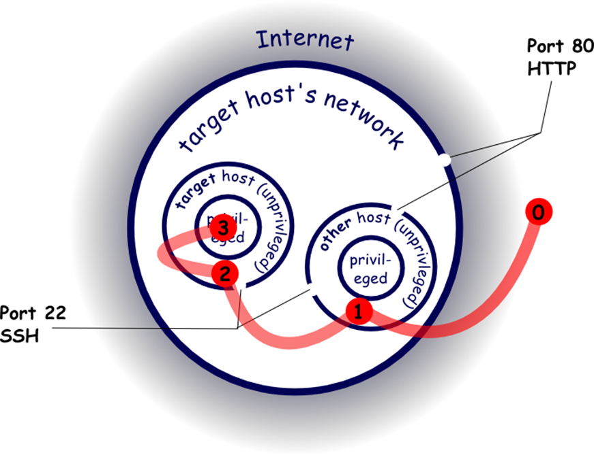
Pivoting
An attack may hop from host to host (“pivoting”) until it gets to the host and resource it’s really interested in.
In our example this was necessary, since there is no access to the target host from the outside.
Infrastructure like routers and wireless base stations often have admin accounts that come with default passwords
These can easily be looked up via the internet.

Slide 16

Questions?

