Slide 1

Computer network defense usna sY110
Lcdr Brian Kiehl
Leahy 101 | 410.293.0953
kiehl@usna.edu

Slide 2
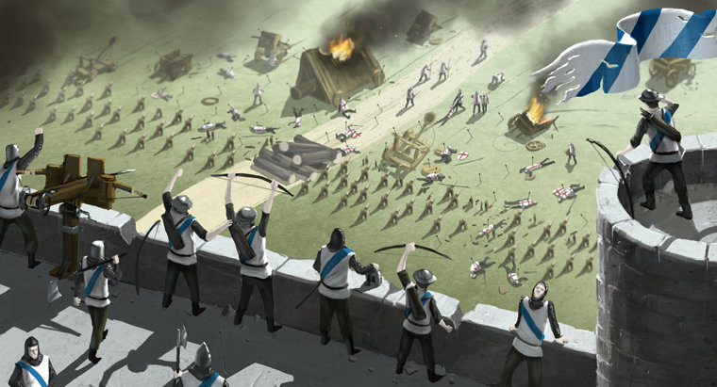
What Does Successful Defense Look Like?
All authorized use is allowed
All unauthorized use is denied
Pretty simple, right?

Slide 3
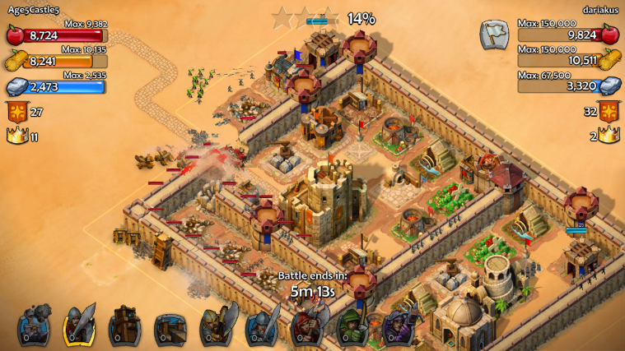
Defense is Harder than Offense
An attacker only has to find one vulnerability to exploit in order to start an attack.
A defender must guard against an attack on any and every service or user.
Defender’s goal: reduce risk and mitigate impact

Slide 4
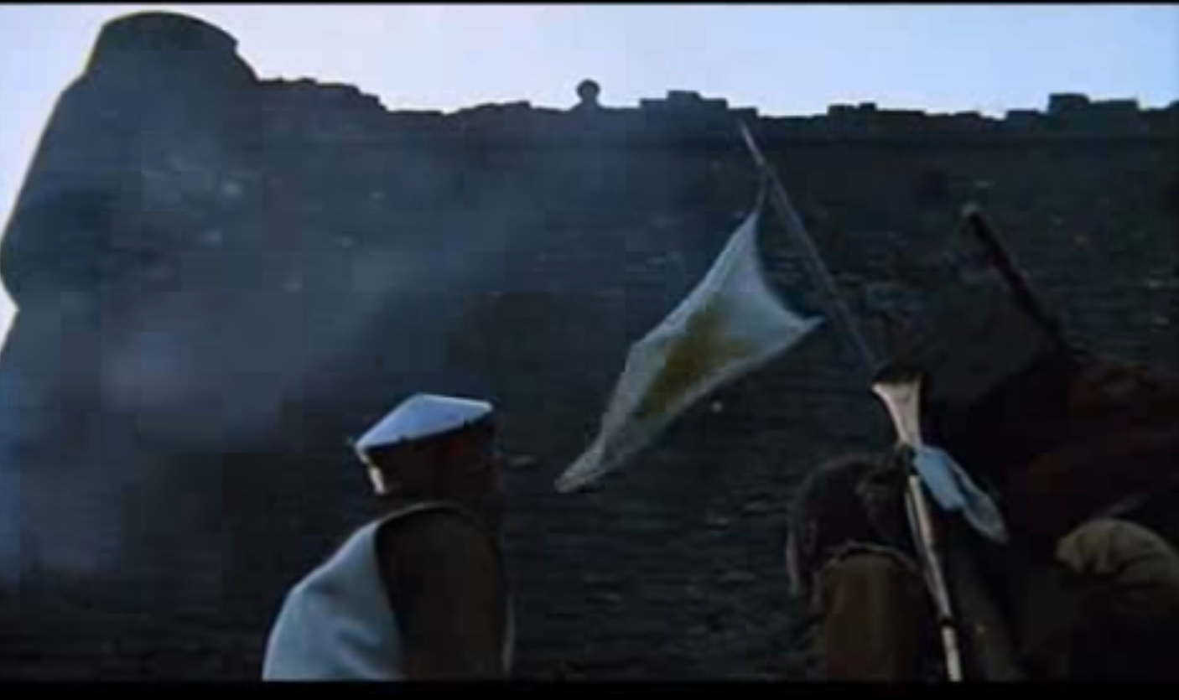
DEFENDING YOUR NETWORK
https://youtu.be/zqtS9xyl0f4?t=37

Slide 5
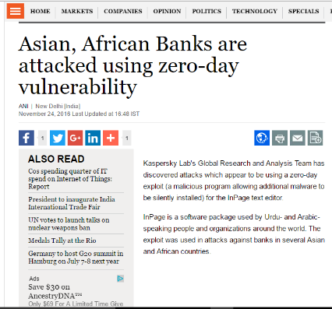
Zero Day Attacks and Hardened Systems
Zero Day attacks occurs on or before the first or "zeroth” day of developer awareness, meaning the developer has not had any opportunity to distribute a security fix to users of the software.
Very difficult to defend against since everything about them is unknown to the defender
A hardened system is one which all unnecessary services (ports) are disabled, and all patches and updates have been installed.
How many days to defend against this attack? Zero!

Slide 6
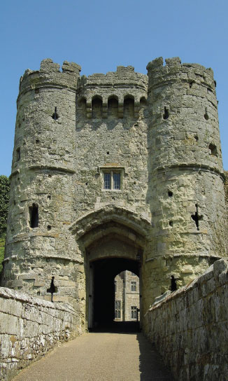
Reality
Near-impossible to fully achieve both goals
Most secure system is the one not connected to the network
May still be vulnerable, but what does this do to system availability?
Cannot defend against every attack: Zero-day exploits
Some defensive measures may block legitimate traffic
Must balance system usability and security
Better goals: minimize risk of operating in a networked environment
Requires robust defense and IA strategies
Defend what we can
Recover from attack / intrusion quickly
Unrealistic Goals:
All authorized use allowed
All unauthorized use denied

Slide 7
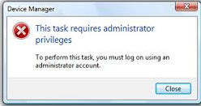

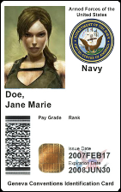
Defense Principle 1: Least Privilege
Give users and programs the privileges they need, and no more.
If your network only needs to provide web and name-resolution services to users/hosts outside your network, then employ a firewall that blocks inbound connections to ports other than 80 (HTTP) and 53 (DNS).
If a file or collection of files is only needed by a specific user or by a particular network service, then that file or those files should only be accessible to the user that needs them, or to the server processes that need them.
Operating system file permissions limit access like this, but this principle should also guide decisions on what information goes on network drives and shared drives.

Slide 8
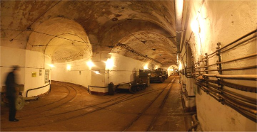
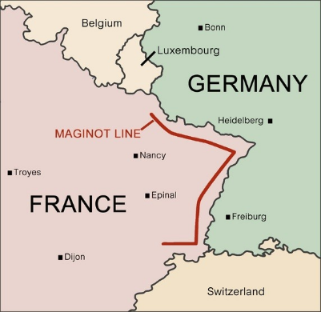
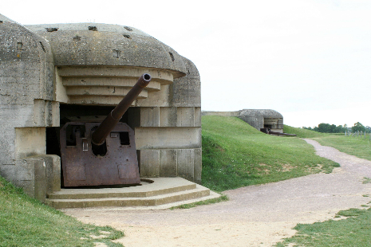
The Maginot Line
Why was this a poor means of defense?

Slide 9
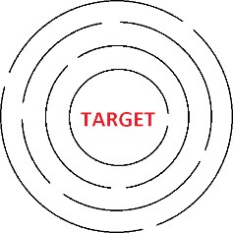
Defense Principle 2: Defense in Depth
Multiple layers of defense are placed throughout an information system
Addresses security vulnerabilities in personnel, technology, and operations
Protection mechanisms cover weaknesses / vulnerabilities of other mechanisms in use
Delay success of attack
Provide time to detect and respond

Slide 10
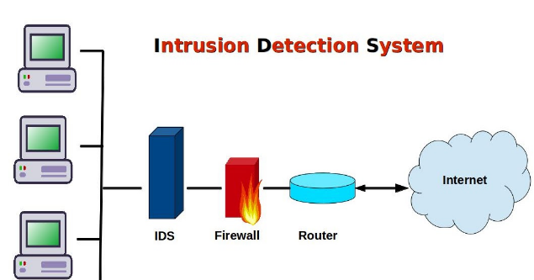
Defense Principle 3: Vigilance
If a system administrator is vigilant, they may well recognize the intrusion and be able to kick the attackers off the system before they get to the asset they were really out to attack.
Administrators need to keep their eyes on these logs files in order to recognize that they're under attack.
Programs called intrusion detection systems (IDS) can be used to help this effort by automatically combing log files looking for unusual activity and alarming administrators when it's found.

Slide 11
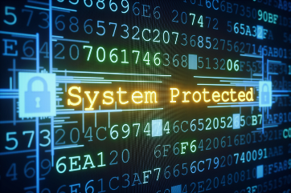

Cyber Security “Best Practices”
Remove unnecessary accounts and privileges
Every service and account represents a potential vulnerability.
Example: Do you really need SSH on a DNS server?
Minimize what programs will run with elevated privileges
Any process that runs as Admin/root is a potential avenue by which an attacker that has gained unprivileged access can obtain privileged access.
Monitor all logs
Intrusion detection systems help, but humans are a part of this effort too
Monitor outbound and inbound traffic closely
Why would a sudden spike in outbound traffic be suspicious?
Inbound traffic?

Slide 12
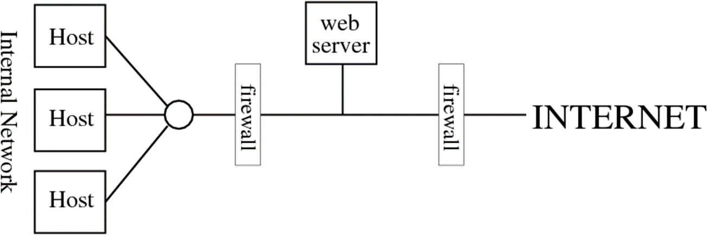
Employ a Demilitarized Zone (DMZ) [aka: a “Perimeter Network”]
DMZ
Placing a second firewall between a public-facing server (e.g. web server) and the internal network.
DMZ servers are usually limited to only one service (easier to defend)
The inner firewall limits access from the DMZ to the internal network.
Instead of allowing all services into the network directly from the internet, DMZ provides defense in depth.
For example: the inner firewall may not allow SSH traffic (port 22) from the DMZ into the inner network.
Inner firewalls have different usernames/passwords than external ones – making authentication attacks harder.

Slide 13
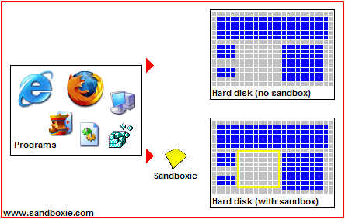
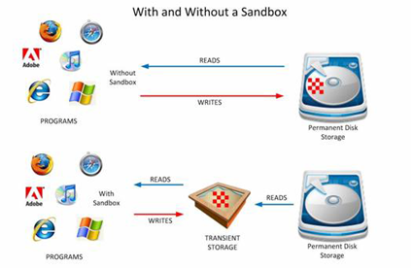
“Sandboxing”
Many services run with elevated privileges
Hackers attempt to exploit these services to gain access with the service’s level of privilege
Sandboxing
The Operating System (OS) only grants to a service enough access to the file system as is minimally needed.
This reduced “view” of the file system is itself actually a separate copy of the file system, so that any problems that might occur has limited damage.

Slide 14

Defending against Specific Types of Attacks

Slide 15
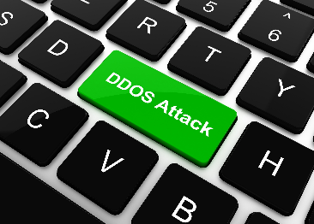
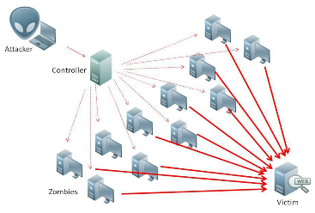
Defending against DDoS
If you can identify the source IP Addresses, you can try to block them (firewall)
Difficult because so many bots.
Have more servers in more locations.
Cloud providers will let you host your applications on virtual servers.
During an attack, traffic can be redirected as needed.
All else fails: kill service (or Port) experiencing the uptick in traffic.

Slide 16
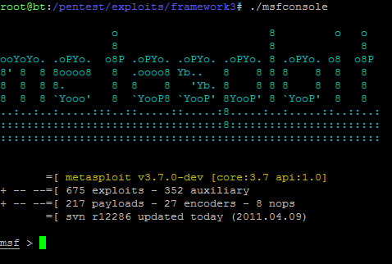
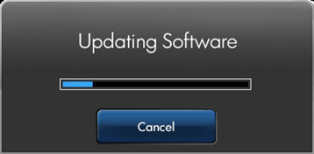
Defending against Remote Exploitation
In the Attack Lab, you attacked the webserver by exploiting a bug in the software that was running. How?
The software was not up-to-date.
Defend by keeping your software patched to the most recent revision.
Disable unnecessary services.
Employ a perimeter firewall and DMZ

Slide 17
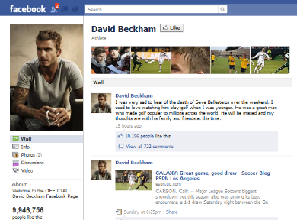
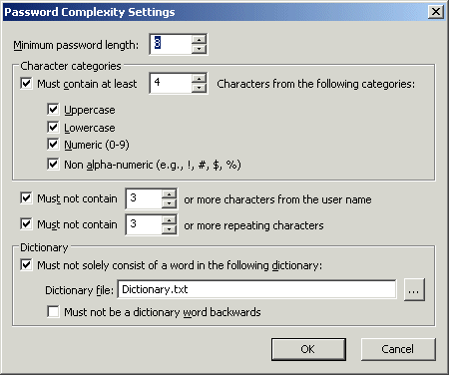
Defending against Password Guessing
In the Attack Lab, you were able to gain access to some target hosts using a guessed username/password.
Limit the information you make publicly available.
Use strong passwords:
Long
Large character set
Unusual
Not based on personal information or dictionary words
Password: ILoveFootball

Slide 18

“Zero days”
https://www.youtube.com/watch?v=C8lj45IL5J4

Slide 19
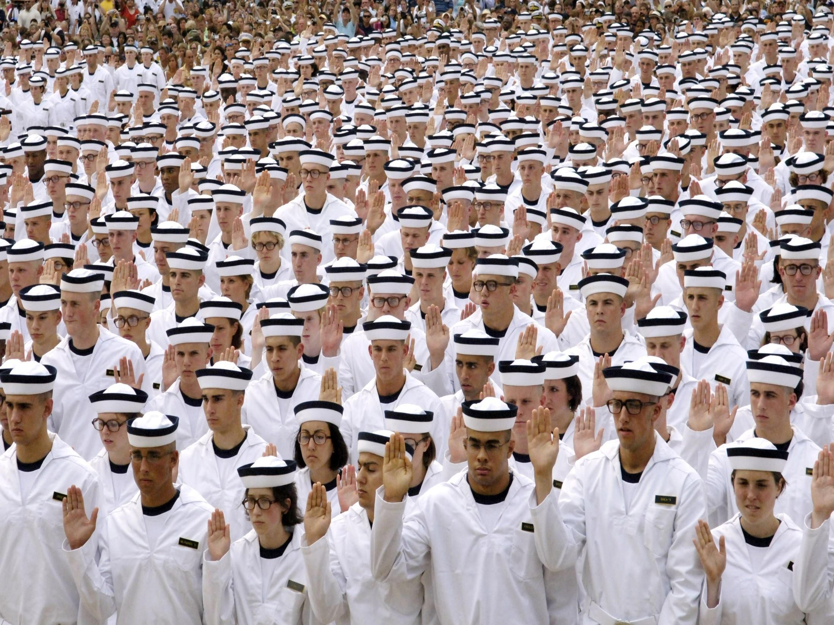
Questions?

